Slide 1
Economics of Bvrewing Industry (v) – malt (1107)
Tomáš Maier
WS 2020/2021

Slide 2
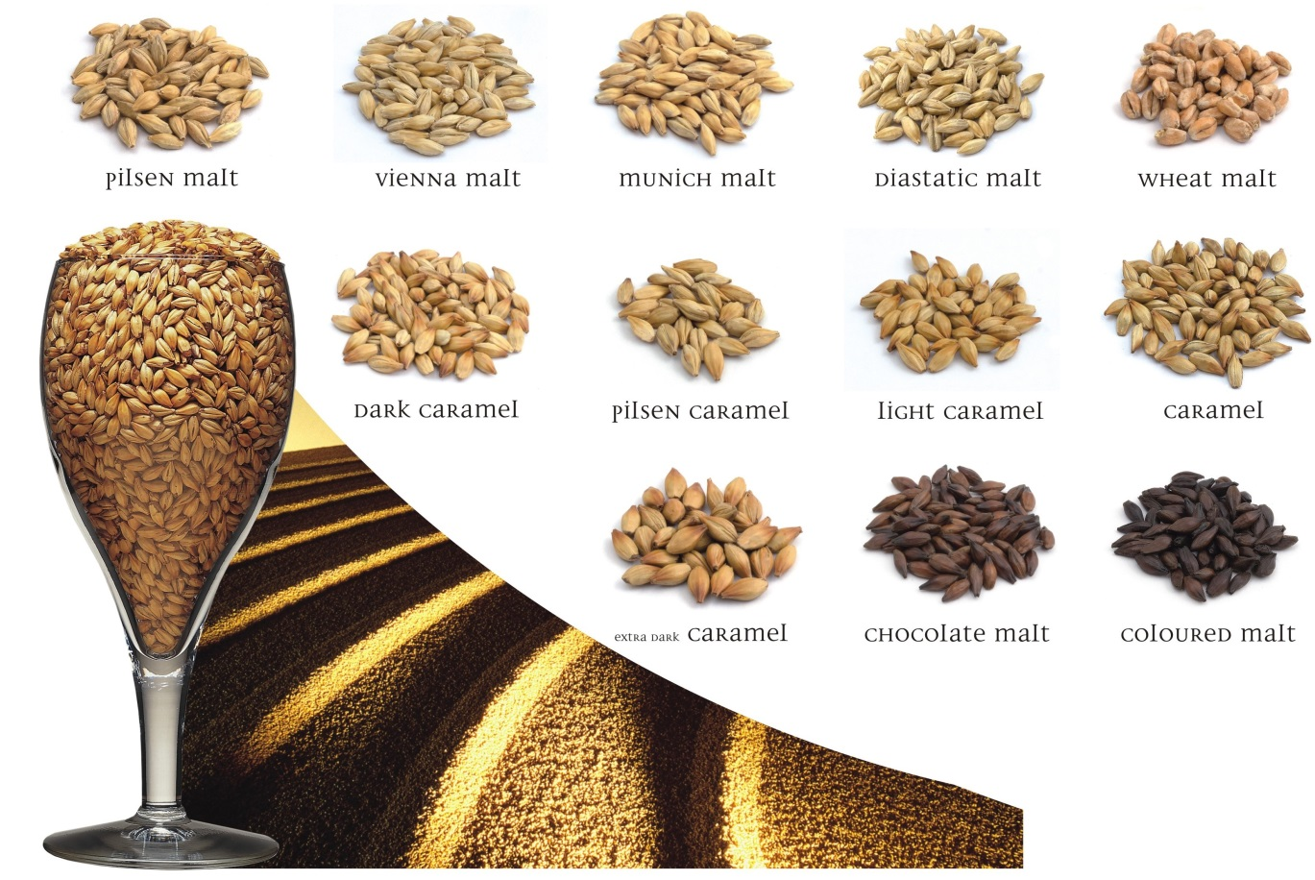
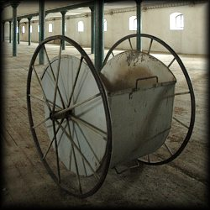
Malting houses
Brewery
Business
Import

Slide 3
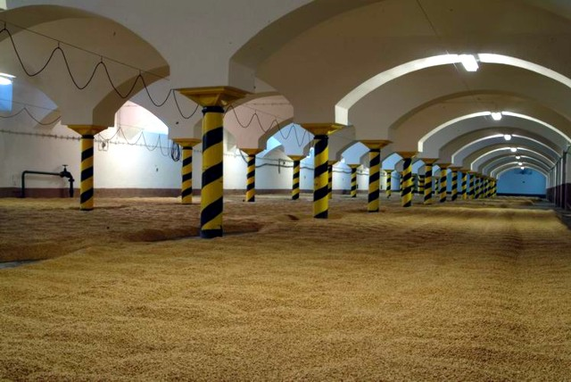
Traditional malting house

Slide 4
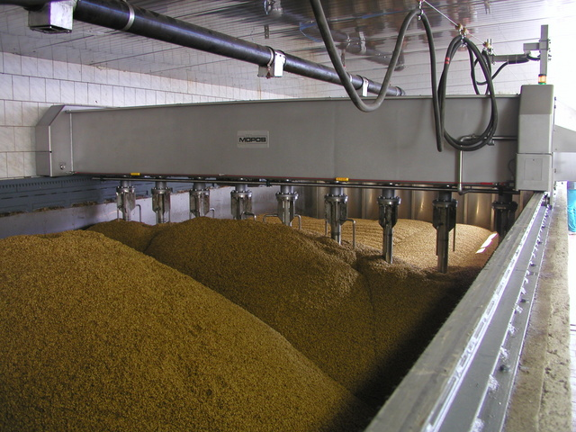
New technologies

Slide 5
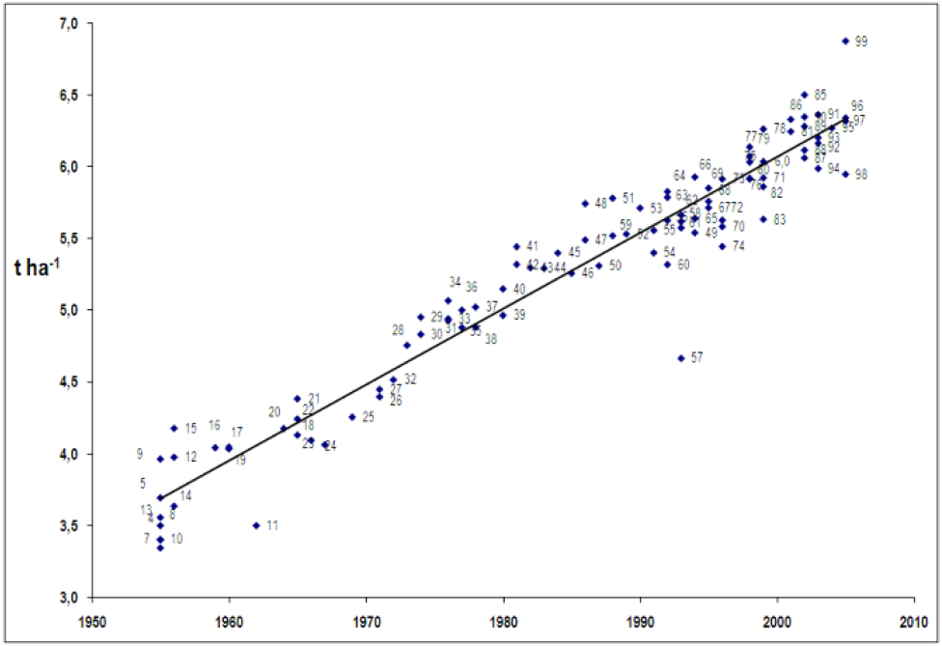
Yield of barley

Slide 6
Prices of barley and malt (CZK/t)

Slide 7
Brewery malting houses
Malting house | Production 2013 (t) | Production 2015 (t)
Hols, a. s. – malting house of brewery Liberec Vratislavice | 1 400 | 1 500
Měšťanský Brewery Havlíčkův Brod, a. s. | 1 220 | 1 370
Brewery Broumov, spol. s r. o. | 120 | 220
Brewery Ferdinand, a. s., Benešov | 1 538 | 2 263
Brewery Herold Březnice, a. s. | 0 | 0
Brewery Nová Paka, a. s. | 650 | 650
Brewery Nymburk, s. r. o. | 1 652 | 1 393
Brewery Platan, a. s., Protivín | 934 | 0
Brewery Samson, a. s. | 1 679 | 0
Plzeňský Prazdroj, a. s. – malting house Plzeň | 76 717 | 78 701
Plzeňský Prazdroj, a. s. – malting house Nošovice | 32 102 | 34 656
Family Brewery Chodovar, spol. s r. o. – Chodová Planá | 768 | 715
Malting house Bernard, a. s., Rajhrad u Brna | 6400 | 6 166
Staročeský Brewery, spol. s r. o., Dobruška | 135 | 102

Slide 8

Soufflet
Malting houses Soufflet ČR, a. s. | Production 2013 (t) | Production 2015 (t)
- Malting house Hodonice | 102 759 | 101 733
- Malting house Kroměříž | 97 646 | 98 396
- Malting house Litovel | 10 421 | 11 101
- Malting house Nymburk | 104 150 | 107 863
- Malting house Prostějov | 33 902 | 33 330

Slide 9
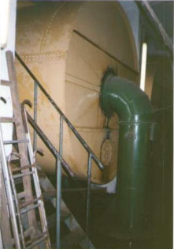
Other business malting houses
Gallant drums
Sladovna | Production 2013 (t) | Production 2015 (t)
Českomoravské sladovny, a. s. – sladovna Zábřeh na Moravě | 20 871 | 23 511
Drahotín Horňák, Castello soukromá sladovna, Prostějov | 1 500 | 1 614
Družina, spol. s r. o. – provoz sladovna Tábor | 7 500 | 11 400
Ergo, spol. s r. o. – sladovna pivovar Jevíčko | 0 | 0
Ing. Karel Klusáček – sladovna Kounice | 2 100 | 2 340
JK Nápoje, spol. s r. o., Náměšť na Hané | 2 500 | 2 500
Moravamalt, spol. s r. o., Brodek u Přerova | 17 050 | 16 161
Raven Trading, spol s r. o. – sladovna Záhlinice | 2 350 | 2 200
Sladovna, spol. s r. o., Bruntál | 1 616 | 1 595
Sladovna Mšeno, spol. s. r. o. | 0 | 1 770
Suchomastská obchodní společnost, spol. s r. o. | 244 | 584
Sladovna Jablonec, spol. s r. o., Jablonec nad Nisou | 2 800 | 2 680
Zámecká Sladovna v Kolíně | 1 116 | 1 181

Slide 10
Year 2015
Total production 548 000 t
Brewery 23 %
Business 77 %
Share on production of Soufflet 64 %
Market share of Soufflet in frame of business 84 %
Share on export 43 %

Slide 11
Year 2018
Total production 547 500 t
Export 248 000 (45 %)
Increasing export 4,8 %
Export Poland (37 %), Germany (13 %), Austria (10), Japan (8 %)
Number 5 in production in EU

Slide 12
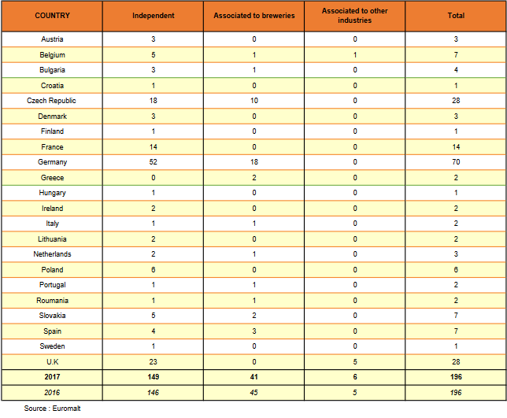

Slide 13
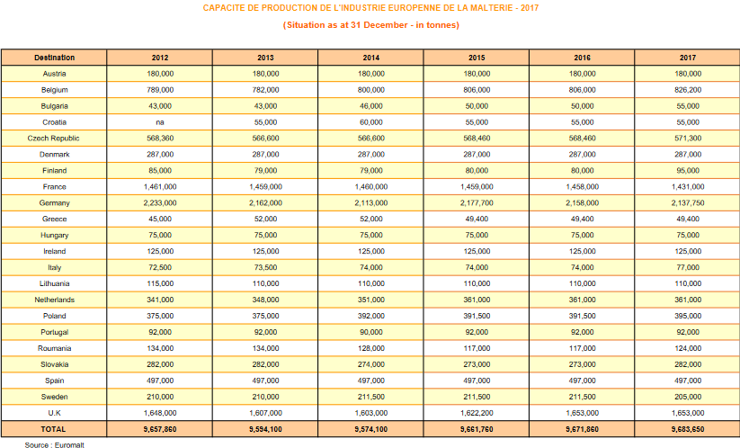

Slide 14
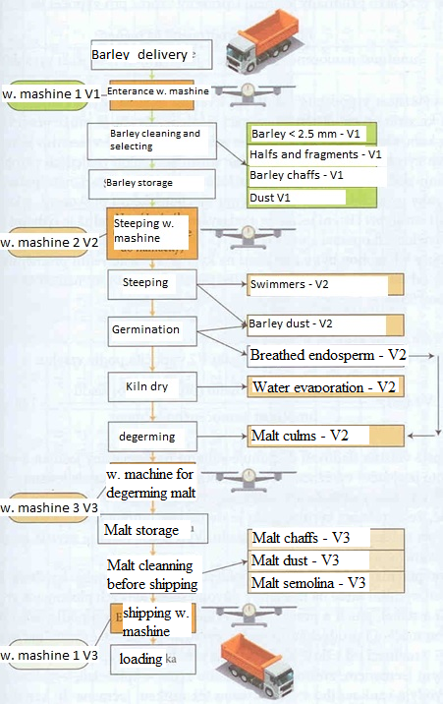
Source: Paulů, R.

Slide 15
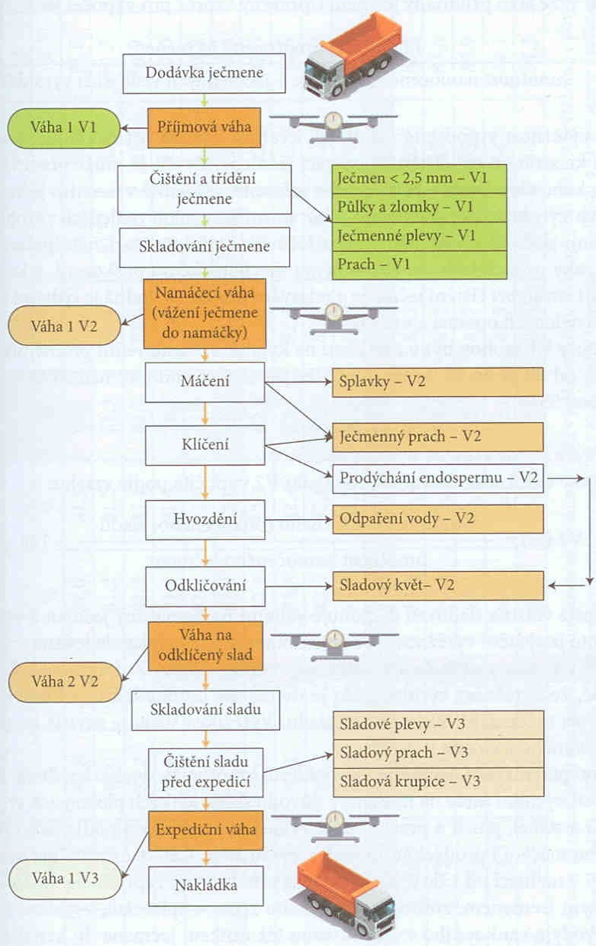
Zdroj: Paulů, R.

Slide 16
Formulas
Yield rate of purchased barley - V1
Yield rate of real malt production V2
Yield of shipped malt V3

Slide 17
Formulas
Total yield rate
Coefficient of barley usage

Slide 18
Coefficents for malts
Czech malts: 1.24 – 1.25
Munchen malt: 1.26 – 1.28
Caramel malt: 1.33 – 1.35
Color malt: 1.45 – 1.5

Slide 19
Costs
Raw material
Real production costs
Amortization
Administration costs
Financial costs

Slide 20
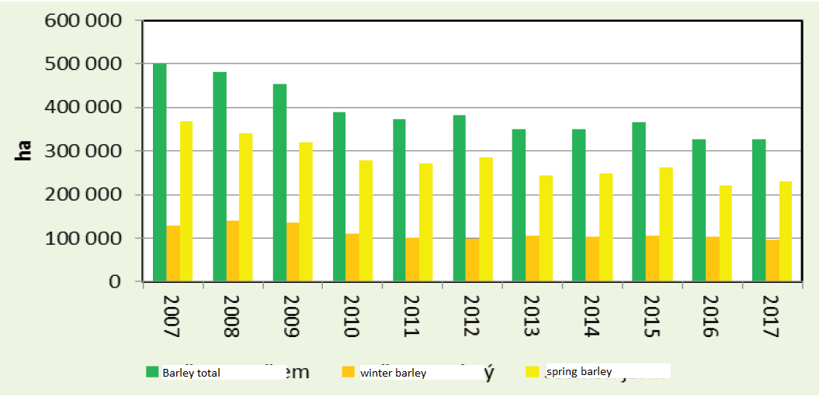
Area of barley

Slide 21
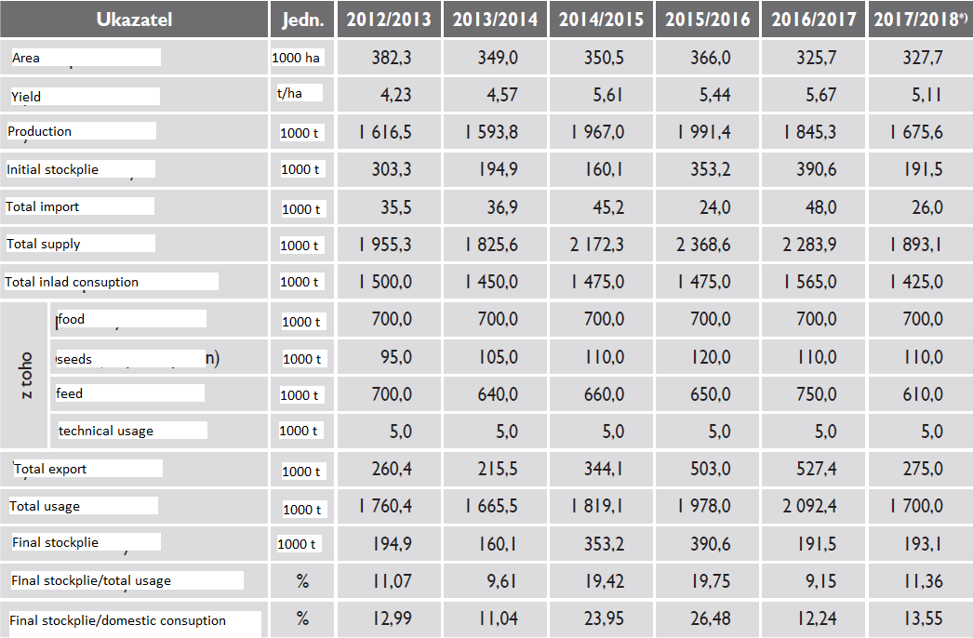

Slide 22
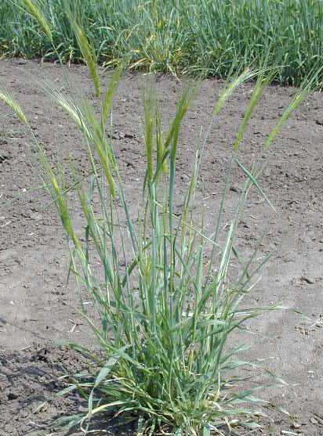
Hordeum spontaneum

Slide 23
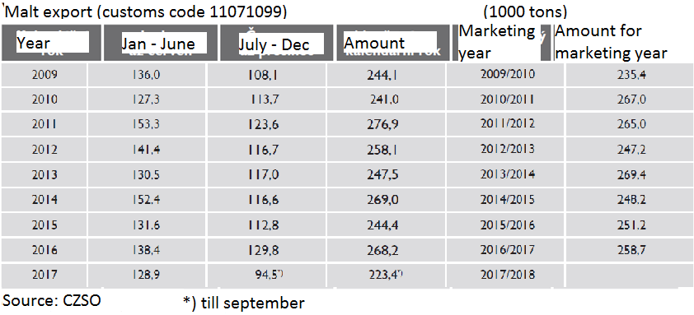

Slide 24
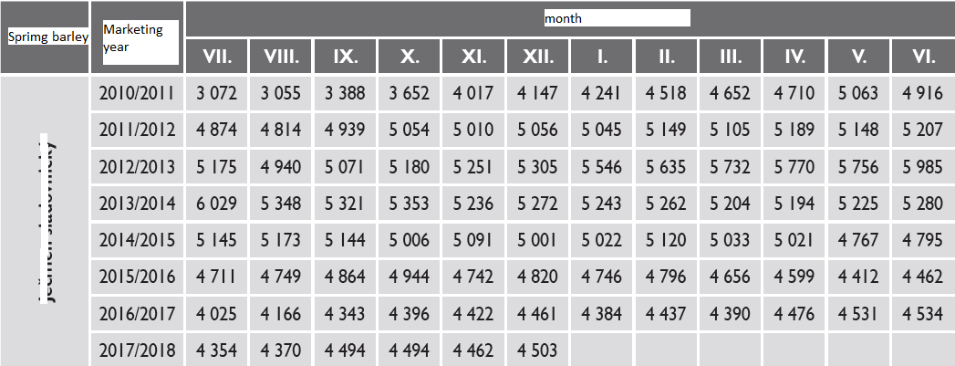
Price of barley for barley

Slide 25
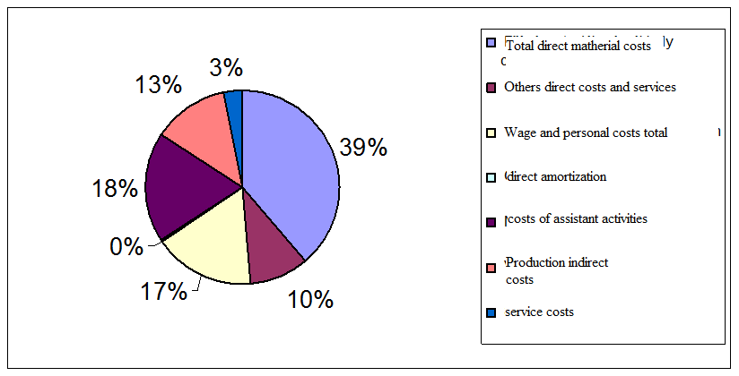
Costs structure – barely (2013)
Real costs are 21 308 CZK/ha. Share of main product is 85 %, so the real
costs per main product are 18 112 CZK/ha. Real costs of the product are
3 576 CZK/t.

Slide 26
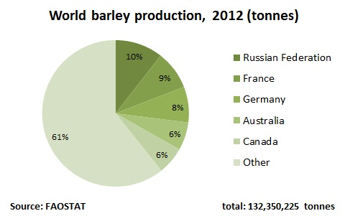

Slide 27
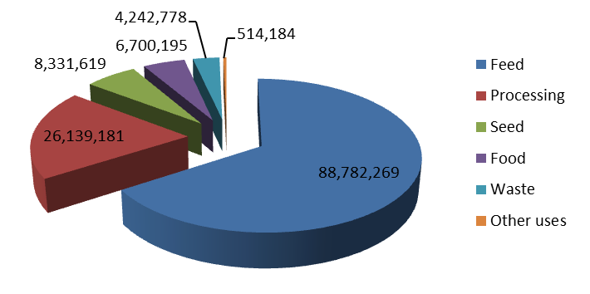
Usage of barely (2015, tons)
http://www.factfish.com/statistic/barley%2C%20production%20quantity

Slide 28
