Slide 1
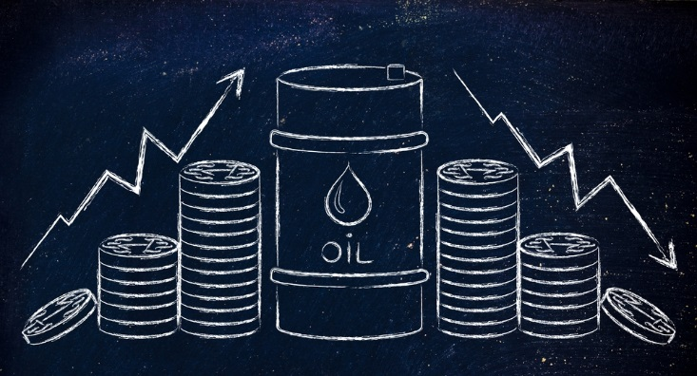
Seminar 2 Dutch disease
2021

Slide 2
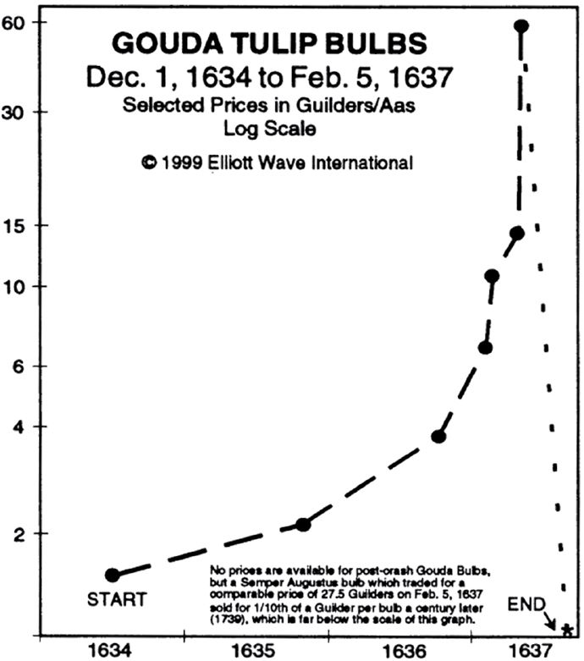
Tulip mania
Basket of goods allegedly exchanged for a single bulb of the Viceroy[
Two lasts of wheat | 448
Four lasts of rye | 558
Four fat oxen | 480
Eight fat swine | 240
Twelve fat sheep | 120
Two hogsheads of wine | 70
Four tuns of beer | 32
Two tuns of butter | 192
1,000 lbs. of cheese | 120
A complete bed | 100
A suit of clothes | 80
A silver drinking cup | 60
Total | 2500
Tulip introduced in 16th century from Ottoman empire
Due to its beauty became a luxury good (3-4K guilders, 10y earnings of skilled craftsman)
Future market developed – buying bulbs at the end of the season
Most of trading without the real product
tulip bulb became the 4th export product in NL, after gin, herrings and cheese.
Craftsmen speculators (weavers - collaterals)
Bubble collapsed in Harleem when buyers did not appear at bulb auction - PLAGUE
Source: CNBC.com

Slide 3
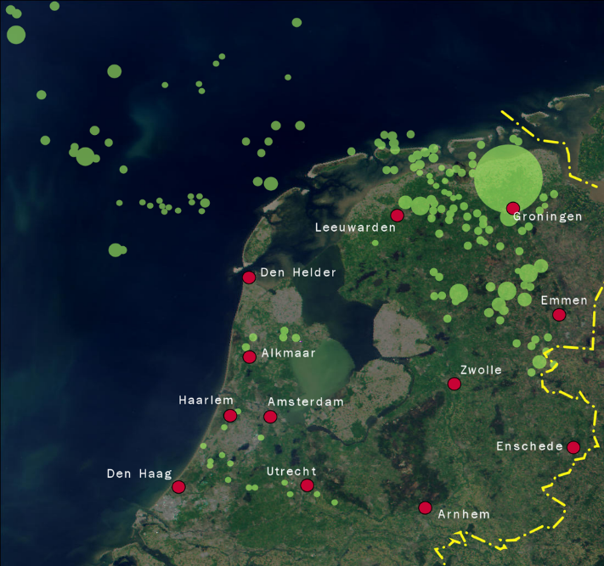
Dutch disease – the other example
Explained on the example of Netherlands, where natural gas reserves were discovered in the 1959
The term was introduced by The Economists magazine in 1977
General theory on Dutch disease explain:
causal relationship between the increase in the economic development of a specific sector and a decline in other sectors
Labor demand change: resource movement effect
Export of natural resources (commodities) add pressure on domestic currency (HOW?)
What happen with competitiveness of other goods and industries? (how does change imports and exports?) - direct-deindustrialization
How stable are prices of the commodities?
Spending effect – revenues (how they are distributed)??
indirect-deindustrialization through non traded items (which one?)
Source: shell.com

Slide 4
Ways out of the disease
slowing the appreciation of the real exchange rate
Not bringing the funds into the country
WHAT THAN ?????
See example of Norwegian Pension Fund (https://www.nbim.no/en/the-fund/holdings/holdings-as-at-31.12.2017/?fullsize=true)
Politically viable in developing countries?
Stabilization of revenue stream (Volatility)
boosting the competitiveness of the adversely affected sectors
Investments where?
Education and Infrastructure => improving situation in lagging manufacturing and agriculture

