Slide 1
Economic interventionism
Recommended videos:
https://www.youtube.com/watch?v=8h8rK12L_hc
https://www.youtube.com/watch?v=3ez10ADR_gM&list=PL8dPuuaLjXtPNZwz5_o_5uirJ8gQXnhEO

Slide 2
Market failure concepts
Economic welfare
Self-interested behaviour
Rational behaviour
Private benefits and privated costs
Social welfare
Social benefits and social costs
Economic Efficiency / inefficiency
Income inequality
Information failure
Public goods, free rider problem
Complete failure (due to missing market - pure public goods)
Partial failure (negative externalities)
Market power in markets
Monopoly, Oligopoly,

Slide 3
Market failure

Slide 4
Public Goods is a good that is both non-excludable and non-rivalrous

Slide 5
NEGATIVE EXTERNALITIES from production

Slide 6
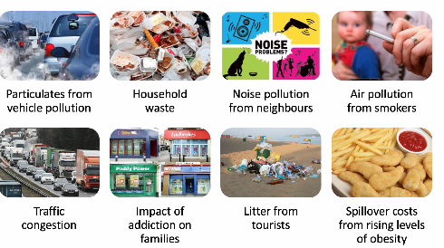
NEGATIVE EXTERNALITIES from concumption

Slide 7
POSITIVE EXTERNALITIES from concumption

Slide 8
POSITIVE EXTERNALITIES from production

Slide 9
MERIT goods
Merit goods are those goods and services that the government feels that people will under-consume, and which ought to be subsidised or provided free
Creates positive externality
Individuals are myoptic

Slide 10
DE-MERIT goods
Merit goods are those goods and services that the government feels that people will over-consume, and which ought to be subsidised or provided free
Creates negative externality

Slide 11
CONSUMER INFORMATION FAILURE

Slide 12
Purpose of governmental intervention

Slide 13
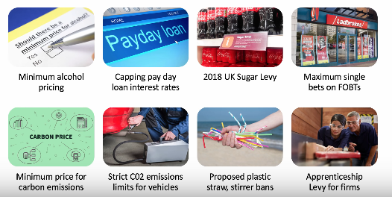
Examples of intervention

Slide 14
Regulations

Slide 15
Government failure

Slide 16
Evaluating GOV intervention in the market
How significant is the market failure (what are consequences)?
Can the market/price mechanism find some solution?
What are likely consequences of not intervening?
How effective is an intervention? (alternatives to consider?)
Who are the winners / losers from intervention?
Consider potential for one or more government failures
Which works bes – market-based or regulátory („command and control“) approaches
What impact might behavioural interventions have?

