Slide 2
Content:
Introduction of the Norwegian market
Market concentration
Dominant producers
History and ownership
Legislative laws and excise taxes
Consumption development
Craft beer industry
Case: Nøgne Ø brewery
Production of malt and hops
The trade of beer
KVEIK
Sources

Slide 3
Intro
-The norwegian market for beer
Competition:
-The Norwegian market for beer is characterized, just as the domestic retail industry, as controlled by a small number of large producers.
-Huge power in the distribution chain
-Very concentrated market
Logistics in Norway is characterised by:
•Long distances
•High transportation costs
•Low quality on roads

Slide 4
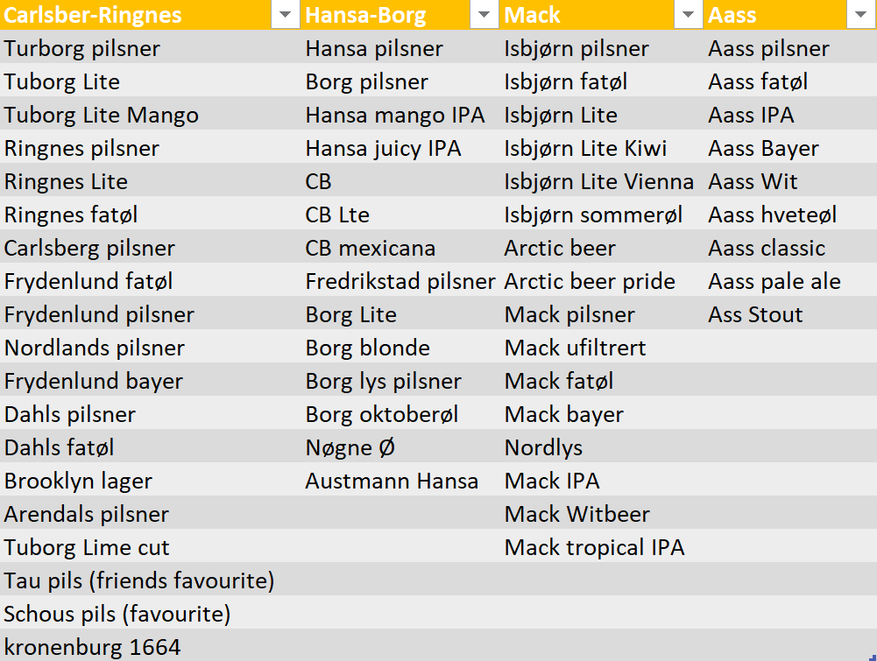
Main beer companies and their respective brands:

Slide 5
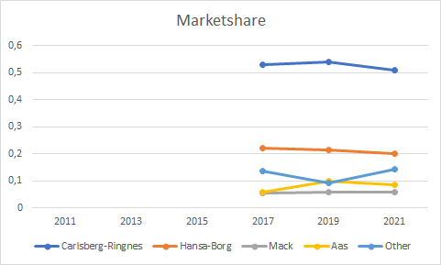
Market analysis:
Findings
Overview:
-The market is dominated by Carlsberg-Ringnes, followed by Hansa Borg.
-Aass and Mack equal competitors in 2017
Insight:
-Hansa Borg market share declines due to “best friends agreement” with REMA 1000 (E24.no, 2017)
-Quite unchanged market share for Carlsberg-Ringnes AS
-Aas increases market share and take 3. posaision in front of Mack as new products is welcomed by the market
-Other companies has taken advantage of the pandemic as beer-tasting becomes popular

Slide 6
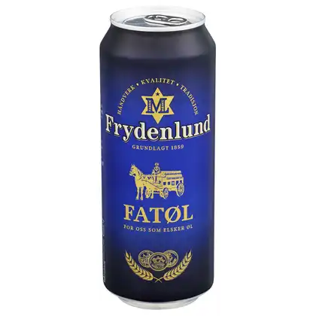
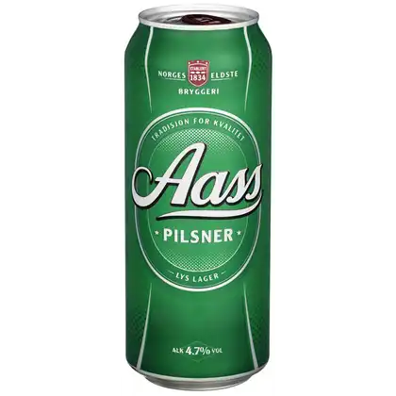
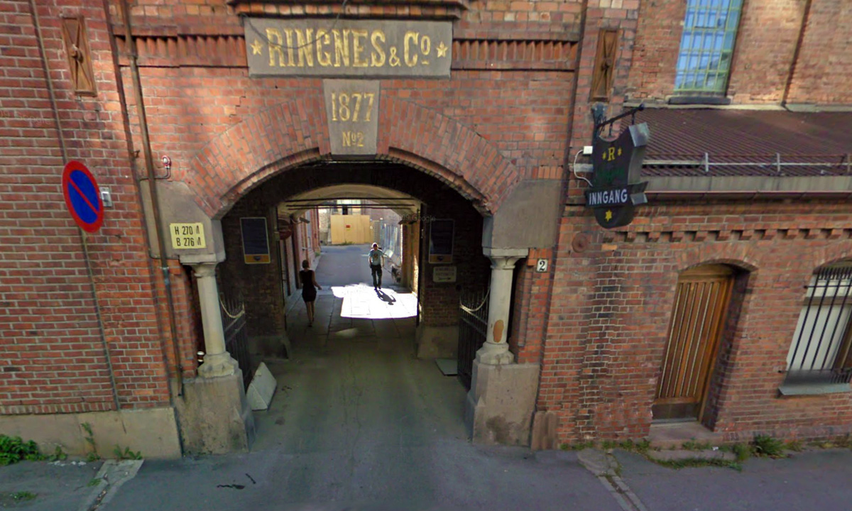
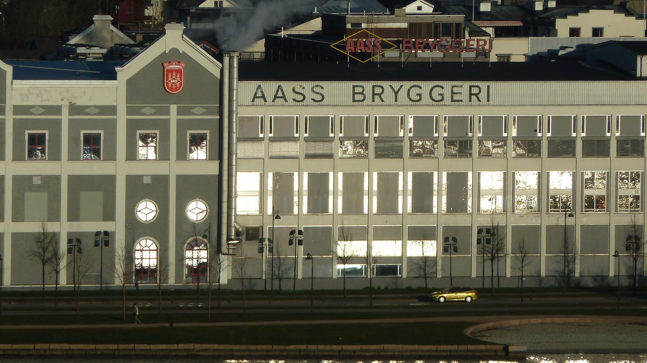
Ownership structure and its development
Comparison of Ringnes AS and Aass Bryggeri: Profit maximizers vs. Family business with passion
Fans favourite Ringnes AS:
Fans favourite Aass Bryggeri:

Slide 7
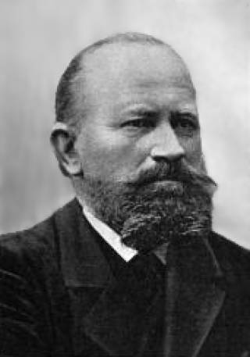
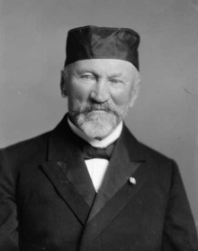
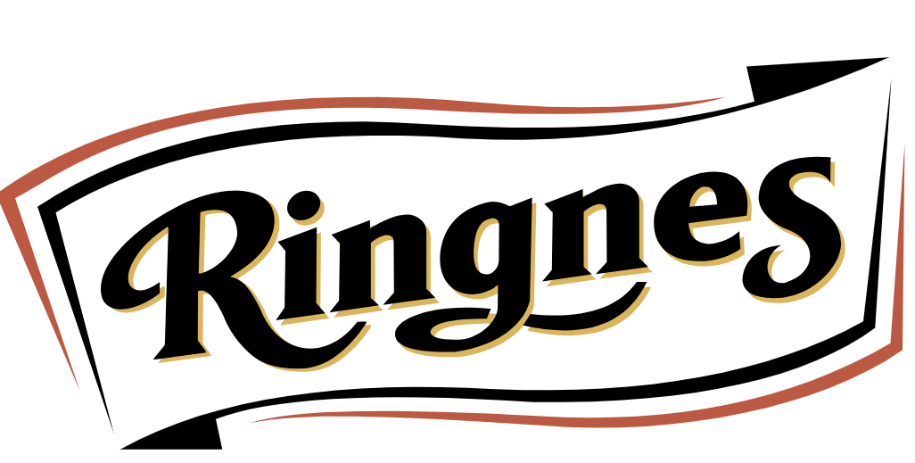
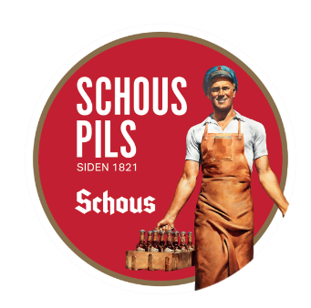
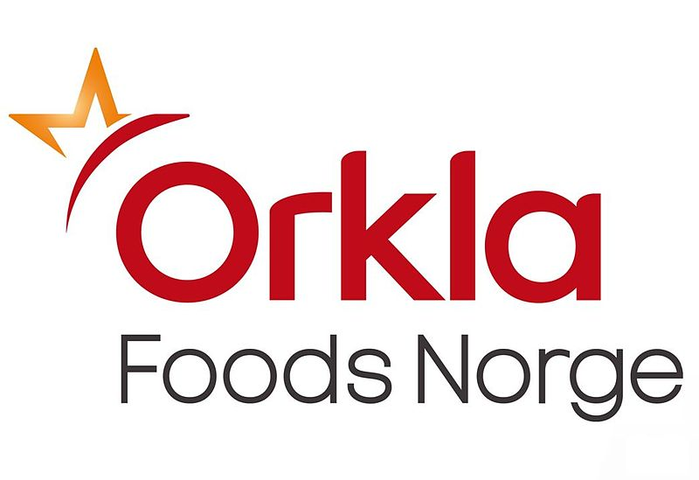
Ringnes AS (Oslo ølen) - Early history
Norwegian owners
Ownership:
1876: Established in Christiania in by Axel Heiberg, Amund and Ellef Ringnes
1899: The company became a joint stock company
1978: Merging of Ringnes, Frydenlund and Schous under the name Ringnes AS
1991: Ringnes AS acquired by ORKLA ASA
2004 - present : Ringnes AS acquired by Danish company Carlsberg
Today:
900 employees
Sold 120m L of beer in 2020 (KK.no, 2021)
Over 100 different beer types
The biggest beer company in Norway
Fully owned by Carlsberg
Danish owners

Slide 8
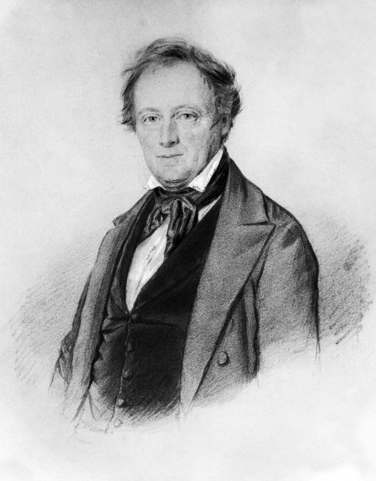
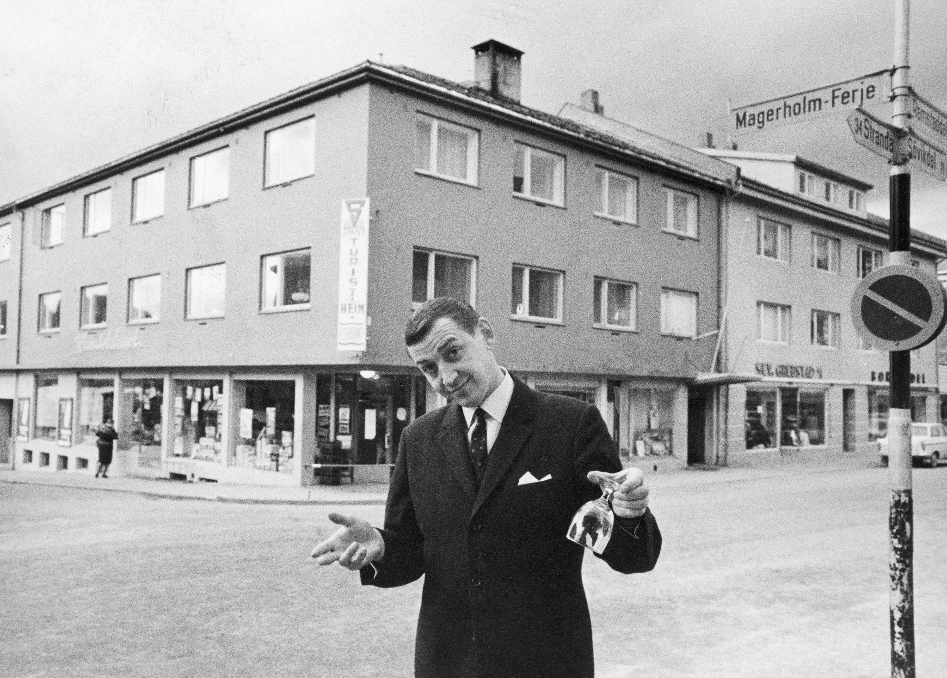
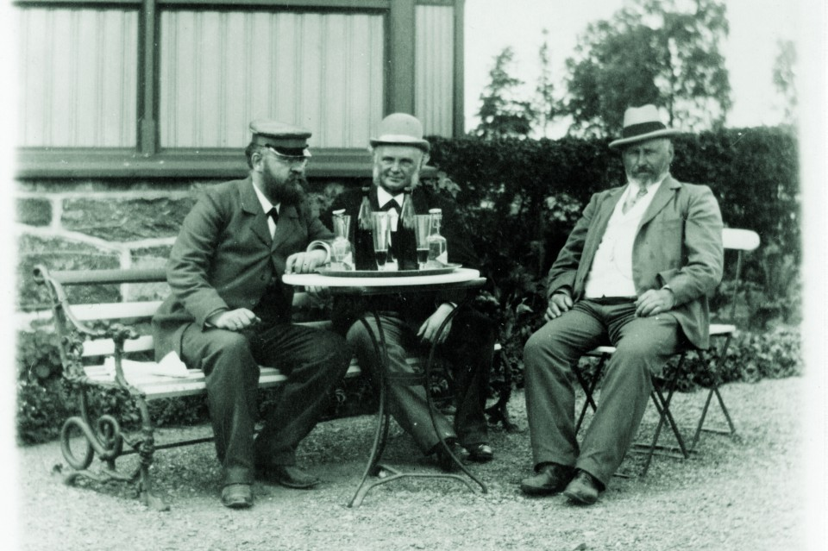
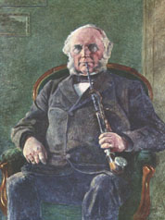
Aass Bryggeri (Drammens ølen) - Early history
Norwegian owners
Ownership:
1834: Established by the brewer and baker Ole Pehrson in Drammen
1842: Sold on auction due to debt problems to Halvor Ellingsen.
1860: Sold to H.F Gjessing and the peasant boy Poul Lauritz Aass and renamed Gjessing & Aass Bryggeri
1866-present: Fully overtaken by Poul Lauritz Aass
Today:
5th generation in charge: Christian K. Aug. Aass
Sold 30,1m L of beers in 2020 (Aass.no, 2021)
100 employees
30 different beer types
The oldest brewery in Norway
Fully family owned

Slide 9
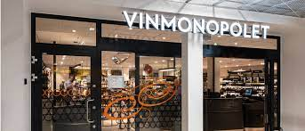
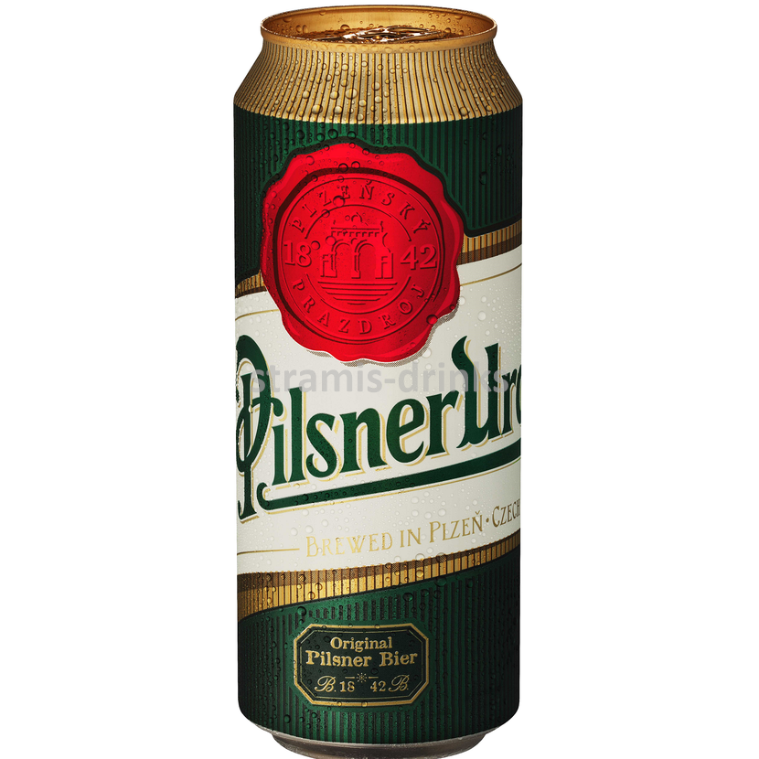
Production under license and Consumer restrictions +
Legislative laws and excise taxes
Production under license:
Production and sale of alcohol requires registration as a taxable activity to the tax authorities
(§. Registration duty, paragraf 1-4)
Sale of alcohol that involves consumption at the same spot requires bar grant
(§. Registration duty, paragraf: 1-4)
Wholesale are not allowed to sell alcohol stronger than 4,7%.
Stronger alcohol (4,7%+) is to be sold at a registered Wine monopoly
Further, sales of alcohol is allowed between 08-20 in weeks. 08-18 on Saturdays. Not allowed on Sundays and other National Holidays.
(§. Alcohol law, paragraf: 3-7)
Consumer restrictions
Since 1991: Private brewing of beer allowed only for own consumption
(§. alcohol law, paragraf: 6-1)
In other terms: Not allowed to sell privately brewed beer
It is not allowed to sell alcohol to people under 18 y.o.a, but allowed to consume.
It is not allowed to sell strong alcoholic liquid (22%+) to people under 18.
Taxes
Increased alcohol percentage increases the tax pr. Liter when importing alcohol.
For 3,7-4,7% alc. equals fees 2,127,- EUR pr. Liter.
Example: Import Pilzen Urquell can 0,5L. 0.5L*2,127EUR + price

Slide 10
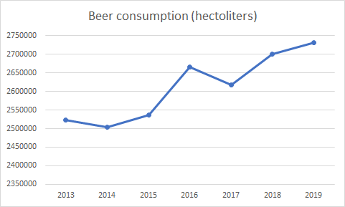
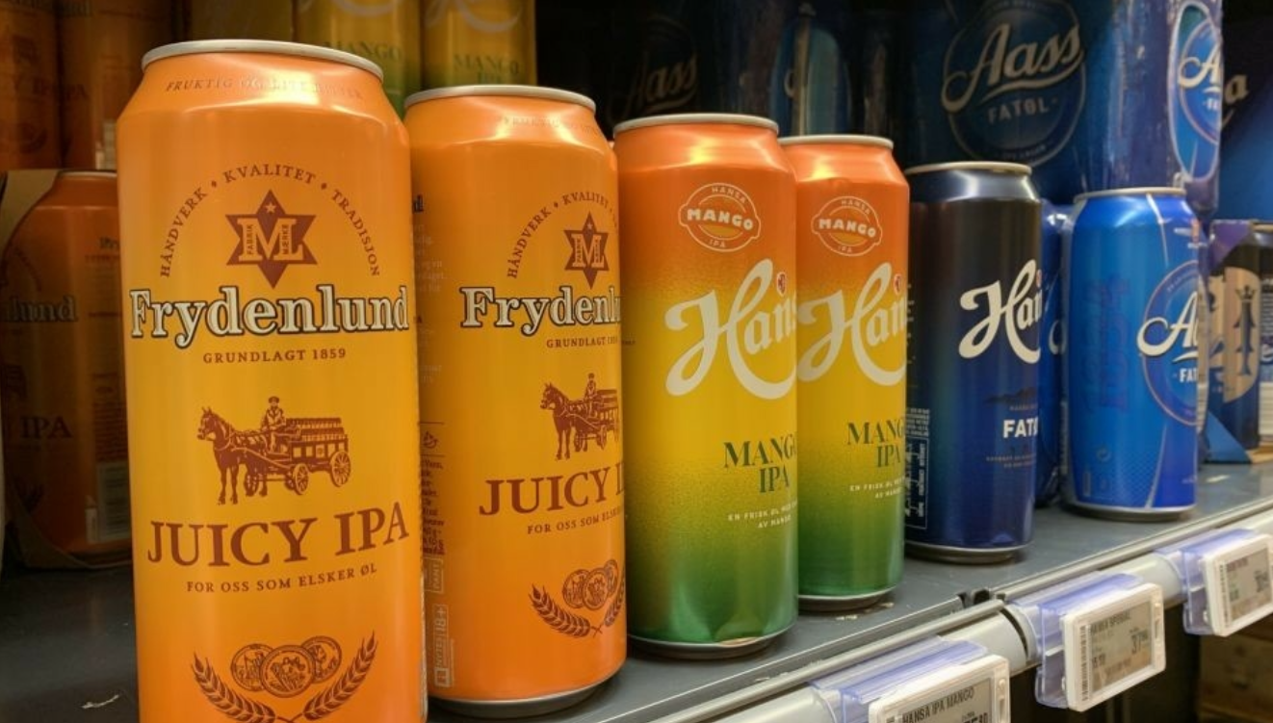
Consumption development
Key features of beer consumption in Norway
Consumption per capita in Norway: 51L / Year
Comparison: In Czech Republic, 135L / Year by 2020 (Lowest since 1960) (Expatz.cz, 2021)
Significant increase in norwegian beer consumption
Currently 129 breweries in Norway
**********
The Covid-best sellers (2020) where
hIghly dominated by fruity IPA’s
(Brewersofeurope.org, 2020)

Slide 11
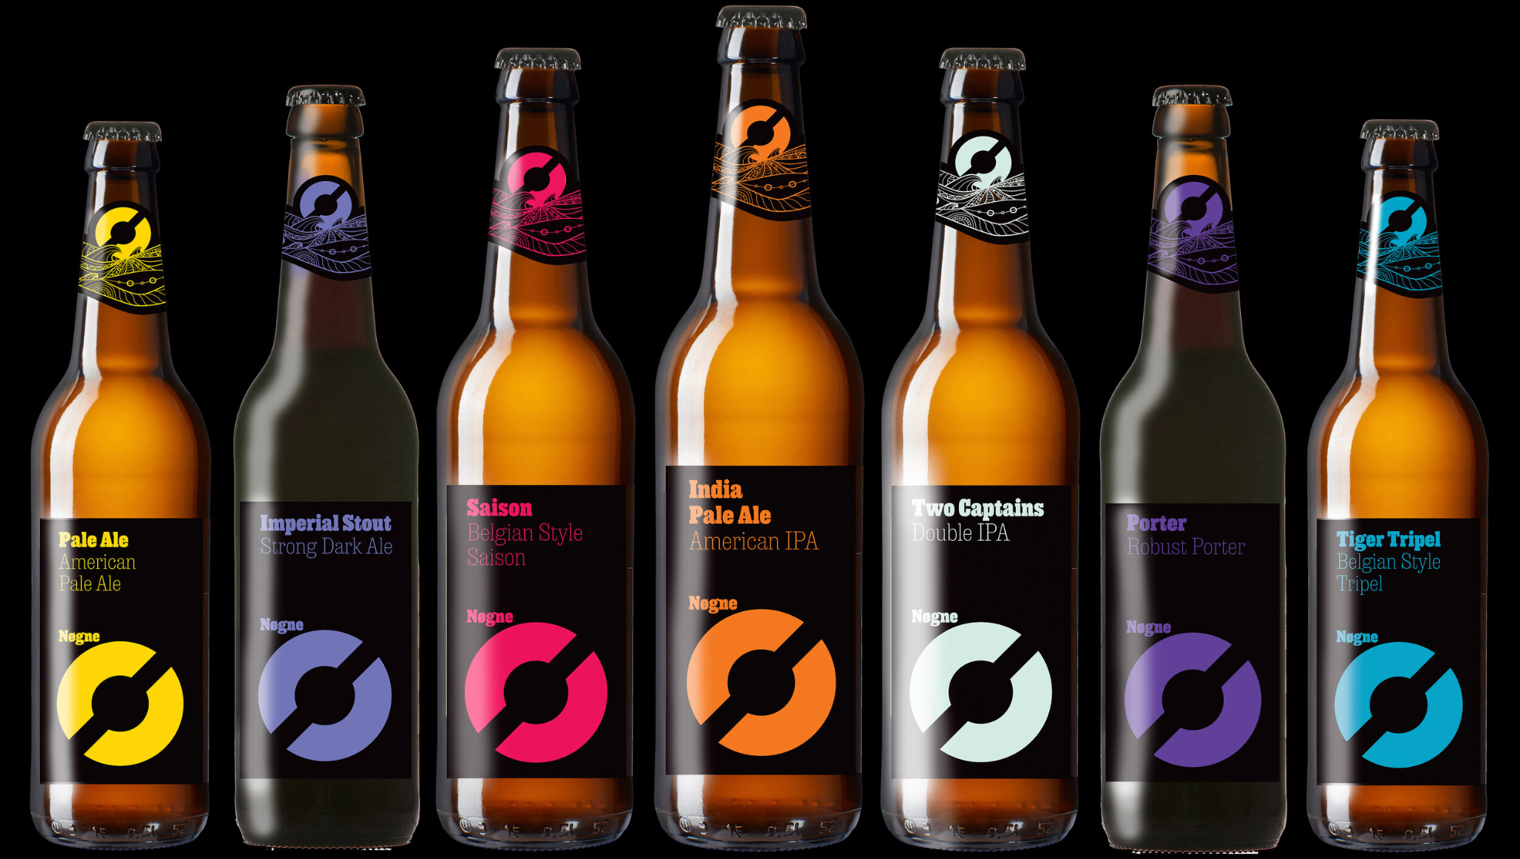
Craft beer industry
-Example: Nøgne Ø

Slide 12
Production of malt and hops
An old tradition of producing hops and malt in norway
The plants were already mentioned in the Frostating Act about a thousand years ago
Cold temperatures and long summer days make it difficult to grow
Hop production fell from 1103ha in 1881 to 200 ha only 20 years later, before almost disappearing in the twentieth century
The production is again steadily increasing due to technology improvements

Slide 13
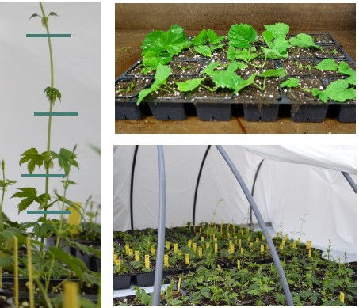
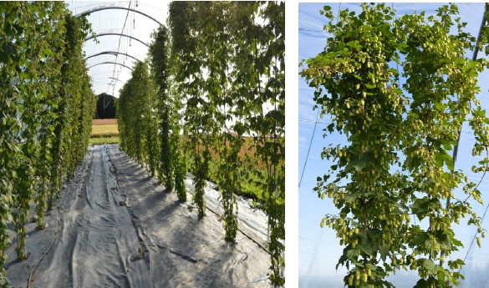
Production of malt and hops

Slide 14
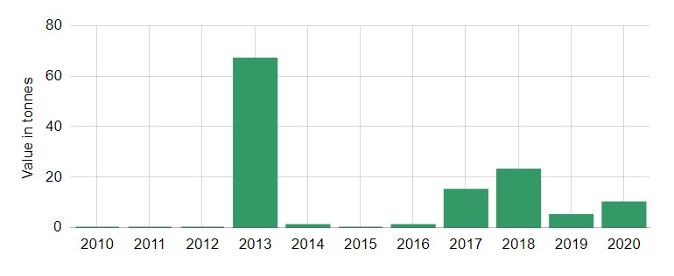
Production of malt and hops
Norway's stake of the world's total malt's exports in 2019 was 4.6 per cent. The country is ranked position 8 in world exports of malt
The demand for Norway malt (cereals/grains category) decreased, with a change of -78.261 per cent compared to the year 2018
Norway bought 41,443 tonnes of malt in 2019.

Slide 15
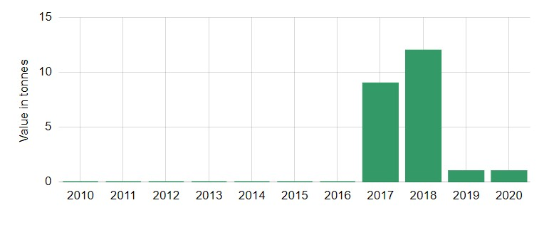
Production of malt and hops
Norway's stake of the world's total hop cones' exports in 2019 was 1.9%. The country holds position 11 in world exports of hop cones
In 2019 Norway exported 1 tonnes of hop cones
Norway imported 261 tonnes of hop cones in 2019

Slide 16
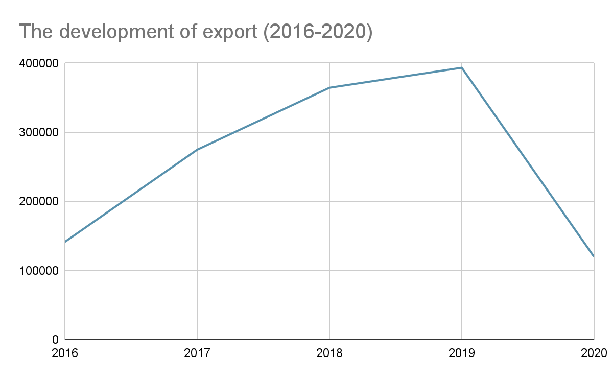
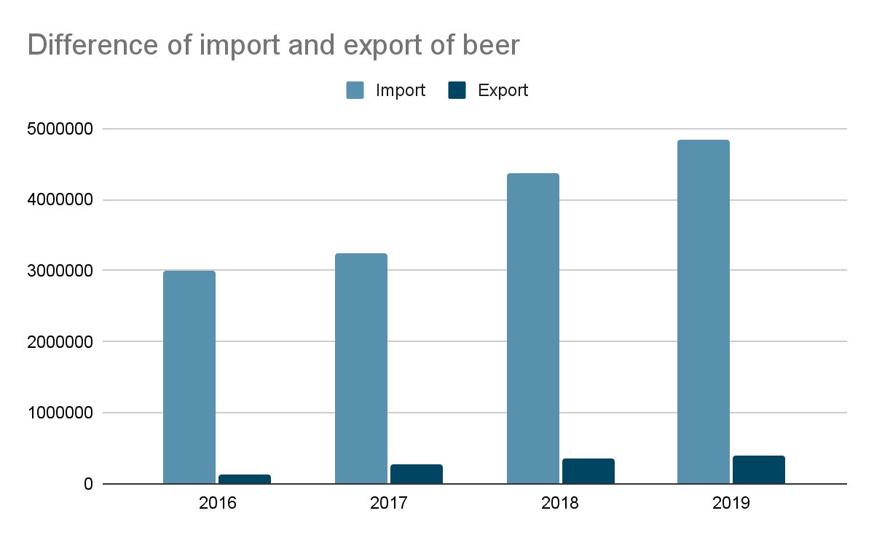
The trade of beer
Total beer sale in Norway in April 2019 was 27 718 493 liters of beer with an increase of 15% since the previous year
A steady rise of beer export pre-covid
Norway is still a much larger importer of beer than exporter

Slide 17
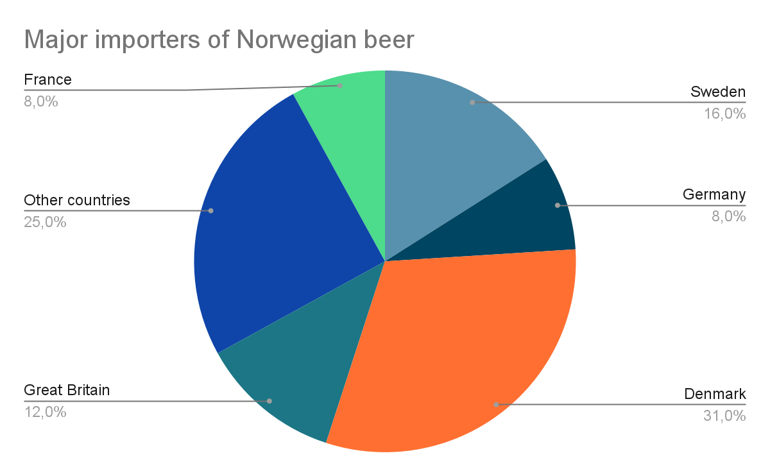
The trade of beer
Biggest importers of Norwegian beer: Germany, France, Denmark, Sweden, Great Britain
Biggest exporters of beer to Norway: Estonia, Mexico, Denmark, Germany, Poland

Slide 18
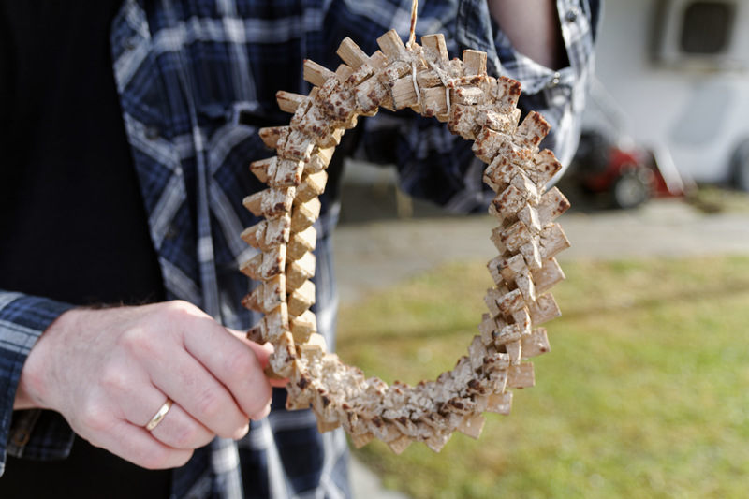
KVEIK
Kveik is a collective term for a family of strains of brewing yeast that has been used in Norwegian farmhouse brewing for generations
Original meaning - To start or to produce life
Quick fermentation
Easy to harvest and long viability
Can be used to brew almost any beer
Mostly sour beer

Slide 19
Sources:
https://bryggeriforeningen.no/tall-og-fakta/salgsstatistikk/
https://www.aass.no/splash/aass-bryggeri/?site=aass-bryggeri
https://www.ringnes.no/om-ringnes/bryggerier-og-anlegg/
https://www.carlsberggroup.com/who-we-are/about-the-carlsberg-group/global-presence/norway/
https://www.ringnes.no/produkter/?beerType=37396&beerType=74443&beerType=37458&beerType=37423&p=2
http://www.ekrheim.no/assets/downloads/Aass_produkter.pdf
https://brewersofeurope.org/site/countries/figures.php?doc_id=681
https://www.dn.no/marked/korona/olproduksjon/regjeringen/bryggerier-permitterer-ringnes-vurdere-a-folge-etter/2-1-943792
https://e24.no/naeringsliv/i/LA9Mjp/frykter-bestevenn-avtalen-svekker-oelkonkurransen
https://brewersofeurope.org/uploads/mycms-files/documents/publications/2020/economic-report-norway.pdf
https://www.itromso.no/meninger/2020/07/02/Det-er-Mack-i-de-foldede-hender-22215117.ece
https://www.skatteetaten.no/bedrift-og-organisasjon/avgifter/saravgifter/om/alkoholholdige-drikkevarer/
https://www.expats.cz/czech-news/article/czech-beer-consumption-in-2020-fell-to-its-lowest-level-since-the-1960s
https://www.kk.no/helse/disse-drikkevarene-kjope-vi-mest-av-i-pandemiaret-2020/72854159

