Slide 1
Jakub Horák horakj(at)fld.czu.cz L231
Forest Protection

Slide 2
Conditions for sucessful credit
Watch our web for actual information: http://home.czu.cz/horakj/forest-protection/
We will have 5 weeks.
Max 17 points of which:
Field lecture fungi (1 point),
Field lecture abiotics (1 point),
Presentation (5 points),
Cognitive test (10 points),
and 10 is min for your sucessful credit with min 1 from each.

Slide 3
Conditions for sucessful exam
10 and more points from credit,
Written test (three options) with 8 questions per 1 point:
0-3 points: 4 (fail);
4-5 points : 3 (good);
6-7 points : 2 (very good);
8 points :1 (excellent).

Slide 4
How to do your presentation?
Each of you will have 3min for presentation and your colleagues will have 3min for questions.
You will obtain from 0 to 5 points.

Slide 5
How to do your presentation?
Search for scientific paper from journals indexed on Web of Science dealing with Forest Protection (section Journal Citation Reports-e.g. subsections Forestry and Entomology)
e.g. Forest Ecology and Management or BioControl
Search e.g. by http://scholar.google.com/

Slide 6
How to do your presentation?
First search and choose…
…then send pdf of selected paper on e-mail (resnerovak(at)fld.czu.cz) for approval (obligatory)
– at least one week before.

Slide 7
How to do your presentation?
Use IMRaD format:
I – introduction
M – materials and methods
R – results
D – discussion (with conclusion)

Slide 8
How to do your presentation?
1st slide: Name of paper and your name
2nd slide: Short introduction and aim(s)
3th slide: M&M
4th slide: Results
5th slide: Discussion and conclusion

Slide 9
How to do your presentation?
1st slide: Name of paper and your name
Michael Jordan

Slide 10
How to do your presentation?
2nd slide: Short introduction
Chalcid wasps are the most effective and abundant parasitoids…
The main aim of this study was the answer on the question: …

Slide 11
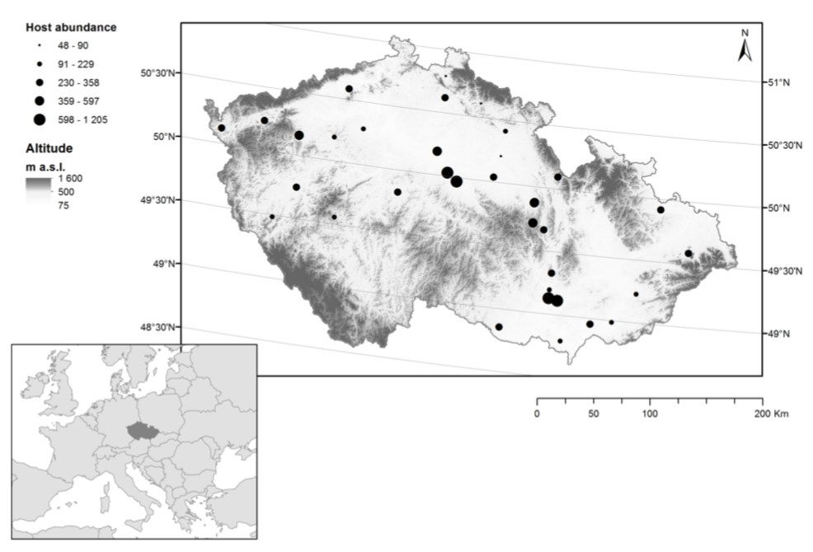
How to do your presentation?
3th slide: M&M
Dependent variables, predictors, methods…

Slide 12
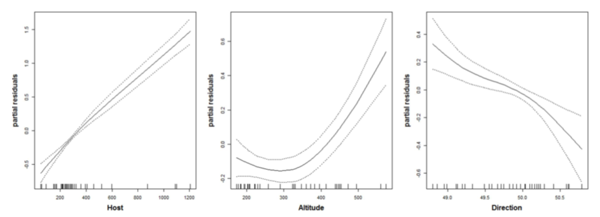
How to do your presentation?
4th slide: Results
Species richness of chalcids was…

Slide 13
How to do your presentation?
5th slide: Discussion and conclusion
The number of parasitoid species was not significantly related to the studied predictors. This result indicates that the adaptation…
The results provide evidence that biological control…

