Slide 1
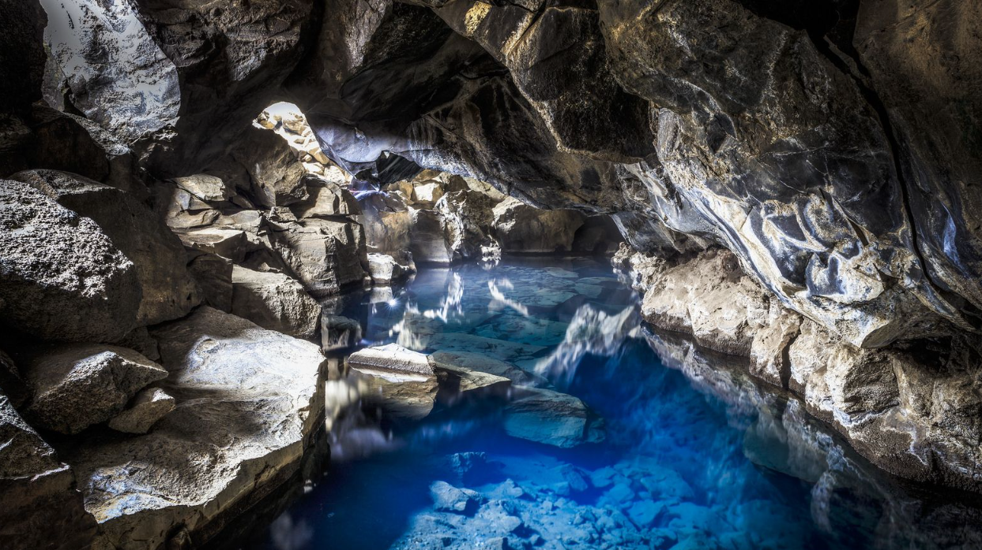
ZVX111E (ZVX130E)Groundwater Hydraulics
2024_2025
Lecture_6

Slide 2
SEEPAGE – 2D FLOW NETS

Slide 3
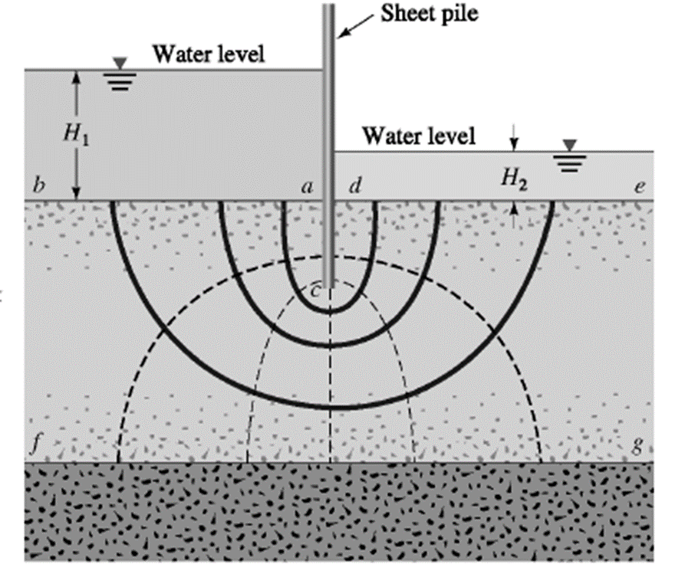
LAPLACE EQUATION
Darcy eq. for anisotropic porous media
$$v_{x}={−K}_{x}\frac{∂h}{∂x}$$
$$v_{y}={−K}_{y}\frac{∂h}{∂y}$$
$$v_{z}={−K}_{z}\frac{∂h}{∂z}$$
From continuity equation
$$\frac{∂v_{x}}{∂x}+\frac{∂v_{y}}{∂y}+\frac{∂v_{z}}{∂z}=0$$
with Darcy eq.:
$$\frac{∂}{∂x}\left(K_{x}\frac{∂h}{∂x}\right)+\frac{∂}{∂y}\left(K_{y}\frac{∂h}{∂y}\right)+\frac{∂}{∂z}\left(K_{z}\frac{∂h}{∂z}\right)=0$$
If soil is isotropic ….K_{x}= K_{y} = K_{z} = K
$$\frac{∂^{2}h}{∂x^{2}}+\frac{∂^{2}h}{∂y^{2}}+\frac{∂^{2}h}{∂z^{2}}=0$$
$∇^{2}h=$0
… LAPLACE EQUATION

Slide 4
2-D SEEPAGE – LAPLACE EQUATION
Laplace eguation is a very important equation in engineering
It represents loss of fluid flow through porous medium
$\frac{∂^{2}h}{∂x^{2}}+\frac{∂^{2}h}{∂z^{2}}$ = 0
Exat solution of Laplace´s equation for 2-D seepage can be obtained for cases with simple boundary conditions
For most practical geotechnical problems, it is simpler to solve this equation graphically by drawing FLOW NETS.
It is assumed:
the soil is homogeneous and isotropic with respect to permeability
The pore fluid is incompressible

Slide 5
SEEPAGE-terminology
FLOW NET consists of two sets of curves – equipotentials and flow lines (stream lines) – that intersect each other at 90° .
Along an equipotentional, the total head is constant.
A pair of adjacent stream lines define a flow channel through which the rate of flow of pore fluid is constant.
The loss of head between two successive equipotentials is called the equipotential drop.
stream line is simply the path of a water particle (molecule).
From upstream to downstream, total head steadily decreases along the stream line.

Slide 6
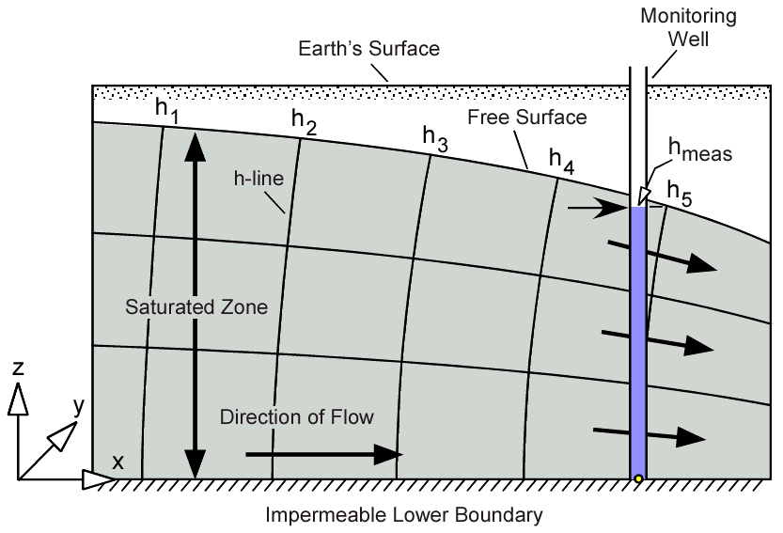
Actual
stream lines
equipotentional lines
velocity

Slide 7
SEEPAGE – FLOW NETS
STREAM LINE
h_{L}
concrete dam
datum
TH = h_{L}
TH = 0
stream line
soil
impervious layer

Slide 8
SEEPAGE – FLOW NETS
Equipotential line is simply a contour of constant total head.
h_{L}
datum
concrete dam
TH = h_{L}
TH = 0
TH=0.8 h_{L}
soil
impervious strata

Slide 9
SEEPAGE – FLOW NETS
FLOWNET - a network of selected stream lines and equipotential lines.
A flownet is a grid obtained by drawing a series of streamlines and equipotential lines
h_{L}
concrete dam
curvilinear square
90º
soil
impervious strata

Slide 10
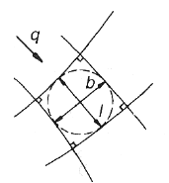
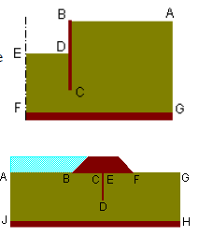
SKETCHING RULES
Flow lines cross the equipotentials at right angles (by definition, there is no flow along an equipotentials and therehore, all of flow must be at 90° to it
An equipotentials cannot cross other equipotentials ( one point cannot have two different values of total head)
Although an infinite number of flow lines could be sketched, the flow net must be constructed so that each element is as curvilinear square (sides may be curved…. Curvilinear square is as broad as it is long, so that a circle may be inscribed within it that touches all four of its sides
Impermeable boudaries and lines of symetry are flow lines ( FG is flow line)
Bodies of water (such as reservoir) behind a dam, are equipotentials
(AB)

Slide 11
piezometers
Each interval between two equipotential corresponds to a head loss ∆h equal to 1/N_{D}
h
N_{D} = 8
∆h
∆h
$$∆h=\frac{h}{N_{D}}$$
1
8
A
2
1
l₁
2
7
3
N_{D} – total number of equipotentials drops
3
6
D
B
4
5
l₂
N_{f} – number of flow tubes
C
4
N_{F} = 4

Slide 12
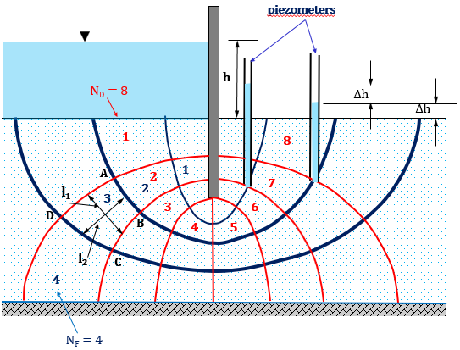
Consider a pair of flow lines
Let us consider the flow through abcd delimited by two flow lines and two equipotentials
$$∆h=\frac{h}{N_{D}}$$
The hydraulic gradient is :
$$i=\frac{∆h}{l_{1}}= \frac{h}{(N_{D}.l_{1})}$$
where l₁ – distance between the two equipotentials;
l₂ – distance between the two flow lines
$$v=K.i=K\frac{∆h}{(l_{1})}$$
Applying Darcy´s law, the velocity in the tube ABCD is
The flow passing into ABCD, per 1 m width of soil is
$${∆q}_{ABCD}=Area. velocity= l_{2}.1.K.\frac{∆h}{l_{1}}$$
If the FLOW NET l₁ = l₂ („squared mesh)
$${∆q}_{ABCD}=K.\frac{h}{N_{D}}$$
$$q=N_{f} ∆q$$
N_{f} – number of flow tubes
The total flow rate is:
$Q=q.$b
b is width perpendicular to the 2D seepage plane:

Slide 13
QUANTITY OF SEEPAGE (Q)
$$Q=kh_{L}\frac{N_{f}}{N_{d}}$$
number of flow channels
….per unit length normal to the plane
number of equipotential drops
head loss from upstream to downstream
h_{L}
concrete dam
impervious strata

Slide 14
HYDRAULICS OF WELLS

Slide 15
WELL HYDRAULICS
A water well is a hydraulic structure that is designed and constructed to permit economic withdrawal of water from an aquifer
Water well construction includes:
Selection of appropriate drilling methods
Selection of appropriate completion materials
Analysis and interpretation of well and aquifer performance

Slide 16
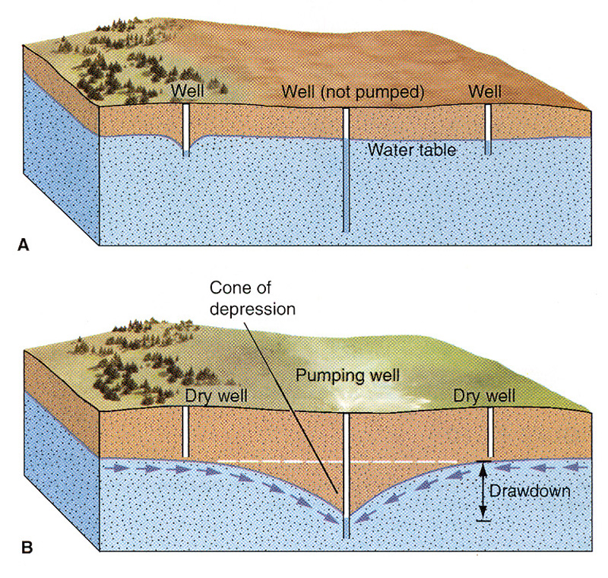
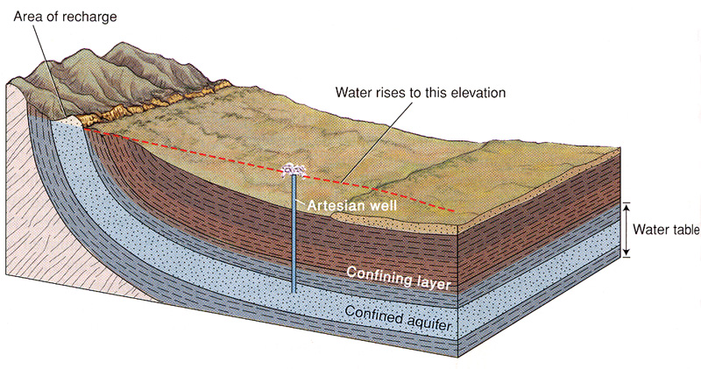
WELLS
Well - a deep hole dug or drilled into the ground to obtain water from an aquifer
For wells in unconfined aquifers, water level before pumping is the water table
Water table can be lowered by pumping, a process known as drawdown
Water may rise to a level above
the top of a confined aquifer,
producing an artesian well

Slide 17
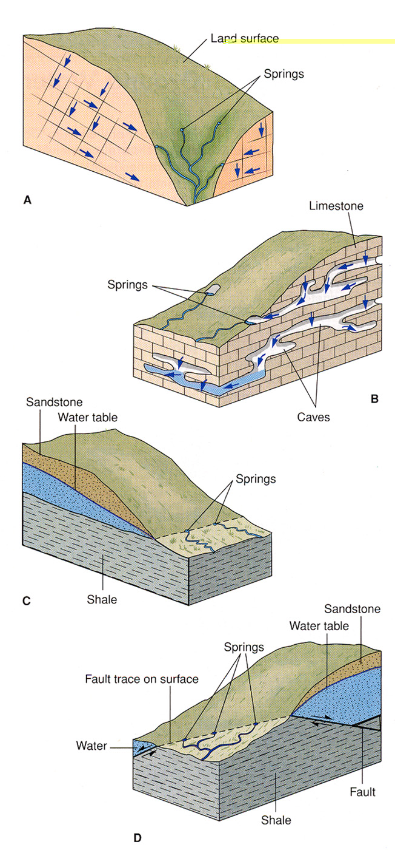
SPRINGS
Spring - a place where water flows naturally from rock or sediment onto the ground surface

Slide 18
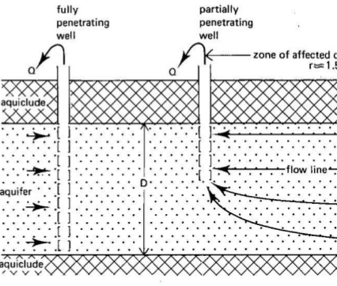
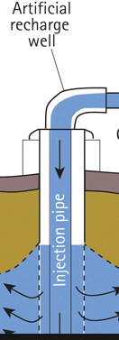
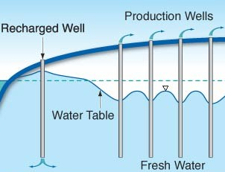
WELL
- Unconfined aquifer
- Confined aguifer
- (Artesian aquifer)
B) – Fully penetrating
- Partially penetrated
C) – Dug
- Drilled
D) – Discharge (Production, pumped)
- Recharge

Slide 19
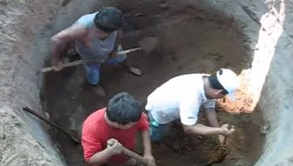
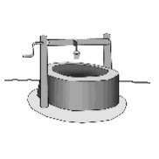
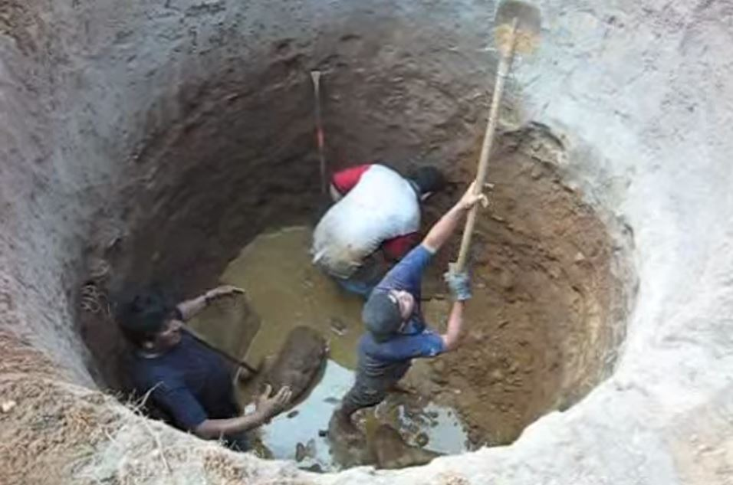
ADVANTAGES AND DISADVANTAGES
Dug Well
Advantages:
High degree of involvement of the local community during the whole process
Under supervision, no skilled workers are required
Simple equipment sufficient for both construction and maintenance
Low cost for construction
Involvement of private sector possible (local well diggers)
Yield can be increased after construction
Reservoir included (large diameter)
Disadvantages:
Long construction phase
Dangerous excavation
Application restricted to regions with rather soft geological formation and relatively high groundwater levels
Alteration of groundwater level can adversely affect the surrounding environment
People (i.e. children) can fall in if the well is uncovered

Slide 20
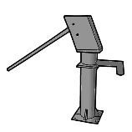
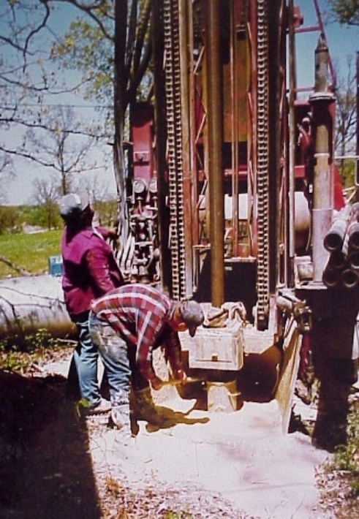
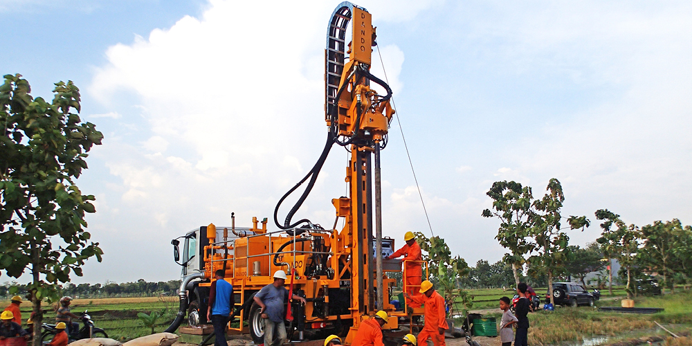
ADVANTAGES AND DISADVANTAGES
Disadvantages:
Skilled staff and experts required for drilling
Pump required
Lower yield than hand-dug wells (smaller diameter)
Overexploitation may lead to adverse effects on the environment
More technical equipment and skills necessary for construction
No integrated storage capacity
Drilled Well
Advantages:
Quicker and cheaper to sink than hand-dug wells
Less susceptible to contamination
No dewatering during sinking required
Safer in construction and use
The well itself needs barely maintenance
Many simple drilling techniques available suiting many geological conditions

Slide 21
well digging

Slide 22
PUMPING WELL TERMINOLOGY
Q
Static Water Level [SWL] (H) is the equilibrium water level before pumping commences
Pumping Water Level [PWL] (h) is the water level during pumping
Drawdown (s = H - h) is the difference between SWL and PWL
Well Yield (Q) is the volume of water pumped per unit time
Specific Capacity (Q/s) is the yield per unit drawdown
SWL
PWL
s
H
h

Slide 23
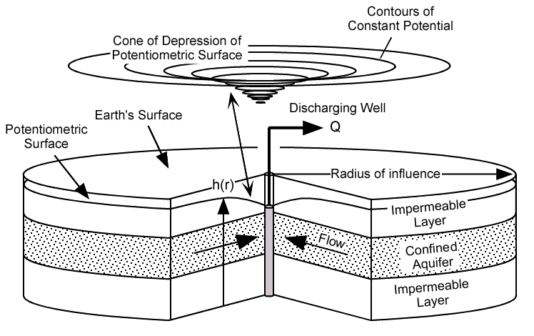
Details on the geometry of drawdown and the “cone of depression”.

Slide 24
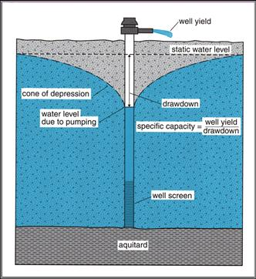
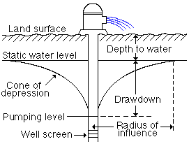
Some useful terms to know:
Cone of depression
Drawdown, s
Radius of influence, R
Specific capacity, q

Slide 25
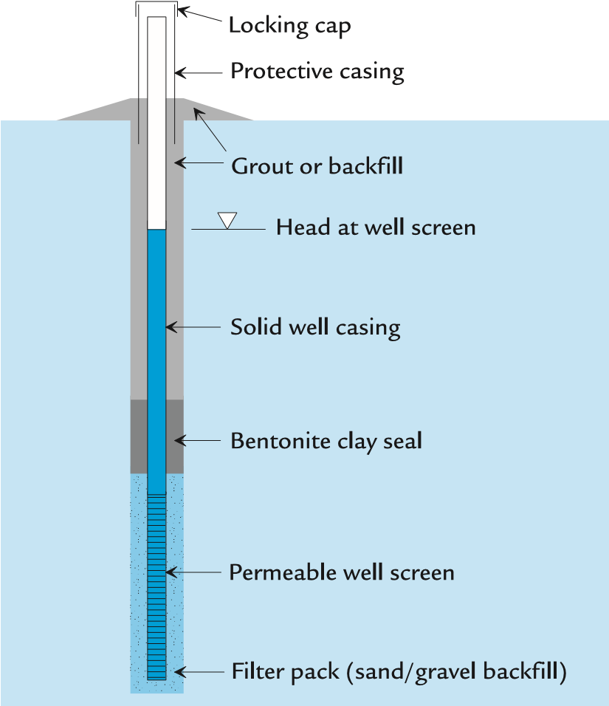
SCHEMATIC OF A TYPICAL WELL INSTALLATION
Well screen
perforated pipe or slotted pipe
Well screen (holds back sediments while allowing water to infiltrate the well)
Filter pack (sand / gravel)
extends at least 0.5 m above well screen
(prevents the well screen from becoming clogged)
Casing
PVC or Steel
(prevents the well from collapse)
Seal
Grout, bentonite, cement
Well development
purge and surge
pump till clean

Slide 26
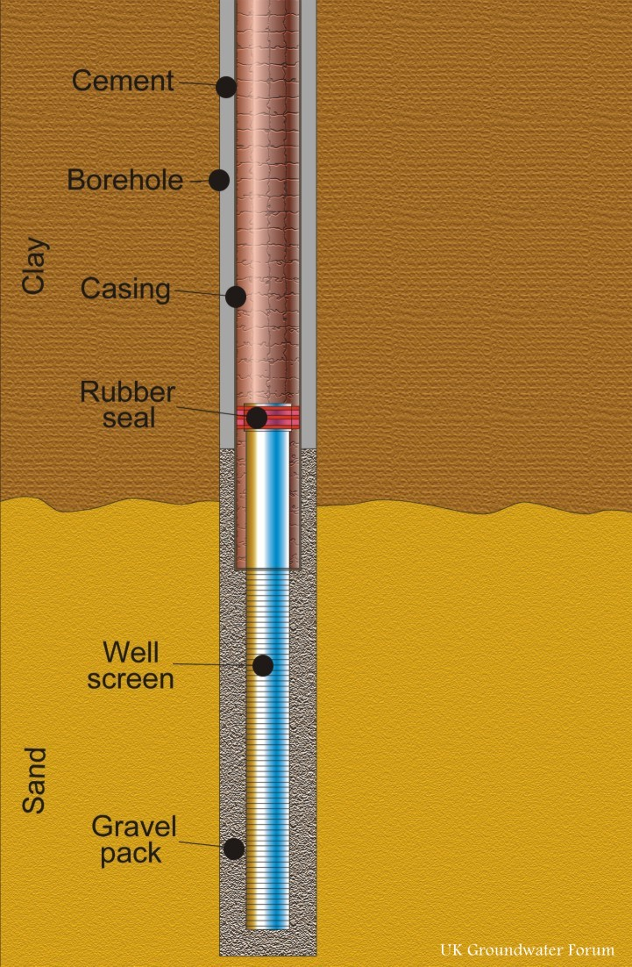
WELL COMPONENTS
Borehole diameter
Depth and length of screen
Filter pack
Seal necessary
BOREHOLE DIAMETERS
Piezometers: 2.5 – 5 cm
Monitoring wells: 5 – 20 cm
Domestic supply: 10 – 40 cm
Public water supply: 20 cm

Slide 27
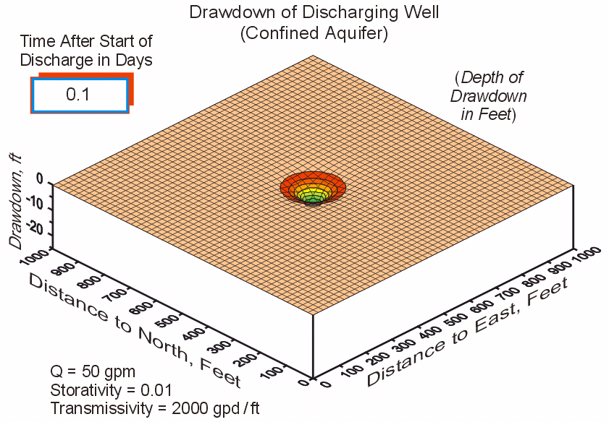

Slide 28
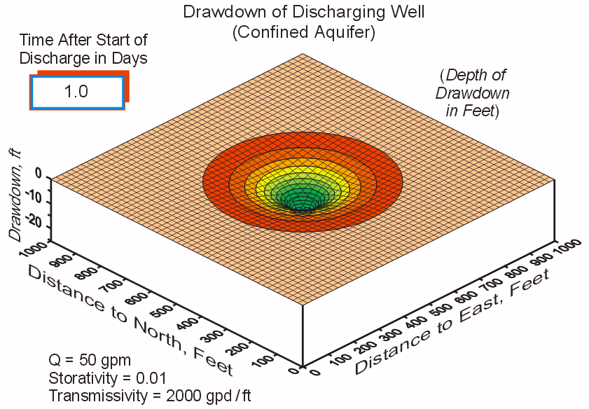

Slide 29
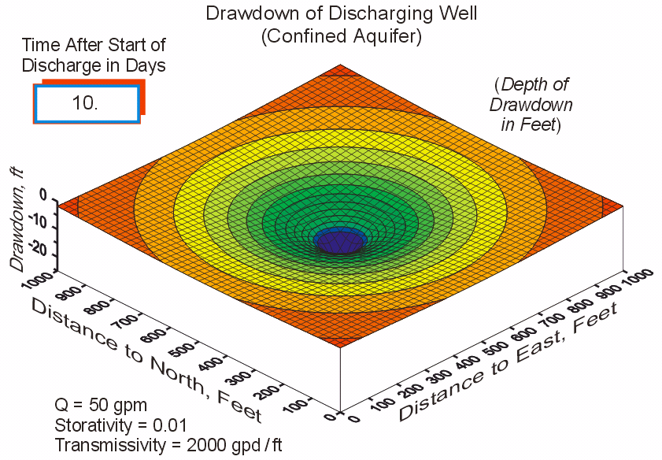

Slide 30
AQUIFER CHARACTERISTICS
PUMP TESTS allow estimation of transmission and
storage characteristics of aquifers
Transmissivity (T = Kb) is the rate of flow through a vertical strip of aquifer (thickness b) of unit width under a unit hydraulic gradient
Storage Coefficient (S = S_{y} + S_{s}b) is storage change per unit volume of aquifer per unit change in head
Radius of Influence (R) for a well is the maximum horizontal extent of the cone of depression when the well is in equilibrium with inflows

Slide 31
BASIC ASSUMPTIONS
The aquifer is homogeneous and isotropic.
All flow is radial toward the well.
Ground water flow is horizontal.
Darcy’s law is valid.
Ground water has a constant density and viscosity.
The pumping well and the observation wells are fully penetrating aquifer.
The pumping well has an infinitesimal diameter and is 100% efficient.

Slide 32
STEADY FLOW - WELL

Slide 33
PUMPING TEST PLANNING
Pump tests will not produce satisfactory estimates of either aquifer properties or well performance unless the data collection system is carefully is addressed in the design.
Several preliminary estimates are needed to design a successful test:
Estimate the maximum drawdown at the pumped well
Estimate the maximum pumping rate
Evaluate the best method to measure the pumped volumes
Plan discharge of pumped volumes distant from the well
Estimate drawdowns at observation wells
Simulate the test before it is conducted
Measure all initial heads several times to ensure that steady-conditions prevail
Survey elevations of all well measurement reference points

Slide 34
ADVANTAGES OF PUMPING TESTS
Measure parameters in situ.
Average parameters over a large volume.
Measure T and S simultaneously.
DISADVANTAGES OF PUMPING TESTS
High cost.
Non-uniqueness of T and S results.

Slide 35
STEADY RADIAL FLOW to well- confined aquifer
Assumptions:
The aquifer is horizontal and has a constant thickness and its boundaries go to infinity..
The aquifer is homogeneous and isotropic.
The water table is horizontal before pumping.
Darcy´s law is valid for the flow in the aquifer.
Water is instantaneously removed from storage as the piezometric head declines.
The pumping rate of well is constant.
The flow is symmetric with respect to the axis of the well.

Slide 36
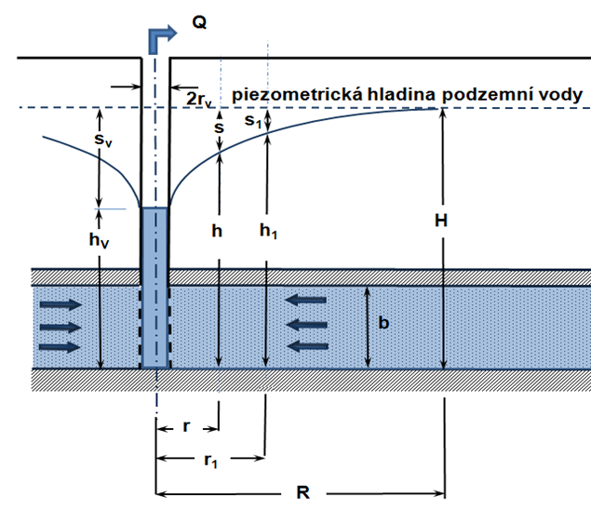
STEADY RADIAL FLOW - confined aquifer
Hydraulic head: h=z+p/γ
Piezometric water level
Continuity equation
$$Q =S.v_{r}$$
$$v_{r} =−K\frac{dh}{dr}$$
$$S =2πr b$$
$$Q =S.v_{r}=2πrb K\frac{dh}{dr}$$
Boundary condition
$$r = r_{v} ...... h = h_{v} \\ r = R ....... h = H$$
$$\int_{h_{v}}^{H}{dh} = \frac{Q}{2πKb} \int_{r_{v}}^{R}{\frac{dr}{r}} ⇒ H−h_{v}=s_{v}=\frac{Q}{2πKb}\ln{\frac{R}{r_{v}}}$$
This is the Thiem equation – steady state flow to a well (confined aquifer)

Slide 37
STEADY RADIAL FLOW - unconfined aquifer
Assumptions:
The aquifer is horizontal and has a constant thickness and its boundaries go to infinity.
The aquifer is homogeneous and isotropic.
The water table is horizontal before pumping.
Darcy´s law is valid for the flow in the aquifer.
The Dupuit assumptions are valid.
Water is instantaneously removed from storage as the piezometric head declines.
The pumping rate of well is constant.
The flow is symmetric with respect to the axis of the well.

Slide 38
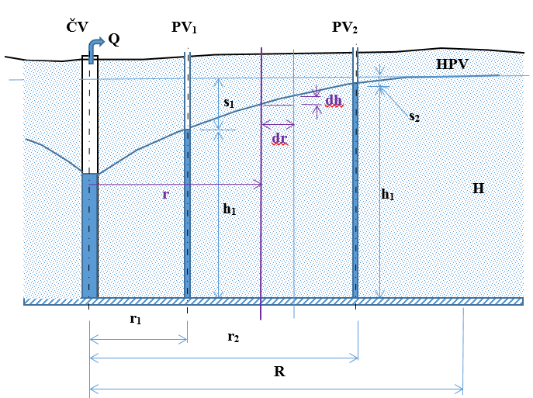
STEADY RADIAL FLOW – unconfined aquifer
PW
OW1
OW2
Continuity equation
$$Q =S.v_{r}$$
$$S =2.πrh$$
$$v_{r} =−K.I=−K.\frac{dh}{dr}$$
$$Q =2.πrh K\frac{dh}{dr}$$
$$\int_{h_{V}}^{H}{hdh} =\frac{Q}{2πK}\int_{r_{V}}^{R}{\frac{dr}{r}}$$
$${\left[\frac{h^{2}}{2}\right]}_{h_{V}}^{H} =\frac{Q}{2πK}{\left[\ln{r}\right]}_{r_{V}}^{R}$$
$$H^{2}−h_{V}^{2} =\frac{Q}{πK}\ln{\frac{R}{r_{V}}}$$
This is the Dupuit-Forchheimer equation –steady flow unconfined aquifer

Slide 39
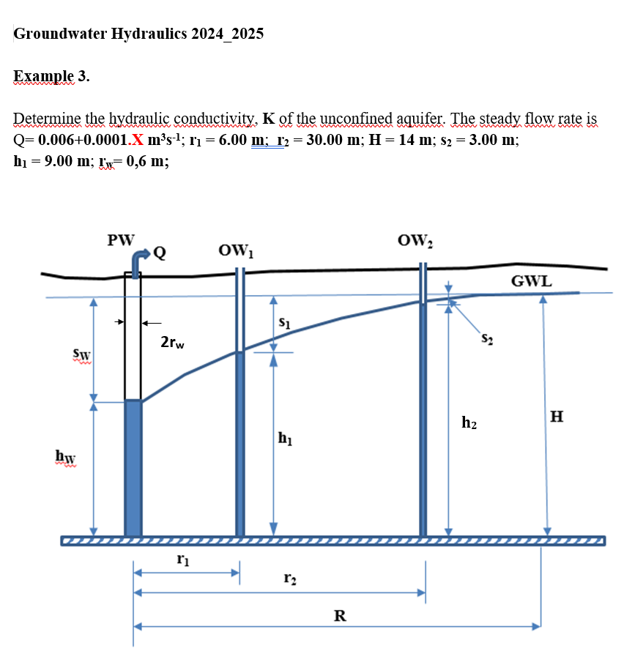

Slide 41
End
Lecture_6

