Slide 1

ZVX111E (ZVX130E)Groundwater Hydraulics
2025_2026
Lecture_8

Slide 2
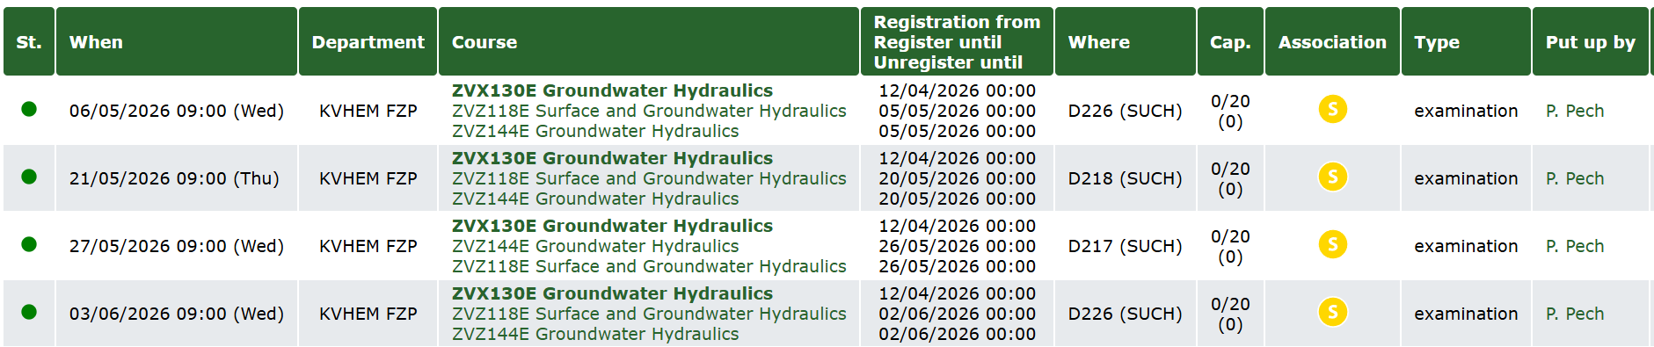
Groundwater Hydraulics - Exam Dates 2025–2026
Early exam date: 29/4/2026 - 8:30 – D220

Slide 3

“REAL WELL“ – SKIN EFFECT

Slide 4
Skin factor, W, refers to a region near the wellbore of improved or reduced permeability compared to the bulk formation permeability.
REASON FOR POSITIVE SKIN
Overbalanced drilling (filtrate loss)
Damaged perforations
Gravel pack
Partial completion
Fines migration after long term production
Non-darcy flow
Condensate banking (acts like turbulence)

Slide 5
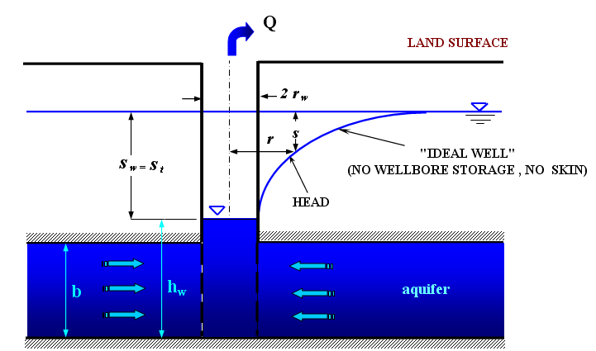
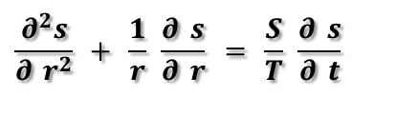
“IDEAL WELL“
- no additional resistances at a well
the well radius, r_{w} is infinitesimally
small (r_{w} ⟶ 0)
The partial differential equation describing radial flow to a well fully penetrating confined aquifer is (in cylindrical coordinates)
Drawdown around a production well (ideal well)
$$\frac{∂^{2}s}{∂ r^{2}} + \frac{1}{r} \frac{∂ s}{∂ r} = \frac{S}{T} \frac{∂ s}{∂ t}$$
Where s is drawdown; r is radial distance from well; S is storativity; T is transmisivity

Slide 6
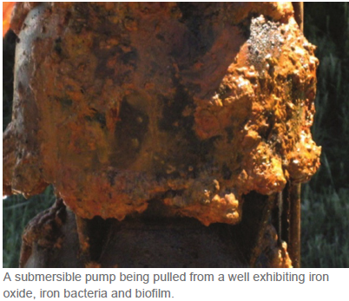
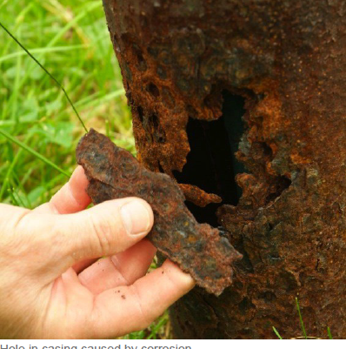
Real well (skin effect)
As a water well „ages“, the rate at which water may be pumped (commonly referred to as the well yield, flow or performance) tends to decrease,
More often, reduced well yield over time can be related
to changes in the water well itself including:
Incrustation from mineral deposits (Fe, Mn, Ca).
• Bio-fouling by the growth of microorganisms
• Physical plugging of "aquifer" (the saturated layer of
sand, gravel, or rock through which water is transmitted
by sediment
• Sand pumping
• Well screen or casing corrosion
• Pump damage

Slide 7
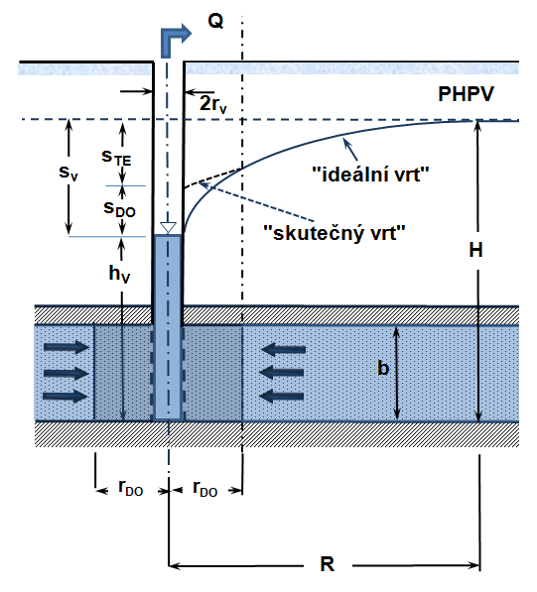
Real well (skin effect)
Total „skin drawdown„ (s_{skin})
Total skin is a summation of the following skin components:
Aquifer damage during drilling and completion (s_{c}) .
Skin due to damage (s_{d}).
Skin due to partial penetration (s_{pp}). for a partially penetrated well
Skin due to inclination (s_{inc}).
Skin due to turbulence or non-Darcy
flow (s_{turb}).
Other types of additional resistances (s_{pp}).
The value of additional drawdown (s_{skin}) is
PGWL
2r_{w}
s_{w}
s_{t}
s_{w}
real well
s_{skin}
theoretical drawdown
h_{w}
aquifer
r_{sk}
r_{sk}
Drawdown around a production well with skin effect and wellbore storage (real well)
s_{skin} = s_{c} + s_{d}+ s_{pp} + s_{inc} + s_{turb} + s_{O}
s_{w} = s_{t} + s_{skin}

Slide 8
Real well (skin effect)
Major changes in any of the following well characteristics is an indication that your well or pump is in need of attention:
Decreased pumping rate
• Decreased water level
• Decreased specific capacity
• Increased sand or sediment content in the water
• Decreased total well depth
The two most common methods to rehabilitate a water well are:
• chemicals to dissolve the incrusting materials from the well
• physically cleaning the well

Slide 9


Real well (skin effect)
THE SKIN EFFECT
The additional resistance is due to hydromechanical, chemical, and biological
factors that occur during drilling or completion operations, and during the exploitation
of a well. This additional resistance causes an additional drawdown at a “real” well ( s_{skin}).
The drawdown at the “real” well (with skin and wellbore storage
s_{t} is drawdown at an “ideal” well , and s_{skin} is additional drawdown at a well
caused by additional resistance.
Equation (1) indicates that the drawdown at a “real“ well differs
from drawdown at an “ideal“ one by an additive amount
where Q is pumping rate, T is transmissivity, and W is skin factor.
$$s_{w}=s_{t}+s_{skin}$$
van Everdingen, 1953
$$s_{skin}=\frac{Q}{2πT}W$$

Slide 10
Real well (skin effect)
Assumptions for the solution of the basic equation of usteady flow to the well
confined aquifer
pumping rate Q = const.
Darcy´s law is valid
all flow is radial to well
well is fully penetrating
flow is horizontal
potentiometric surface steady prior to pumping
- homogeneous, isotropic, infinite areal extent
- pumping well fully penetrates and receives water from
the entire thickness of the aquifer
transmissivity is constant in space and time
storativity is constant in space and time
- well has finite diameter, d
water removed from storage is discharged instantaneously
Additional resistances (skin effect) ≠0

Slide 11
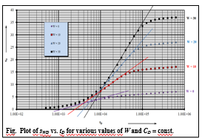

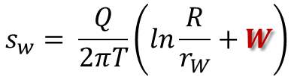
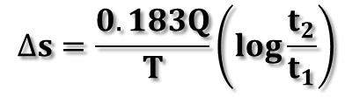
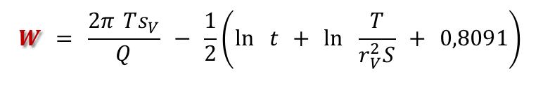
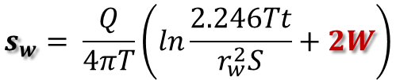
Steady flow (confined aquifer)
Skin factor-W
$$s_{w}= \frac{Q}{2πT}\left(ln\frac{R}{r_{W}}+W\right)$$
Unsteady flow
a) Theis solution:
$$s_{w}= \frac{Q}{4πT}\left(W\left(u\right)+2W\right)$$
b) For t_{D} > 25 ( Cooper-Jacob semilog. method)
$$s_{w}= \frac{Q}{4πT}\left(ln\frac{2.246Tt}{r_{w}^{2}S}+2W\right)$$
$$W = \frac{2π Ts_{V}}{Q} − \frac{1}{2}\left(\ln{ }t + \ln{ }\frac{T}{r​_{V}^{2}​S} + 0,8091\right)$$
For drawdown s₁ (time t₁ ) and s₂ (time t₂ )
$$s_{2}{− s}_{1}= ∆s=\frac{0.183Q}{T}\left(log\frac{2.246T}{r_{w}^{2} S}+\log{t_{2}}−log\frac{2.246T}{r_{w}^{2} S}−\log{t_{1}}\right)$$
and
$$∆s=\frac{0.183Q}{T}\left(log\frac{t_{2}}{t_{1}}\right)$$
Transmisivity, T
Storativity, S -The storativity is determined from data at the observation well in the same way as for an ideal well

Slide 12

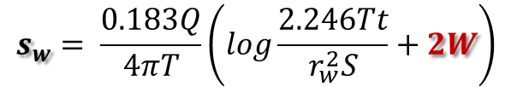
Skin factor-W
$$s_{w}$$
Cooper-Jacob’s semilog approximation
s
$$s_{w}= \frac{0.183Q}{4πT}\left(log\frac{2.246Tt}{r_{w}^{2}S}+2W\right)$$
Fig. Pumping test at a well (Cooper- Jacob’s semilogarithmic approximation)

Slide 13
Skin factor-W
Cooper-Jacob’s semilog approximation
s_{WD}
The first straight line
Influence of the skin and wellbore storage
Fig. Graph s_{WD} vs. log t_{D} for a well with wellbore storage and skin ( C_{D} = 100; W = 10)

Slide 14
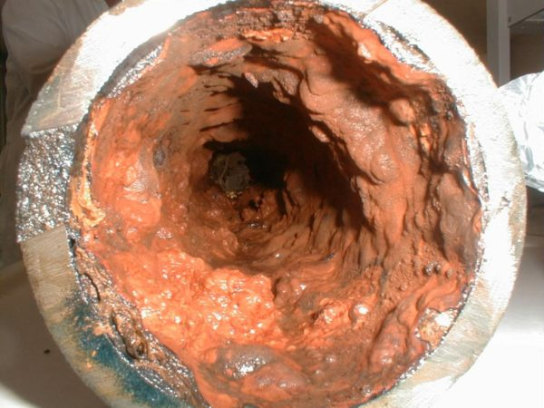
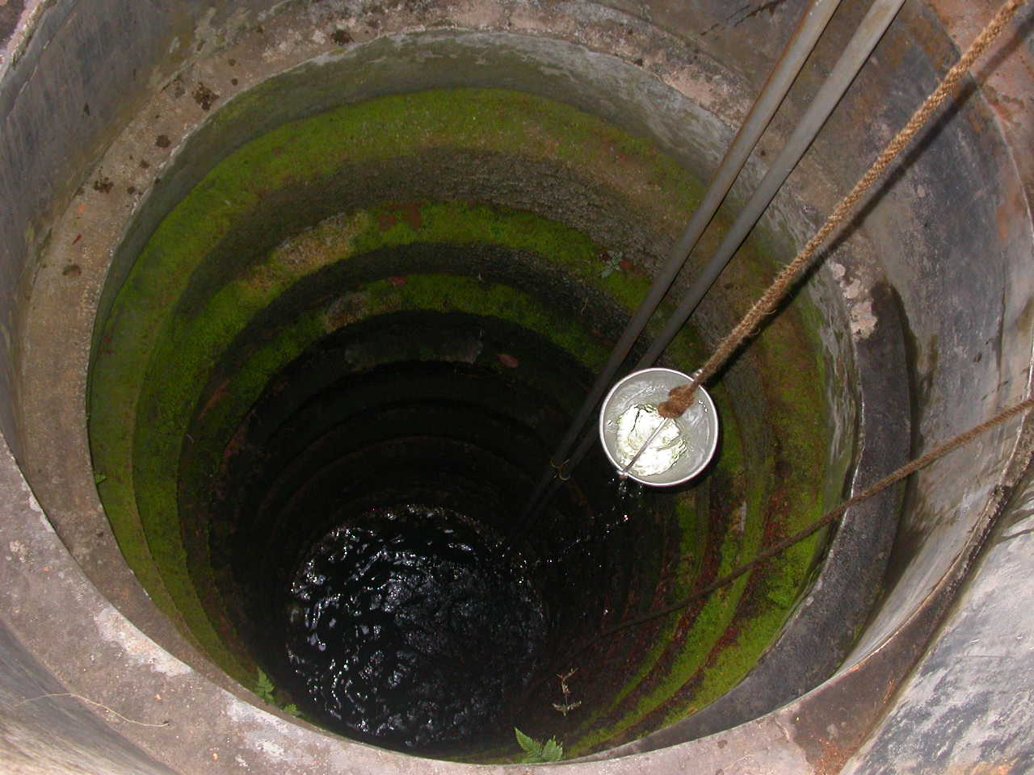
Evaluation of the well rehabilitation
WELL – HV at Veselí nad Lužnicí – mechanical rehabilitation (figures)
Well radius .......................... r_{W} = 1.5 m
Well depth............................. h = 9 m
Jacob’s semilogarithmic approximation :
Transmissivity ............................. T = 0,0109 m² s⁻¹
Storativity .................................. S = 0,13
Dimensionless Wellbore Storage C_{D} = 5.8
Before rehabilitation After rehabilitation 1 year after rehabilitation
Q(m³.s⁻¹) 3.35x10⁻³ 3.7x10⁻³ 3.52x10⁻³
Length of the aquifer test (min) 180 240 75

Slide 15
Evaluation of the well rehabilitation
Parameters -HV:
Q = 0.0037 m³s⁻¹
r_{W} = 1.5 m
T = 0.0109 m²s⁻¹
S = 0.13
C_{D} = 5.8
s_{W}
t’
t(s)
Fig. Graph of s_{w} vs. log t – before rehabilitation
s_{W}
s_{W}
t’
t’
Fig. Graph of s_{w} vs. log t – after rehabilitation
Fig. Graph of s_{w} vs. log t – 1 year after rehabilitation
Evaluation
Before rehabilitation After rehabilitation 1 year after rehabilitation
Skin factor, W 43 15 19
s_{skin} (m) 1.02 0.36 0.45
back

Slide 16
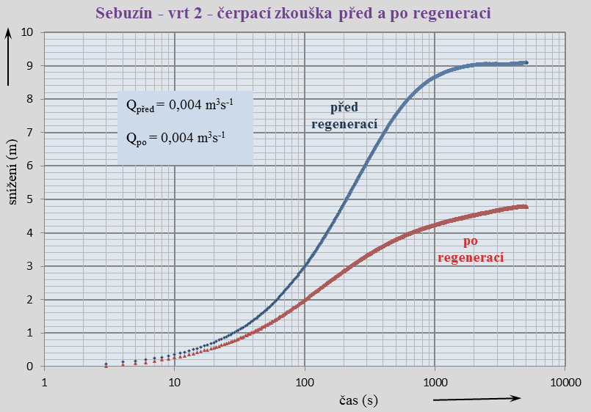
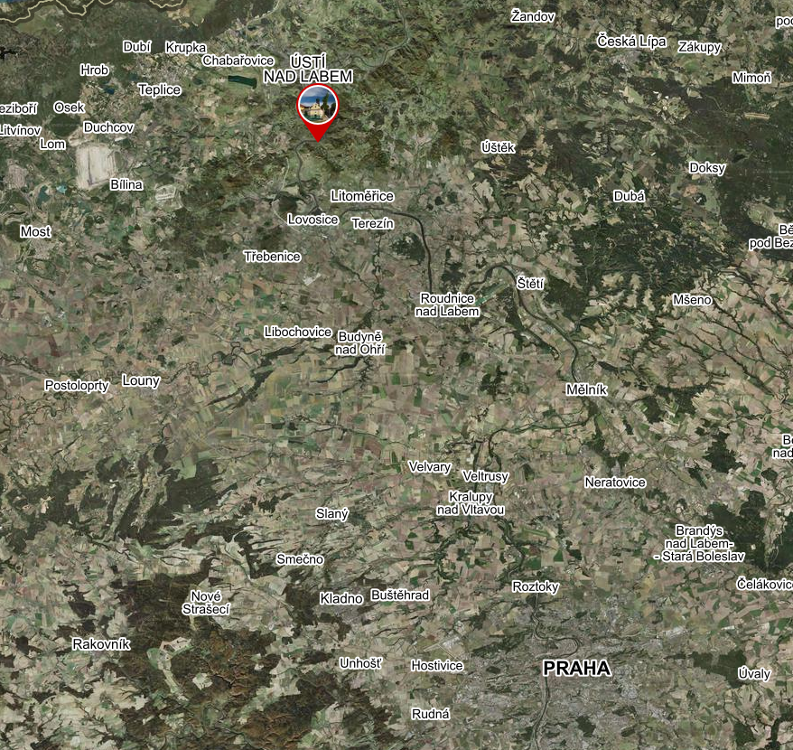
Evaluation of the well rehabilitation
Sebuzín – well- 2 – pumping test before and after reg.
Sebuzín – well -2
Before reg | After reg
Q = 0.0022 m³s⁻¹ | Q = 0.0022 m³s⁻¹
i₁ = 3.67 | i₁ = 1.11
W = 9.9 | W = 1.1
Q_{before}
before
cleaning
Q_{after}
i₁ = 3.67
after
cleaning
i₁ = 1.11
Time (s)

Slide 17
End

