Slide 1
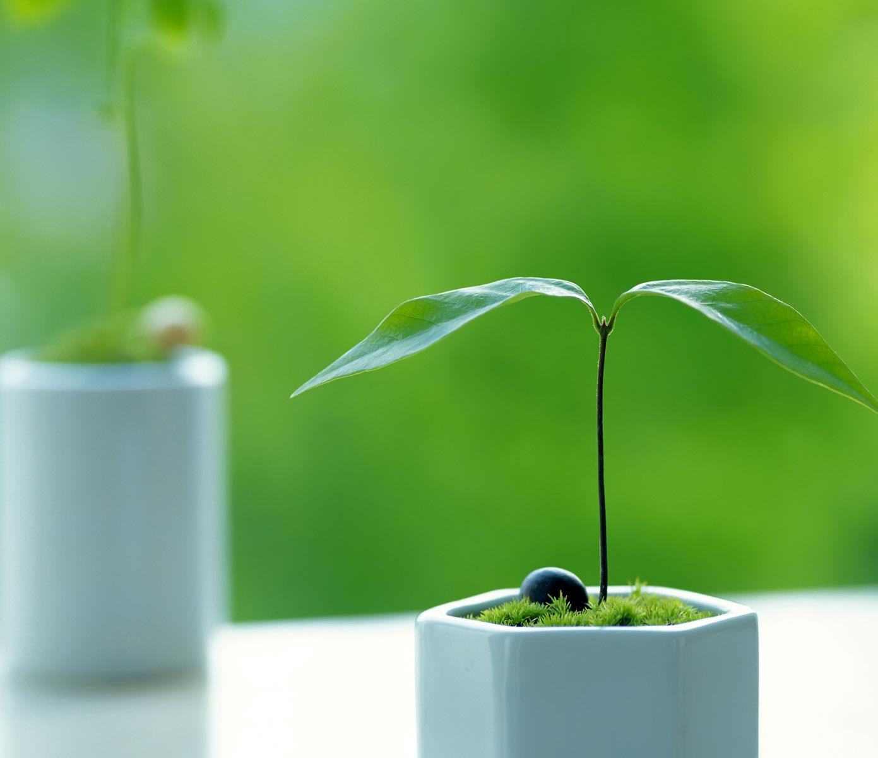
Soil and Plant Relationships
2023
Assoc. Prof. Martin Kulhánek
A357
kulhanek@af.czu.cz

Slide 2
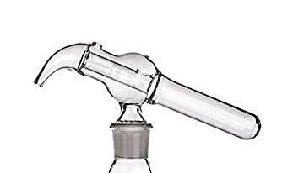
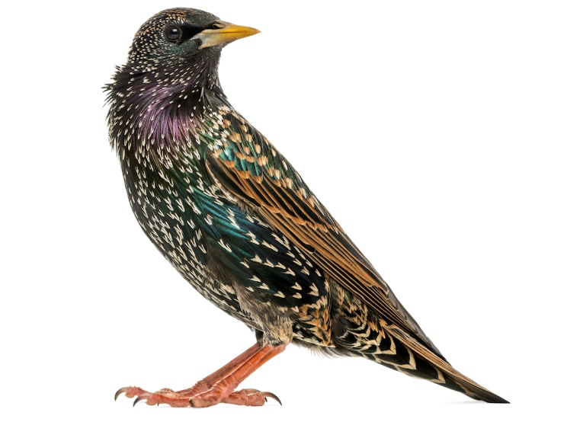
Preparation for the analysis
Tilt measure
Starling

Slide 3
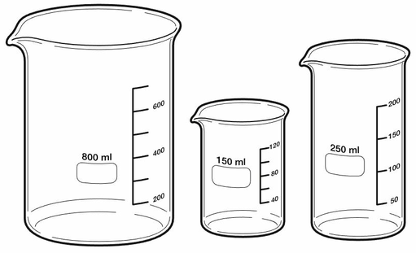
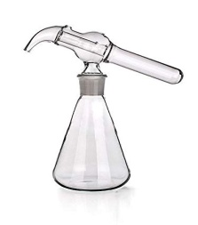
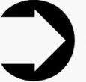
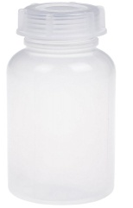
Preparation for the analysis
1. 5 g of soil
Stirring
Exchangeable pH
0.2 M KCl
2. 5 g of soil
30 min. shaking
Active pH
Water
3. 5 g of soil
5 min. shaking
Bioavailable K
M3
Tilt measure (50 mL)

Slide 4
1. pH value
The negative decadic logarithm of the concentration of hydrogen (oxonium) ions in solution.
2. Soil pH
The concentration of H⁺ and OH⁻ ions in soil has no direct effect on plant growth
Significant direct influence on a wide range of factors directly related to plant growth

Slide 5
Příklady poměrů pH a pOH v roztoku ke koncentracím kyselých a zásaditých roztoků
Acidity |  | Alkalinity
pH | Concentration of H⁺ | Concentration of OH⁻ | pOH
0 | 1.0 | 0.00000000000001 | 14
1 | 0.1 | 0.0000000000001 | 13
2 | 0.01 | 0.000000000001 | 12
3 | 0.001 | 0.00000000001 | 11
4 | 0.0001 | 0.0000000001 | 10
5 | 0.00001 | 0.000000001 | 9
6 | 0.000001 | 0.00000001 | 8
7 | 0.0000001 | 0.0000001 | 7
8 | 0.00000001 | 0.000001 | 6
9 | 0.000000001 | 0.00001 | 5
10 | 0.0000000001 | 0.0001 | 4
11 | 0.00000000001 | 0.001 | 3
12 | 0.000000000001 | 0.01 | 2
13 | 0.0000000000001 | 0.1 | 1
14 | 0.00000000000001 | 1.0 | 0

Slide 6
3. Soil pH importance
3.1. Influences - nutrient availability
- solubility of all compounds in the soil
- the proportion of ions bound in the
soil sorption complex
- microbial activity
- soil structure
MANGAN
BÓR
MĚĎ A ZINEK
MOLYBDEN

Slide 7
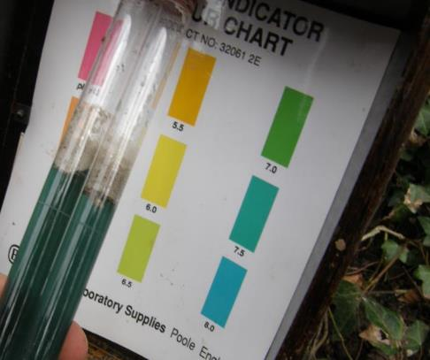
4. The methods of pH determination
4.1. Colorimetric measurement
Can be used directly on the field
Quick method
Cheap
Less accuracy
Not often used in labs

Slide 8
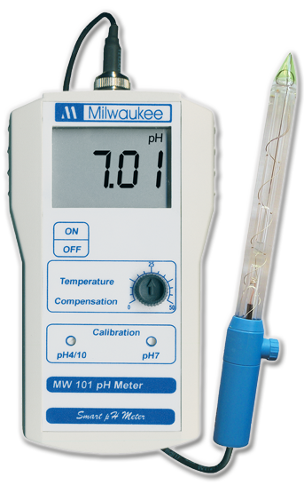
4. The methods of pH determination
4.2. Electrometric measurement
Commonly used in labs
High accuracy
Reliability
Usually more functions
Lab and fields
More expensive
Longer sample preparation

Slide 9
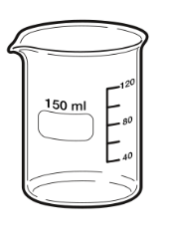
Active acidity
Solution
5. Types of pH analysis
H
K⁺
Ca
K
H⁺
Ca²⁺
Ca
H₂O →
K
H⁺
H
H
K⁺
H⁺
H⁺
H
Active acidity pH
  Water extract
    (ratios: 1 part of sample:5 part of water; 1:10; 1:25)
  Used commonly for garden substrates

Slide 10
Solution
Exchangeable pH
5. Types of pH analysis
K⁺
H
⁺
K⁺
Ca
K
H⁺
K⁺
Ca²⁺
Ca
0,2 M KCl →
K
H⁺
K⁺
⁺
⁺
H
⁺
H
⁺
⁺
K⁺
⁺
H⁺
H⁺
⁺
H
Exchangeable pH
  0,01 mol/l CaCl₂ – pH_{CaCl2} (pH/CaCl₂) – CISTA (Czech)
  0,20 mol/l KCl – pH_{KCl} (pH/KCl)
    Comparable (almost identical results of pH_{CaCl2} and pH_{KCl})
    Exchangeable pH is usually lower than active

Slide 11
6. Interpretation of measured pH values
Optimal pH_{KCl} values of mineral soils (Vaněk et al., 2012)
Soil texture | culture
 | arable soil | permanent grassland
Sandy | 5.5 | 5.0
Loamy-sand | 6.0 | 5.0
Sandy-loam | 6.5 | 5.2
Loamy, clayey | 7.0 | 5.5

Slide 12
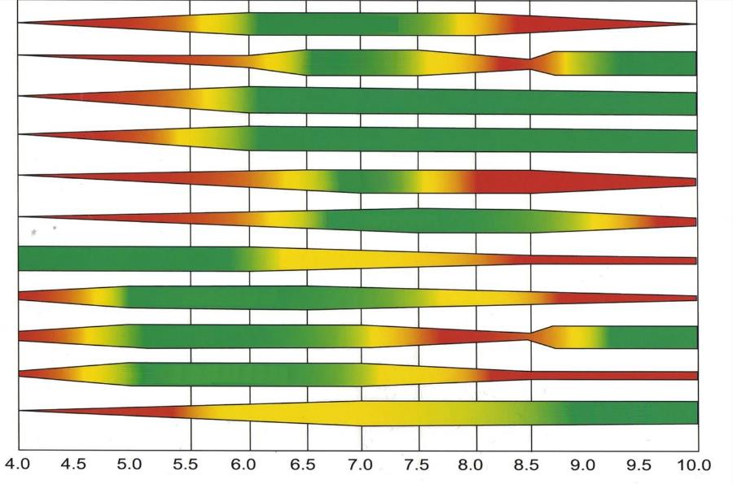
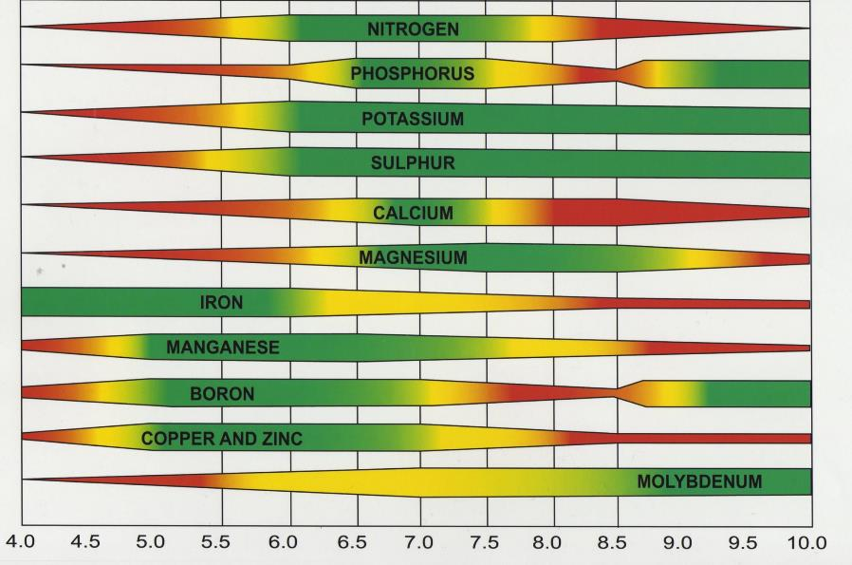
8. Influence of pH_{KCl} on nutrients availability
5.5
7.3
NITROGEN
PHOSPHORUS
POTASSIUM
SULFUR
CALCIUM
MAGNESIUM
IRON
MANGANESE
BORON
COPPER AND ZINC
MOLYBDENUM
pH

Slide 13
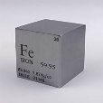
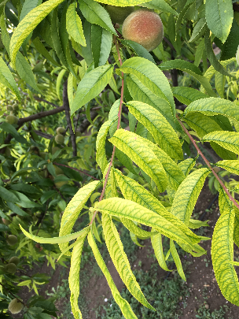
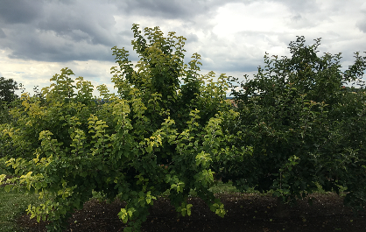
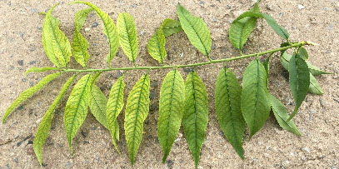
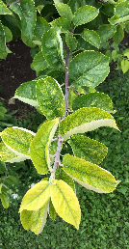
Iron deficiency related to high soil pH
Particularly susceptible garden plants, corn, potatoes, sorghum, beans
Young leaves

Slide 14
9. pH and electric conductivity (EC) – related to salinity
Humid climate
Arid climate
9.1. Climatic conditions
9.2. Soil properties
- Parent rock
- Cation exchange capacity …
9.3. Influence of mineral fertilizers
9.4. Influence of vegetation
9.1. Climatic conditions
PRECIPITATIONS
TRANSPIRATION
TRANSPIRATION
PRECIPITATIONS
base leaching and pH drop
salts accumulation and pH increase

Slide 15
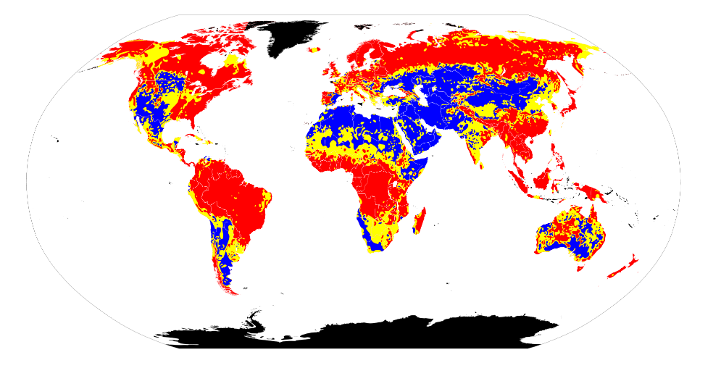
Soil pH (salinity) around the world

Slide 16
Electric conductivity evaluation
Upper conductivity values for substrates (mS/cm)
Substrate type | w/v 1:5* | w/v 1:10 | w/v 1:25
Propagation, sensitive plants | 0.75 | 0.5 | 0.4
For seeding | 1.0 | 0.65 | 0.5
Growing substrate | 1.8 | 1.2 | 1.0
* w = weight of substrate; v = volume of water
Soil EC (mS/cm)
Salinity | w/v 1:10
Low | up to 0.70
Medium | 0.71 – 1.20
High | over 1.21

