Slide 1



Strategies of phosphorus nutrition
New AG
International
Annual
kulhanek@af.czu.cz
Assoc. Prof. Martin Kulhánek
Presentation for 10.4.2024

Slide 2




Presentation structure
Intro
Phosphorus cycles
Plants strategies for phosphorus acquisition
„New“ strategies to solve phosphorus deficiency

Slide 3



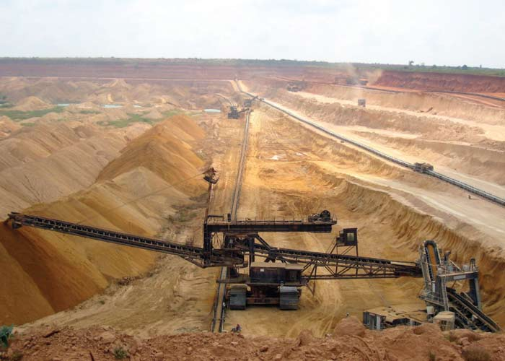
Phosphorus
  History and Nowadays
1669
P storage for 50-100 years

Slide 4
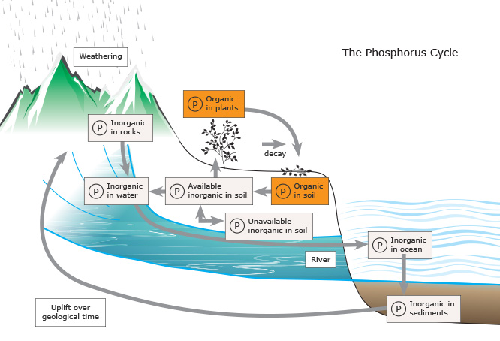



Global phosphorus cycle
P
Organic P in plants
P fertilizers
Organic P in soil
Organic P in ocean
University of Waikato (2013) - modified

Slide 5
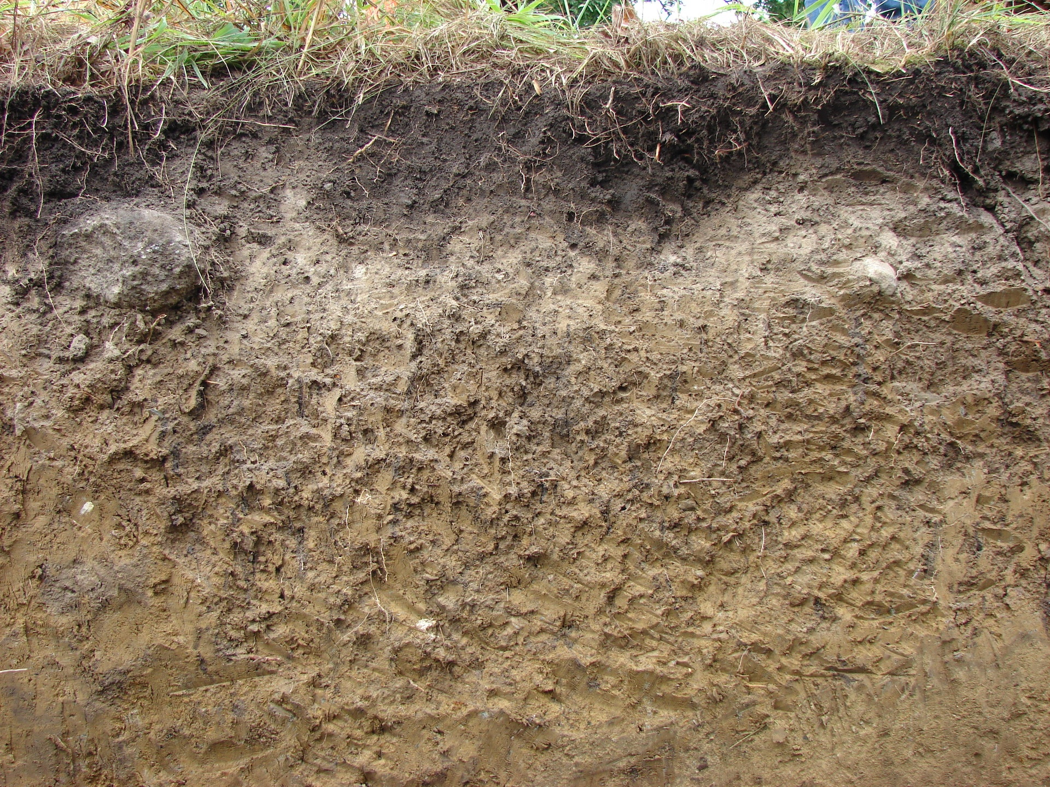
Phosphorus cycle in soil
P
Strongly sorbed
mineral P
Mobile organic and inorganic P
Strongly sorbed
Organic P
Mineral
fertilizers
Plant residues
Organic fertilizer
Primary P minerals
Chemically and Physically bonded
phosphorus
P in
soil
solution
Microbial
biomass phosphorus
Secondary P minerals
0,01 – 1 mg P L⁻¹
Occluded P
Exchangeable sorbed organic P
Mobile organic P
Mineral P 50-80% of total
Organic P 20-50% of total

Slide 6

Why plants developed different strategies for phosphorus acquistion?
Bioavailable soil P content <1 mg kg⁻¹ x plant P content >1000 mg kg⁻¹

Slide 7
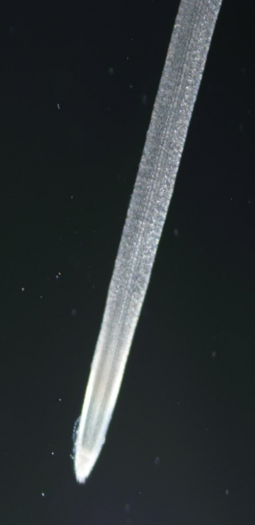
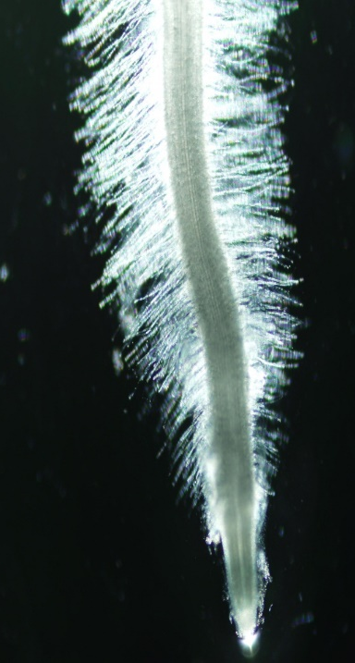
Plants strategies for phosphorus acquisiton
Root density
Root efficiency (metabolic)
Mycorrhiza
Root exudates
→ Acids
→ Enzymes
→ Phenolic compounds
Increased production of root hairs - hotspots:
Satisfactory P
Low P

Slide 8

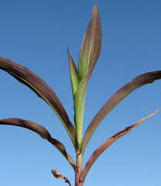
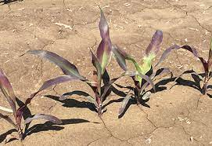
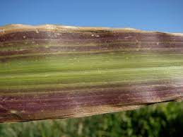
Maize

Slide 9
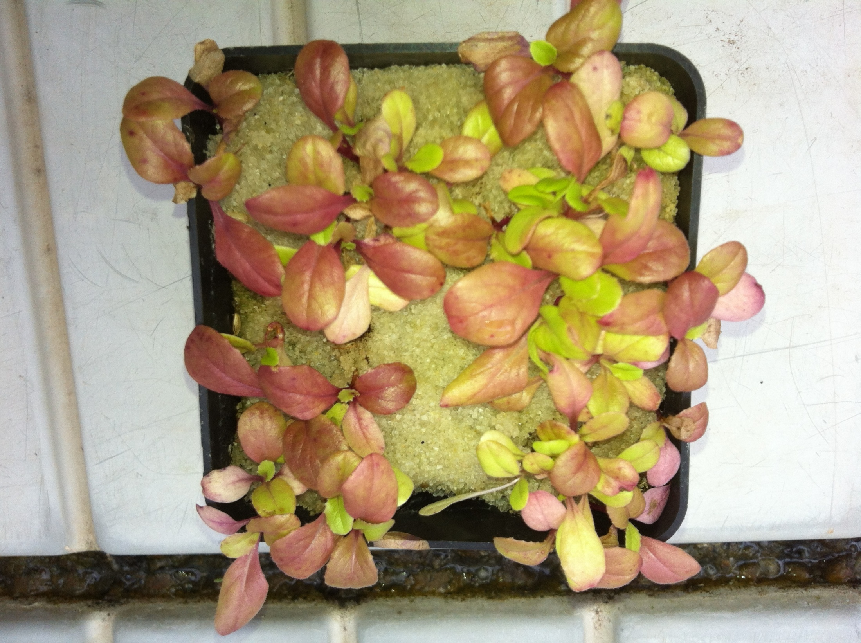
Lettuce
N, P

Slide 10
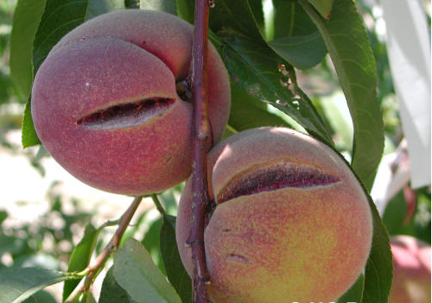
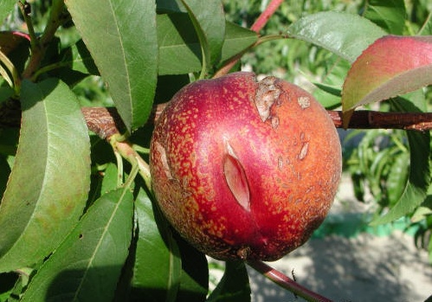
Peaches
P

Slide 11
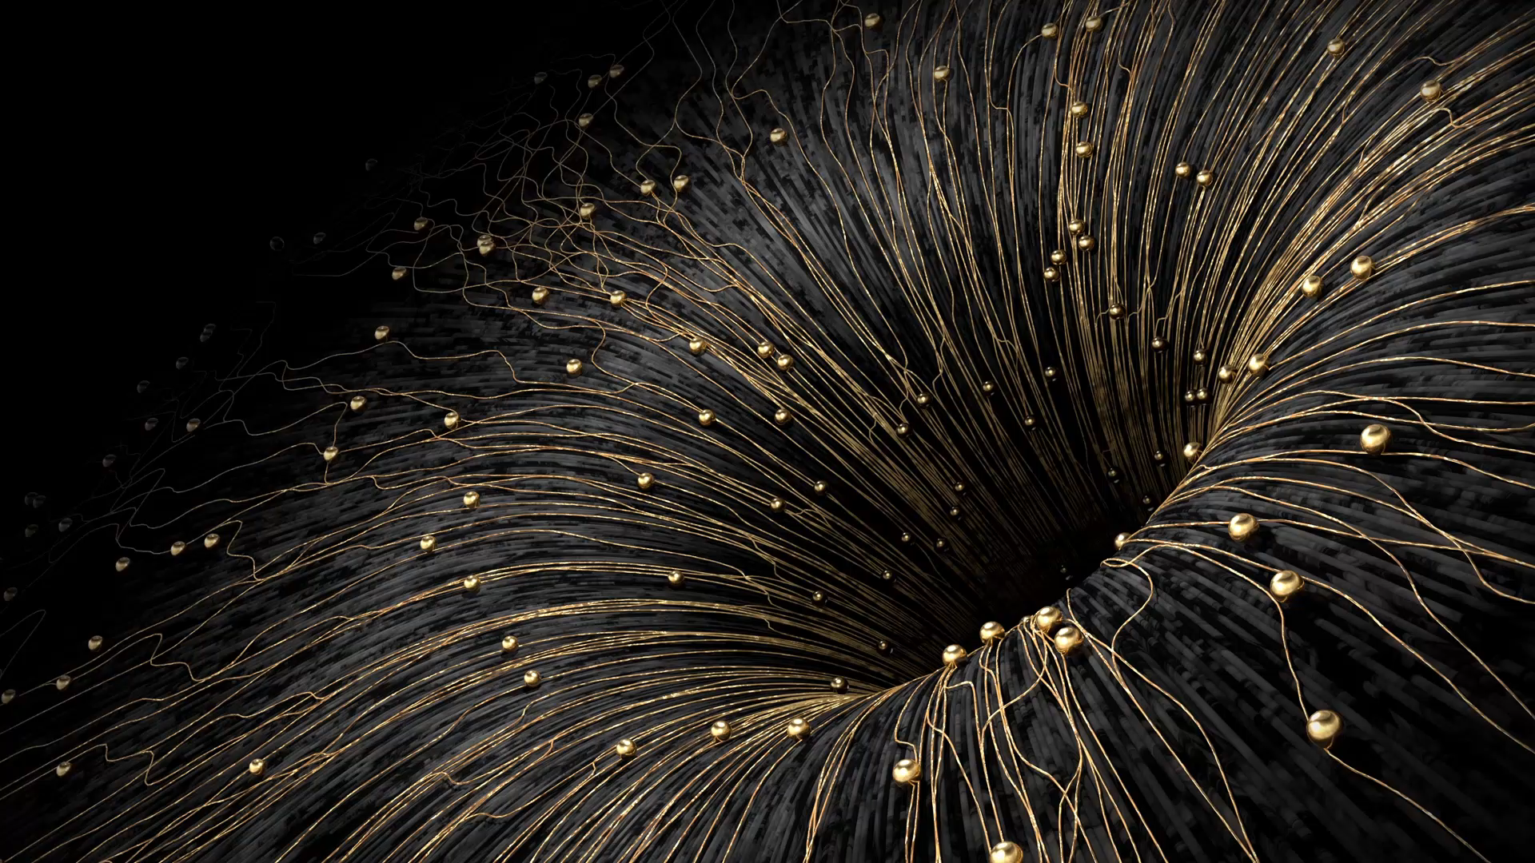

„New“ strategies to solve phosphorus deficiency.
Two pathways

Slide 12
Two main pathways to solve P defficiency
Improvement of phosphorus acquisition and/or use efficiency
Looking for „new“ phosphorus fertilizers

Slide 13

Correction of soil pH level

Slide 14
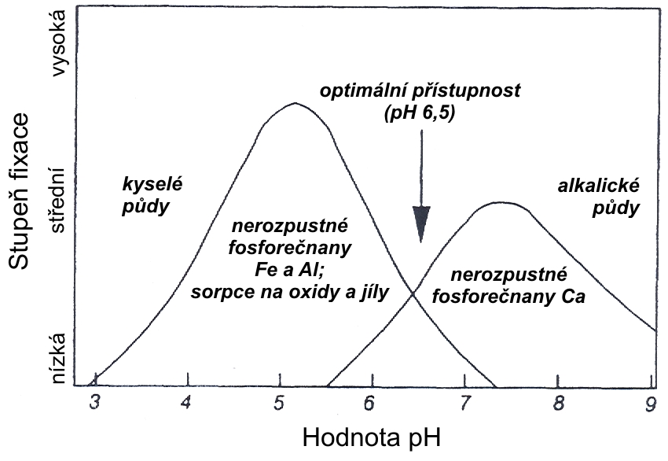
Correction of soil pH level
For new methods, old became often forgotten
strong
6.5)
Optimal P availability (pH_{CaCl2} 6.5)
Acid soils
Alcaline soils
medium
Fixation power
Hardly soluble
Fe-P, Al-P
Strong sorption on oxides and clays
Insoluble Ca-P
(pH 6.5)
6.5)
low
pH value

Slide 15
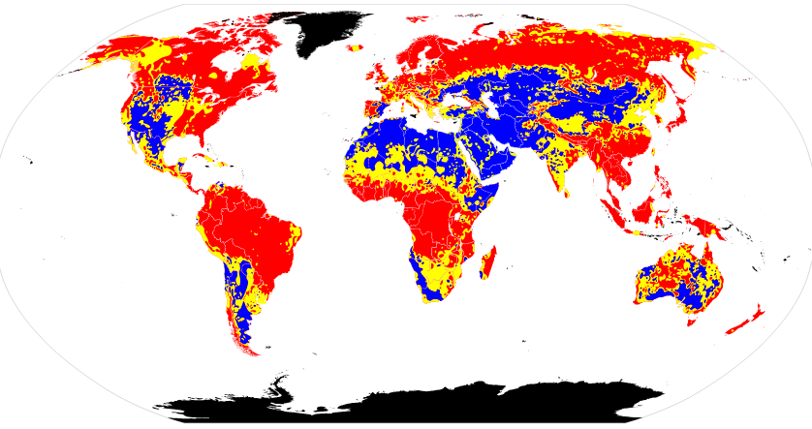
Soil pH around the world?
Strongly acidic
Mild
acidic
Alkaline

Slide 16
Necessary to consider other factors
„Liming makes the father rich, but the son poor “
With liming
Without liming
Plant yield
(crop rotation without legumes)
Time

Slide 17
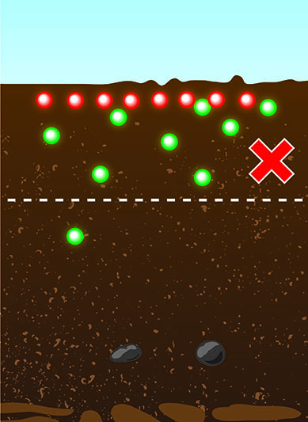
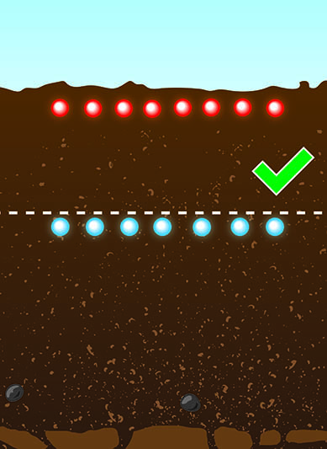
Local aplication of phosphorus fertilizers
Incorporation into soil profile
Local application
seeds
P-fertilizer
Balík J, Pavlíková D, Kulhánek M, Sýkora K (2003) Using of local application of phosphorus fertilizers in practice. Agrochémia, 7:11-13.

Slide 18
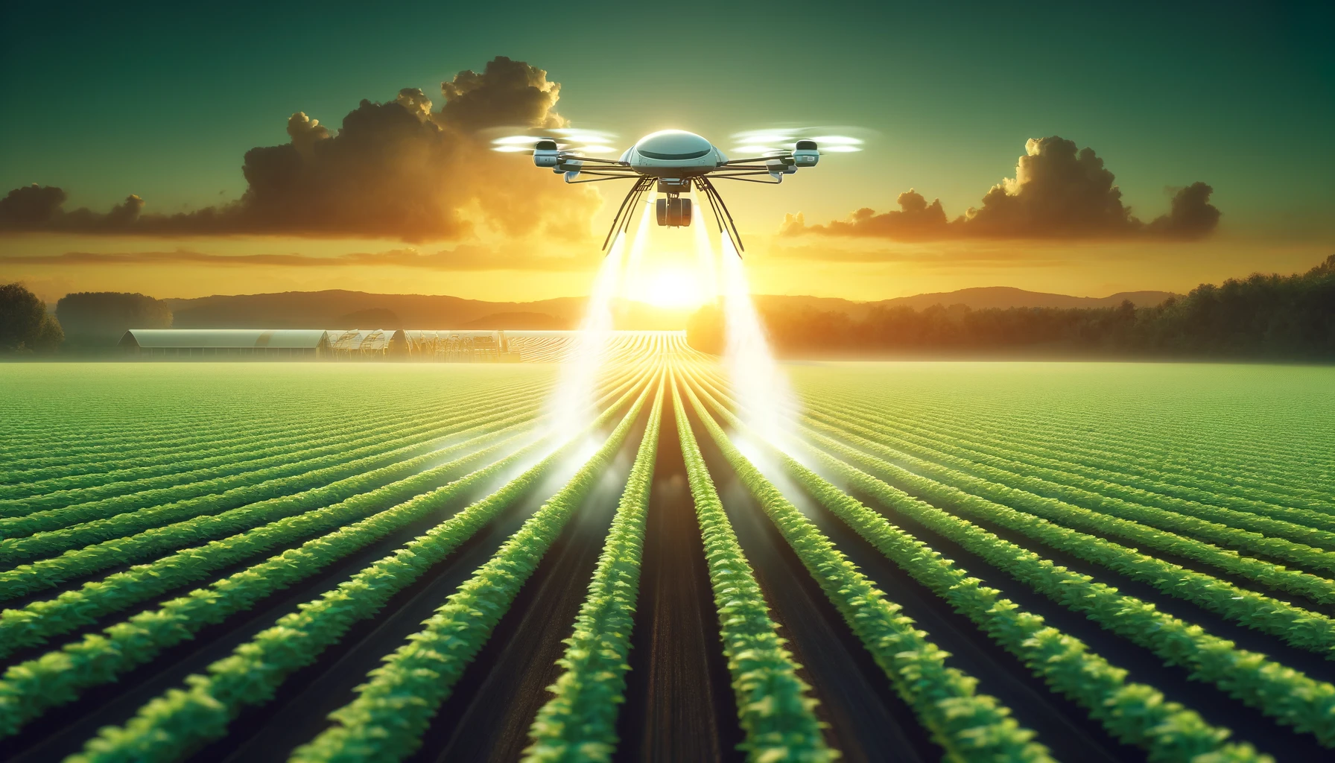
Foliar P application?

Slide 19
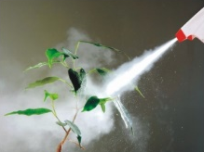
Foliar application of P-fertilizers
Promising results of some studies
New technologies of fertilizers (wetting agens, glues)
Slow P-uptake by leaves
Possible to apply only low P amount (up to 2 kg ha⁻¹)

Slide 20
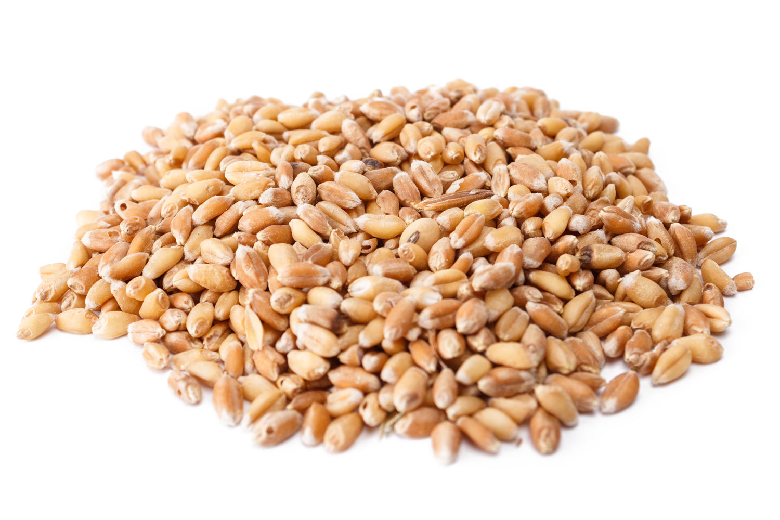
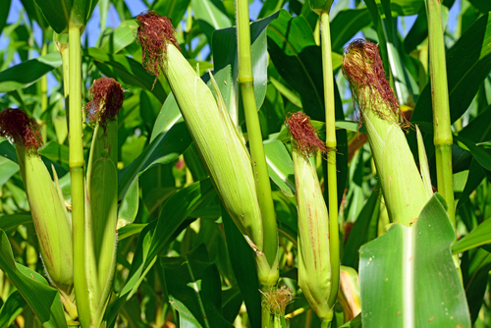
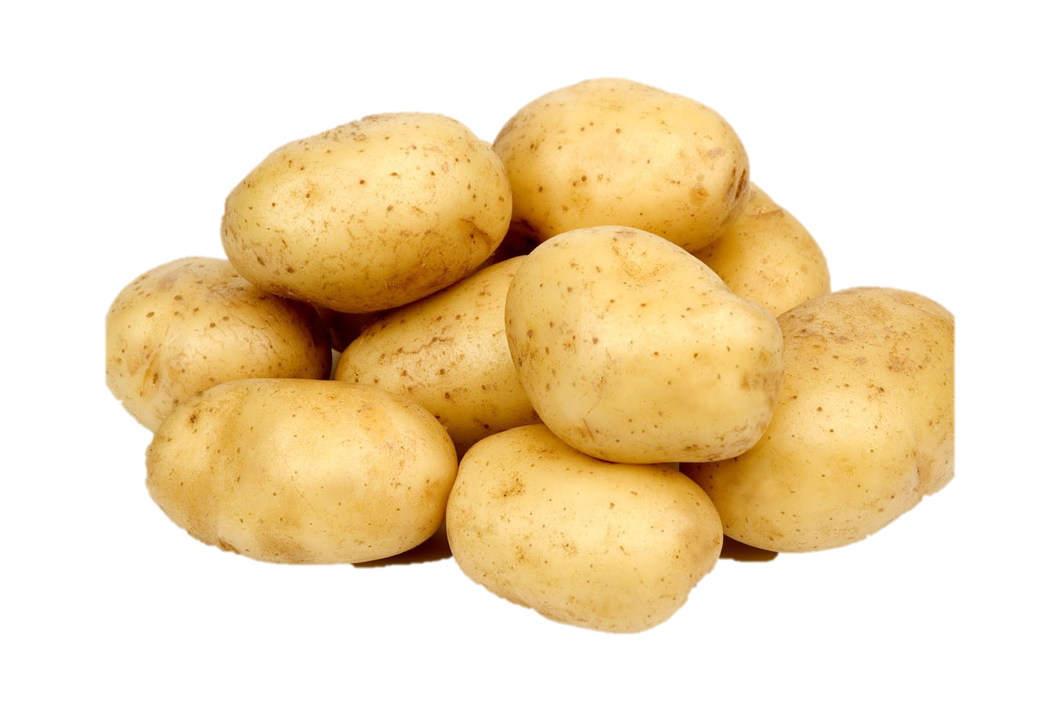
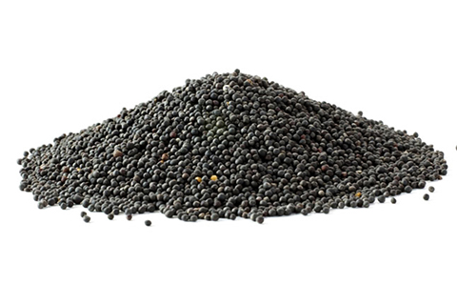
„Importance“ of foliar P application
-18 kg P ha⁻¹
-23 kg P ha⁻¹
-27 kg P ha⁻¹
-35 kg P ha⁻¹
Potatoes
in 35 t of tubers
Wheat
in 7 t of grains
Silo maize
in 45 t of biomass
Oilseed rape
in 5 t of seeds
Folliar application cannot cover the phosphorus requests!

Slide 21

Bio stimulants

Slide 22

(definition according to EBIC, 2020)
Biostimulants
Substances and/or microorganisms, which application stimulates natural processes leading to:
Better nutrients use efficiency
Tolerance to biotic and abiotic stresses
Yield and production quality
(EBIC – European Biostimulants Industry Council, available at www: https://biostimulants.eu/)

Slide 23


Slide 24
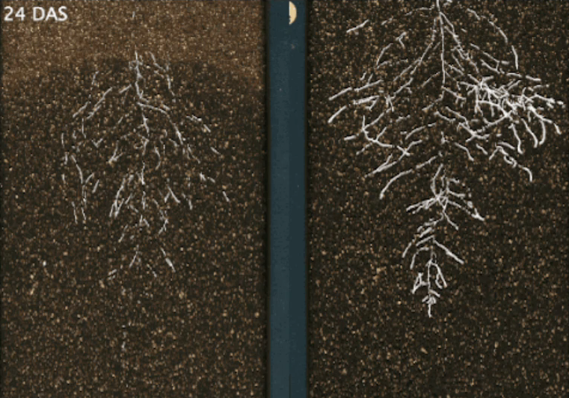
Biostimulants - principles
Direct – nutrients mobilization
Indirect – support of:
  Root growth
  Production of root exudates
  Production of phytohormones
  Protecting against diseases
  Elimination of stresses
Combination of both ways
- biostimulants
+ biostimulants

Slide 25
Examples of biostimulats
● Biostimulants related to phosphorus acquisition
- Trichoderma harzianum – releasing P from hardly available forms
- Pseudomonas sp. – supporting of root growth
- Bacillus amyloliquefaciens – releasing P and support root growth
- Algae, composts and vermicomposts extracts

Slide 26
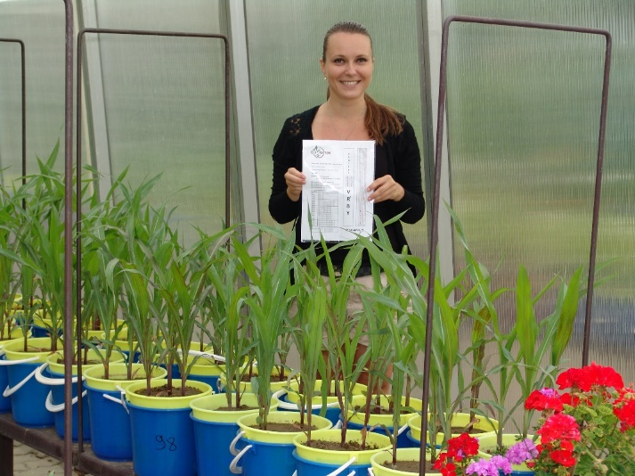
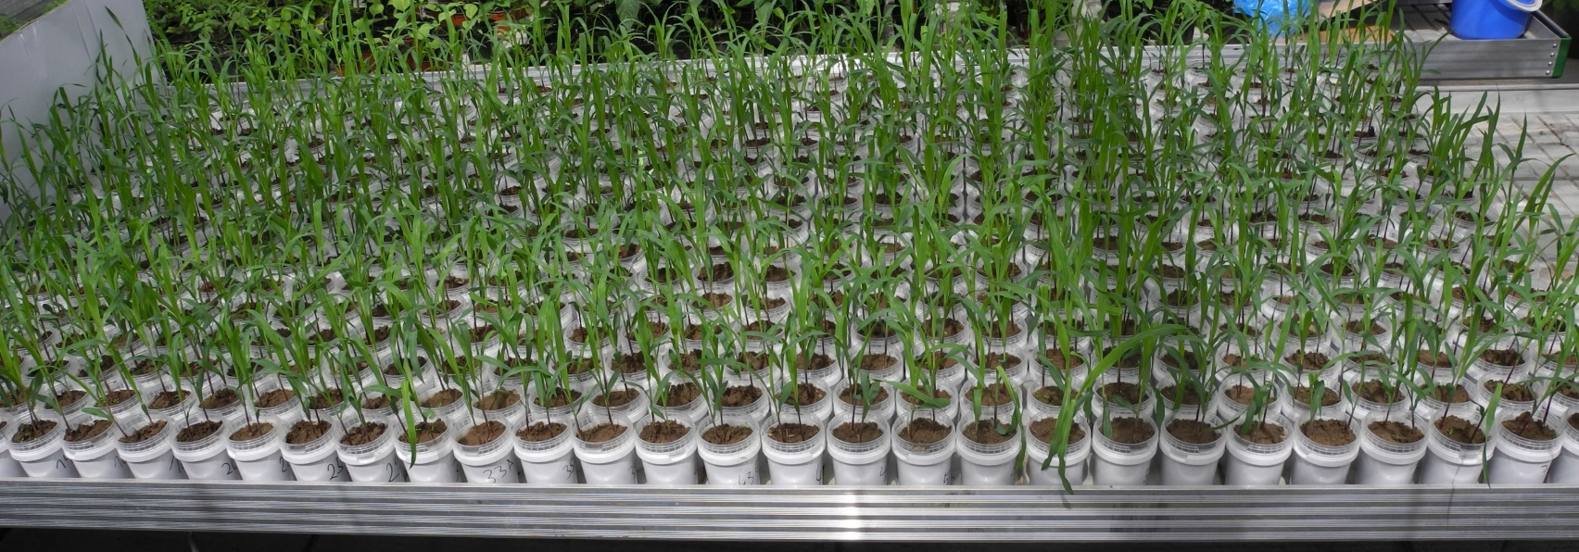
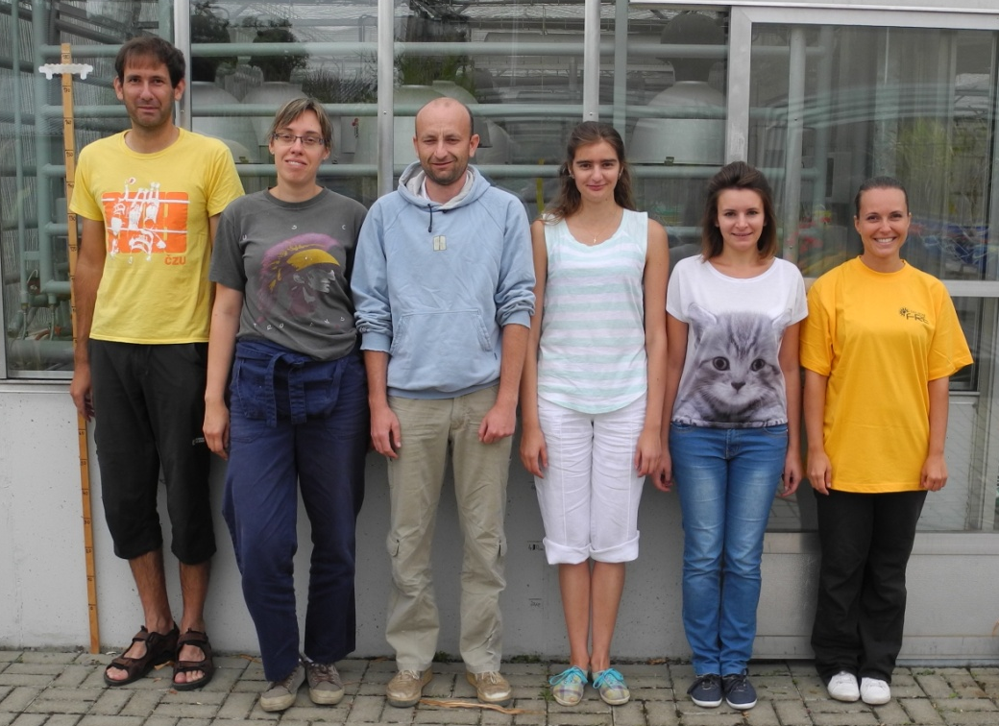
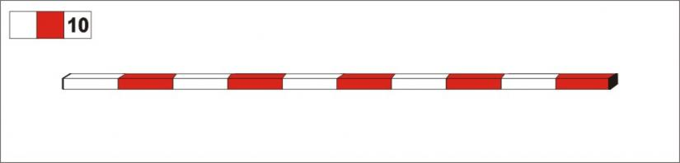
Using of biostiomulants - positives
Excellent results from lab experiments
Good results from pot experiments
200 cm
Lekfeldt JDS, Rex M, Mercl F, Kulhánek M, Tlustoš P (2016) Effect of bioeffectors and recycled P-fertilizer products on the growth of spring wheat. Chem. Biol. Technol. Agric.
Mercl F., García Sánchez M, Kulhánek M, Košnář Z, Száková J, Tlustoš P (2020) Improved phosphorus fertilisation efficiency of wood ash by fungal strains Penicillium sp. PK112 and Trichoderma harzianum OMG08 on acidic soil. Appl. Soil Ecol.
Thonar C, Lekfeldt JDS, Cozzolino V, Kundel D, Kulhánek M et al. (2017) Potential of three microbial bio-effectors to promote maize growth and nutrient acquisition from alternative phosphorus fertilizers in contrasting soils.Chem. Biol. Technol. Agric.

Slide 27
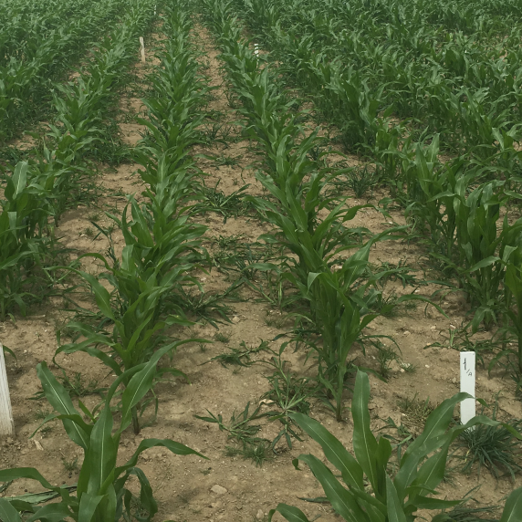
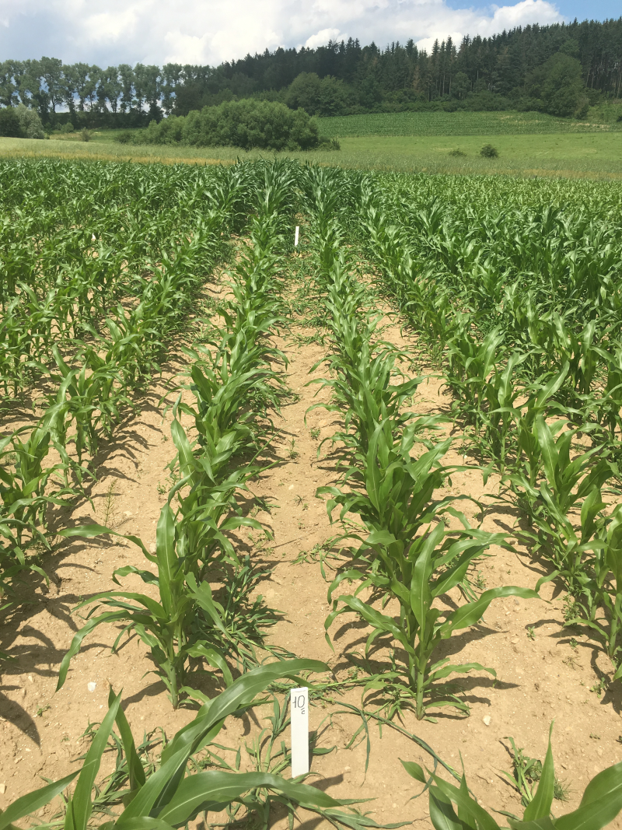
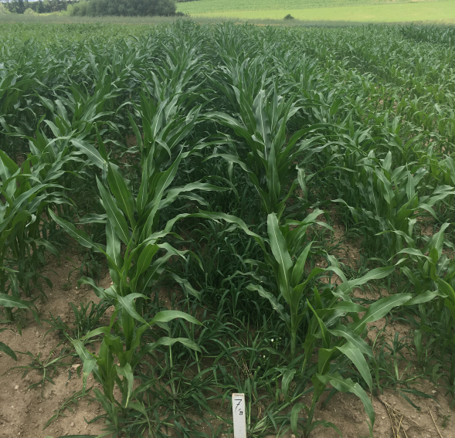
Using of biostimulants - negatives
Nonsignificant results from fields
Overestimating of biostimulants in the literature
Up to now economically not suitable
0
Tukey test (p≤0.05)
RP
Plant height (cm)
TSP
0 – control, RP – rock phosphate, TSP – triple superphosphate; CN – calcium nitrate, AS – ammonium sulfate
PDX – Proradix (Pseudomonas sp.), MUCI – Paenibacillus mucilaginosus, CFA – mix of biostimulants
Holečková Z, Kulhánek M, Hakl J, Balík J (2018) Using of active microorganisms of Pseudomonas genus during cultivation of maize in field conditions. Plant Soil Environ.
Holečková Z, Kulhánek M, Balík J (2018) Influence of bioeffectors application on maize growth yields and nutrient uptake. Int. J. Plant Sci.

Slide 28
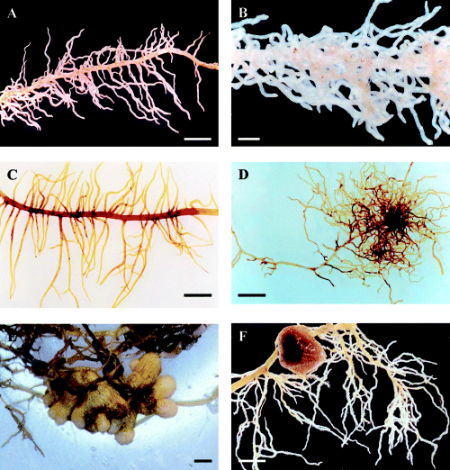


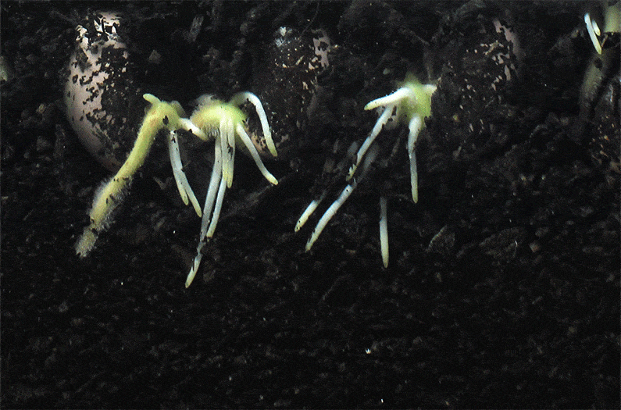
Plant breeding
  Better phosphorus acquisition efficiency
  Lower P uptake
Satisfactory-P Low-P
Adams et al. (2002) Plant, Cell and Environ.
Vaněk et al. (2012)
anthropocenemagazine.org

Slide 29
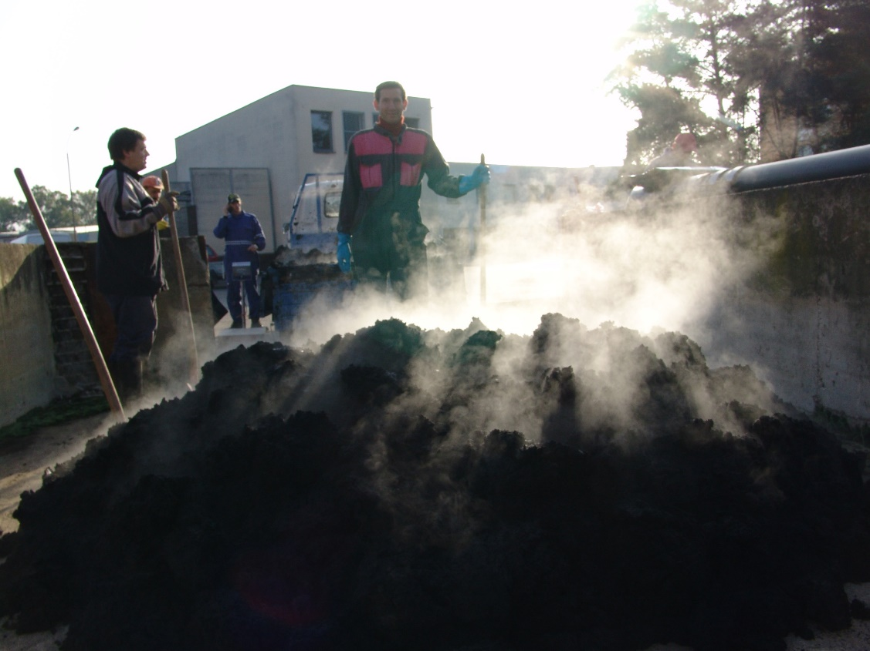
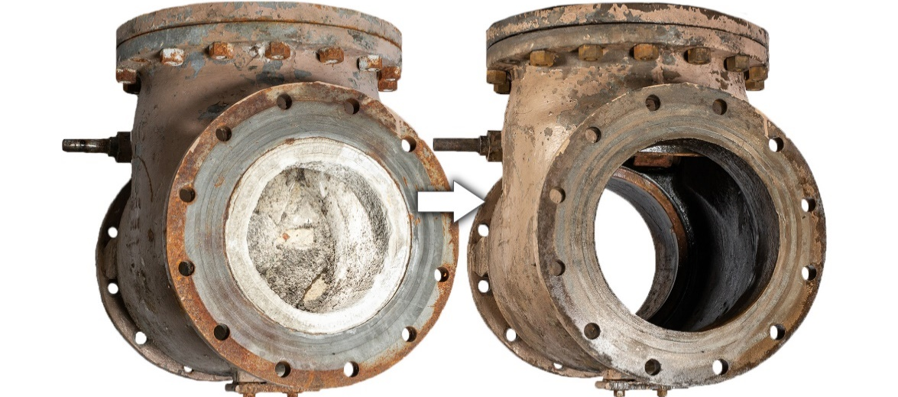
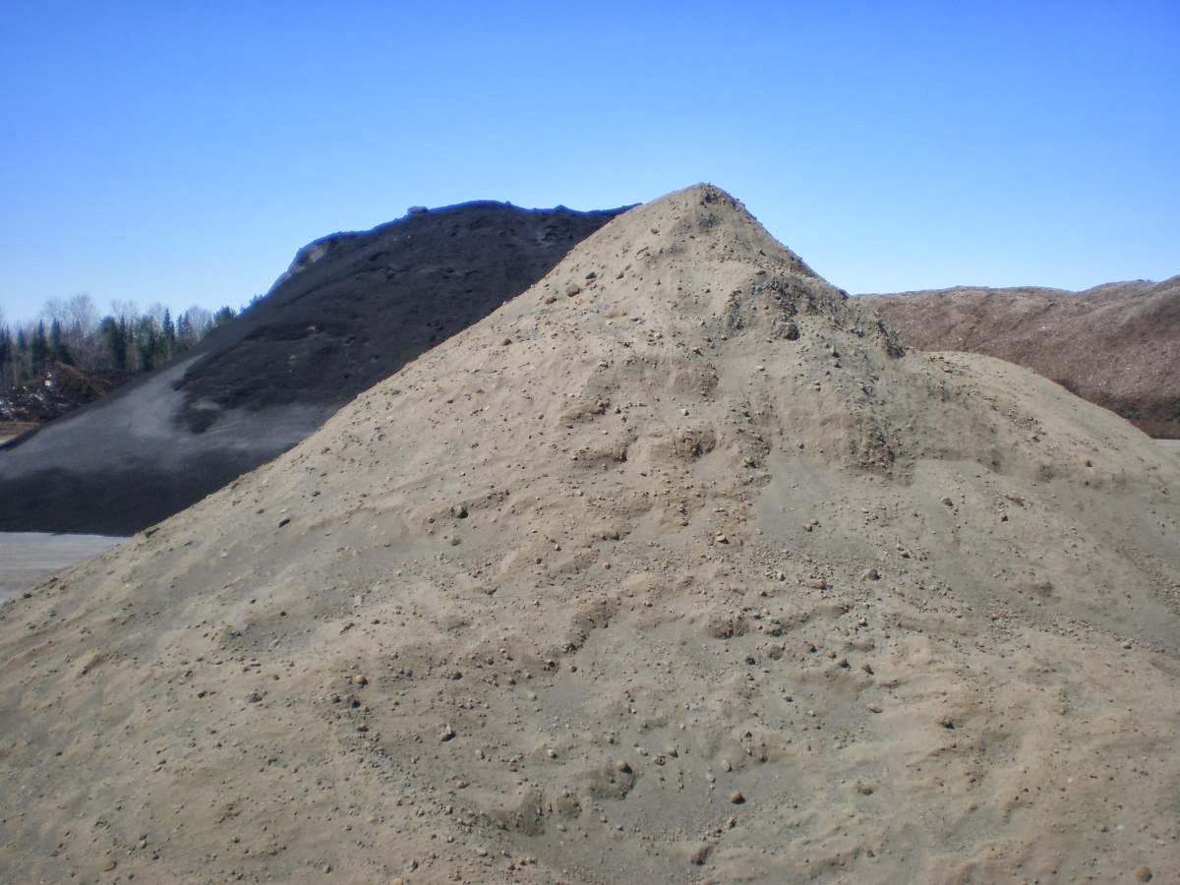
Waste materials as the phosphorus source
P content in fresh bioass:
Sewage sludge ~ 0,70 % P - ? Heavy metals, business
  Struvite ~ 6-7 % P - ? Heavy metals, technologies
Ashes after biomass burning ~ 1.1 % P - Nonavailable P, application
Digestate from biogass stations ~ 0.15 % P - Inappropriate nutrients ratios
Ash from biomass burning
Digestate
Struvite
Sewage sludge
Kulhánek M, Černý J, Balík J, Sedlář O, Vašák F (2019) Changes of soil bioavailable phosphorus content in long-term field fertilizing experiment. Soil & Water Res. 14:240-245.
Mercl F, García Sánchez M, Kulhánek M, Košnář Z, Száková J, Tlustoš P (2020) Improved phosphorus fertilisation efficiency of wood ash by fungal strains Penicillium sp. PK112 and Trichoderma harzianum OMG08 on acidic soil. Appl. Soil Ecol. 147:103360.

Slide 30
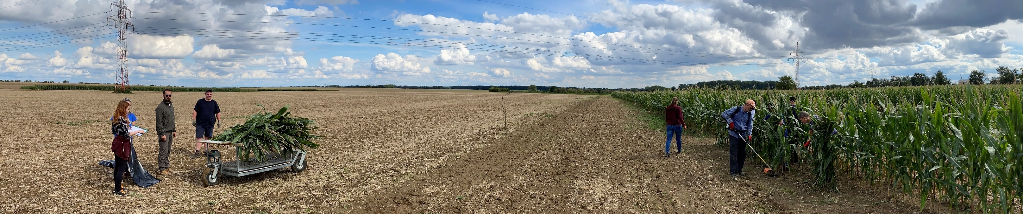
Long term experiments with maize monoculture
Soil-climatic characteristics | Parameter
pH_{CaCl2} | 6,7
CEC (mmol₊ kg⁻¹) | 118
Avg. yearly temperature(°C) | 7,7
Avg. yearly precipitations (mm) | 493
Soil texture(%) | Loamy
Clay (%) (< 0.002 mm) | 5,4
Silt 0.002-0.05 mm | 68,1
Sand (%) (0.05-2 mm) | 26,5
Bulk density (g cm⁻³) | 1,50
Organic carbon ratio C_{SOM} (%) | 1,26
Residual P content (kg ha⁻¹) | 4258
P (Mehlich 3; mg P kg⁻¹) | 158
Location Červený Újezd
  Established 1992
  10 fertilizing treatments
  4 replications
  Uniform N rate 120 kg ha⁻¹ yr⁻¹

Slide 31
Selected treatments – yearly doses
Treatment | Dry mass (t ha⁻¹) | N (kg ha⁻¹) | P (kg ha⁻¹)
Control |  | 0 | 0
UAN |  | 120 | 0
UAN + Straw | 5 t (straw) | 120 | 4.34
Sewage sludge | 3.39 | 120 | 82.1
Farmyard manure | 5.42 | 120 | 32.6
Cattle slurry | 2.12 | 120 | 23.2
  Organic fertilizers – autumn application after harvest
  UAN 390 – urea amonium nitrate – spring application before sowing
  Topsoil (0-30 cm) sampling – yearly before organic fertilizers application
Asrade D.A., Kulhánek M., Černý J., Sedlář O., Balík J. (2023) Side Effect of Phosphorus Fertilizing on the Phosphorus Transformation and Balance over 27 Years of Maize Monoculture. Field Crops Research. 295:108902

Slide 32
Evaluated parameters
Dry aboveground biomass yield
Simle phosphorus balance
Phosphorus content in soil
  Readily available P (P_{H2O})
  Potentially available P (P_{M3})
  Inorganic P (P_{in})
  Organic P (P_{org})
  Pseudototal P (P_{AR})
Phosphorus sorption characteristics
  Degree of phosphorus saturation (DPS)
Asrade D.A., Kulhánek M., Černý J., Sedlář O., Balík J. (2023) Side Effect of Phosphorus Fertilizing on the Phosphorus Transformation and Balance over 27 Years of Maize Monoculture. Field Crops Research. 295:108902

Slide 33
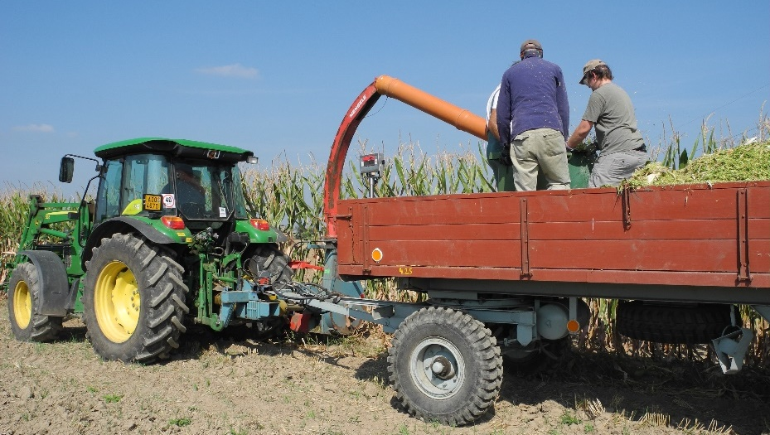
Dry biomass yield
Slurry (13,0 t ha⁻¹)
FYM (13,1)
UAN + Straw (13,5)
Sewage sudge (12,2)
UAN (12,5)
Control (9,0 t ha⁻¹)

Slide 34
Yearly phosphorus balance
P inputs
P uptake
Balance
Control
UAN
UAN+straw
Sew. sludge
F. manure
C. slurry
Different small/CAPITAL LETTERS – sighificant diference among P uptake/BALANCE (Tukey; p ≤ 0,05)
Asrade D.A., Kulhánek M., Černý J., Sedlář O., Balík J. (2023) Side Effect of Phosphorus Fertilizing on the Phosphorus Transformation and Balance over 27 Years of Maize Monoculture. Field Crops Research. 295:108902

Slide 35
Topsoil after 27 years
P fraction | Control | UAN | UAN + straw | Sew. sl. | FYM | CS | unit
Applied P | 0 | 0 | 4.34 | 82.1 | 32.6 | 23.2 | kg ha⁻¹ yr⁻¹
P_{H2O} | 10.2ª | 8.2ª | 12.4ª | 20.8^{ab} | 26.9^{b} | 23.2^{b} | mg kg⁻¹
P_{M3} | 141ª | 102ª | 125ª | 366^{b} | 317^{b} | 303^{b} | mg kg⁻¹
P_{in} | 1681ª | 1440ª | 1558ª | 4201^{c} | 2932^{b} | 2730^{b} | mg kg⁻¹
P_{org} | 2349^{abc} | 2211^{ab} | 2318^{abc} | 2054ª | 2524^{bc} | 2588^{c} | mg kg⁻¹
P_{AR} | 4029ª | 3651ª | 3876ª | 6255^{c} | 5457^{b} | 5318^{b} | mg kg⁻¹
DPS | 33ª | 25ª | 32ª | 78^{b} | 86^{b} | 79^{b} | %
  P_{H2O} - Readily available P; P_{M3} - Potentially available P; P_{in} - Inorganic P; P_{org} - Organic P; P_{AR} - Pseudototal P
Asrade D.A., Kulhánek M., Černý J., Sedlář O., Balík J. (2023) Side Effect of Phosphorus Fertilizing on the Phosphorus Transformation and Balance over 27 Years of Maize Monoculture. Field Crops Research. 295:108902

Slide 36

Summary
Necessary to know – plant, soil and fertilizers properties
New trends in phosphorus fertilization
Local application
Waste materials
Biostimulants
Plant breeding
Socio-economic aspects
The highest perspective has combination of mentioned ways
Future have to be based on knowledge

Slide 37
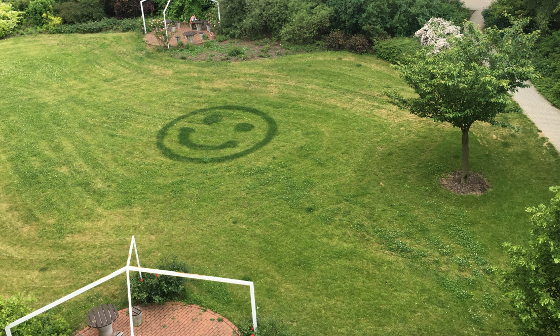


Thanks for your attention
DEPARTMENT
OF AGROENVIRONMENTAL CHEMISTRY AND PLANT NUTRITION
DEPARTMENT
OF SOURCES
kulhanek@af.czu.cz

