Slide 1
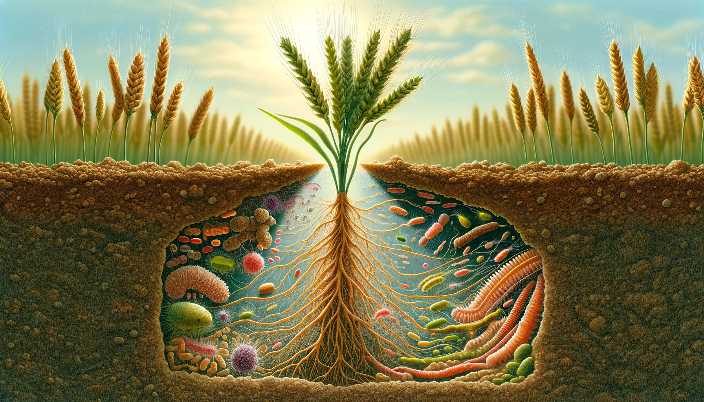
Soil and Plant relationship
Plant
&
Soil
Relationship
Martin Kulhánek
A357
kulhanek@af.czu.cz

Slide 2
Programme of classes
1. - information about programme 15. 2. 2024 (Kulhánek)
- request for credit 22. 2. 2024 (Hanč)
- safety of work
- the principles of soil testing
- agrochemical soil testing in the Czech Republic
- cycles of nutrients
2. - soil pH determination 29. 2. 2024 (Hanč)
- salinity determination 7. 3. 2024 (Kulhánek)
- determination of carbonate content in soil
- evaluation of obtained results
- potassium (MIII, H₂O)

Slide 3
Programme of classes
3. - determination of plant-available soil phosphorus 14. 3. 2024 (Hanč)
- NO₃⁻ in plants 21. 3. 2024 (Hanč)
- vitamin C
- evaluation of obtained results
4. - determination of Ca and Mg in water 28. 3. 2024 (Kulhánek)
- evaluation of obtained results 4. 4. 2024 (Kulhánek)
- performing of calculations (content of nutrients in soil, plant and fertilizers, CEC)

Slide 4
Programme of classes
5. - presentations of students 11. 4. 2024 (Hanč)
- demonstration of vermicomposter 18. 4. 2024 (Hanč)
6. - presentations of students 25. 4. 2024 (Kulhánek)
- credits 2. 5. 2024 (Kulhánek)

Slide 5
Requests for credit
Protocols from laboratory classes
Team presentation in PowerPoint (10 – 15 min.)

Slide 6
Proposals for presentations
Organic matter (importance, fractions, input, output, manure, slurry, straw, organic fertilizers, intercrops)
Potassium cycle (potassium content in soil and plants, types of potassium in soil, importance of potassium for plants, symptoms of deficiency, resources, list of fertilizers, rates, term of application; the importance of potassium for humans, potassium in food)
Phosphorus cycle (phosphorus content in soil and plants, importance of phosphorus for plants, symptoms of deficiency, resources of phosphorus, list of fertilizers, rates, term of application; the importance of phosphorus for humans, phosphorus in food)
Nitrogen cycle (nitrogen transformation in soil, nitrogen content in soil and plants, importance of nitrogen for plants, symptoms of deficiency, resources of nitrogen, list of fertilizers, rates, terms of application; the importance of aminoacids and proteins for humans and their content in food)
Calcium cycle (content in soil and plants, function in plant, importance of liming, pH value, soil class, list of fertilizers, rates, terms of application; the importance of calcium for humans, calcium in food)

Slide 7
Instructions for safe work in lab
Protective coat!
It is forbidden to eat and drink at the laboratory.
Announce your injury to teacher! First-aid kit.
Use extinguisher fire in the case of fire!
Use protective eye shield and gloves at work with dangerous chemicals!
Don´t pipette concentrated solution by common pipette! Use special one!
Add strong acid into water at dilution, not conversely!
Clean your lab table after finishing of your work!
Before your leaving the laboratory, close or check gas and water taps!

Slide 8
Soil testing

Slide 9
Soil sample

Slide 10
pH and content of bioavailable nutrients
Agrochemical soil testing

Slide 11
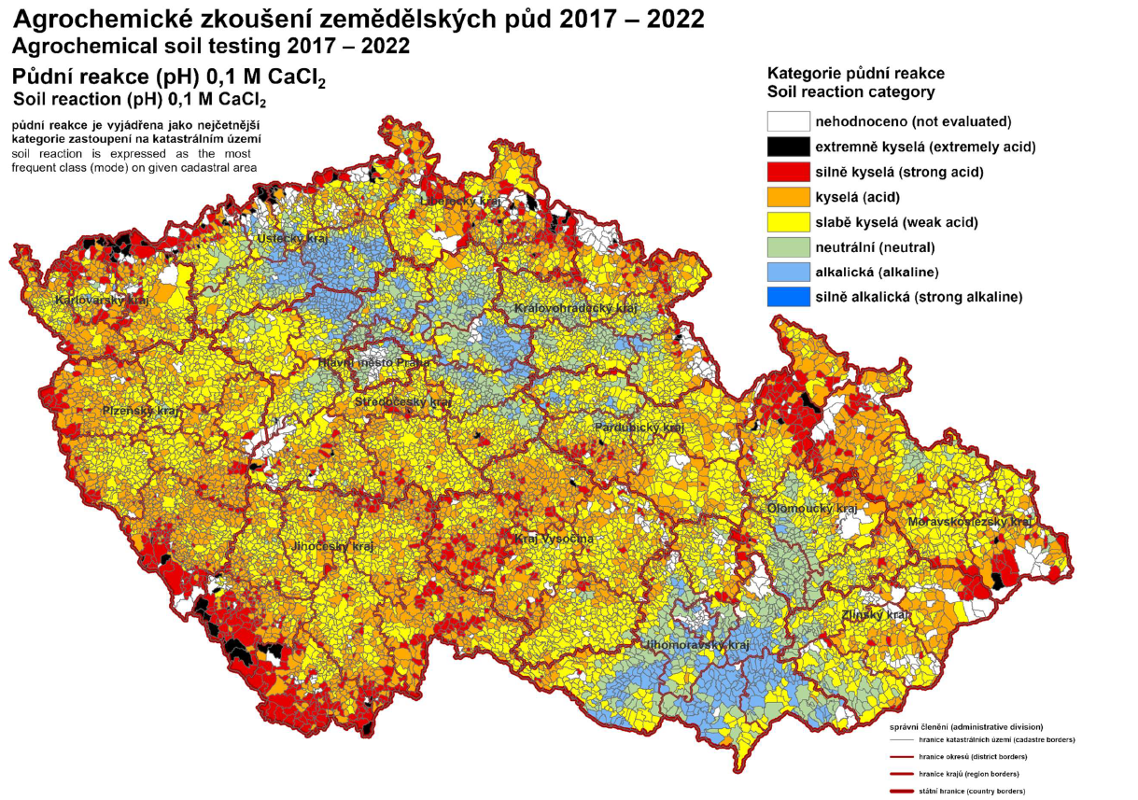
pH
Source: CISTA

Slide 12
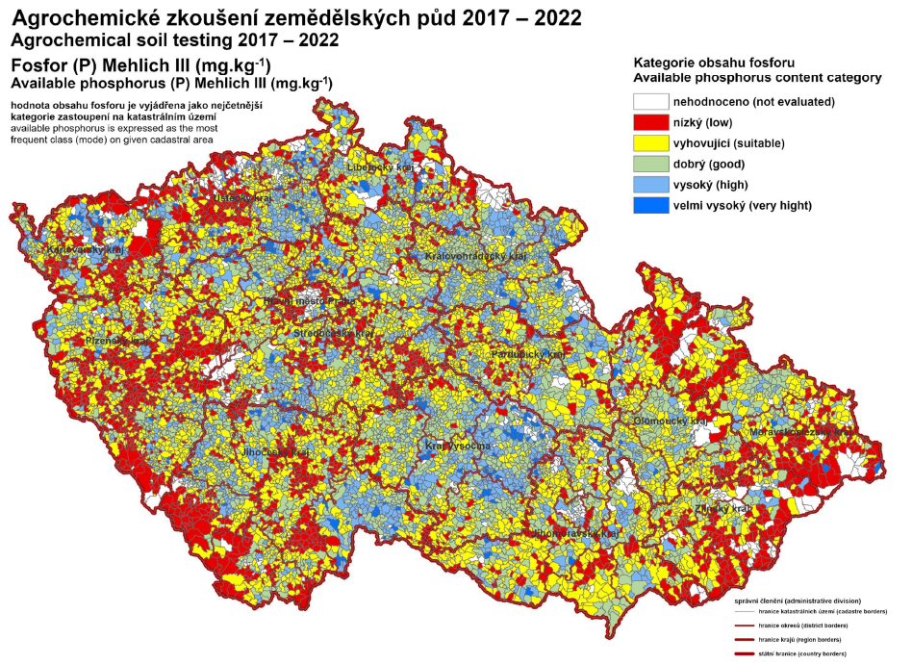
P
Source: CISTA

Slide 13
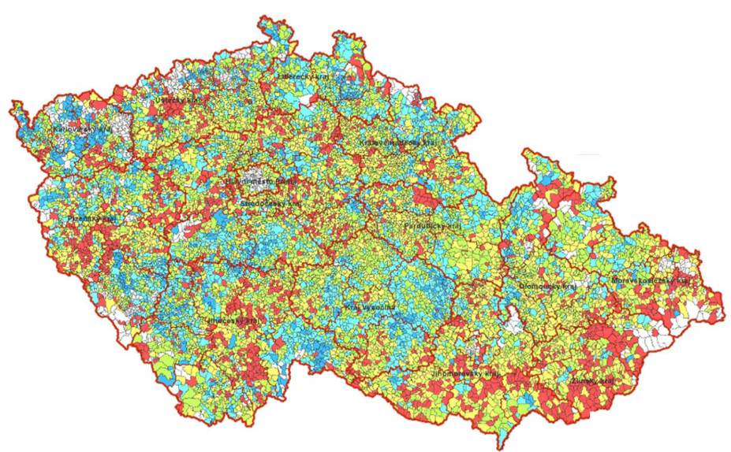
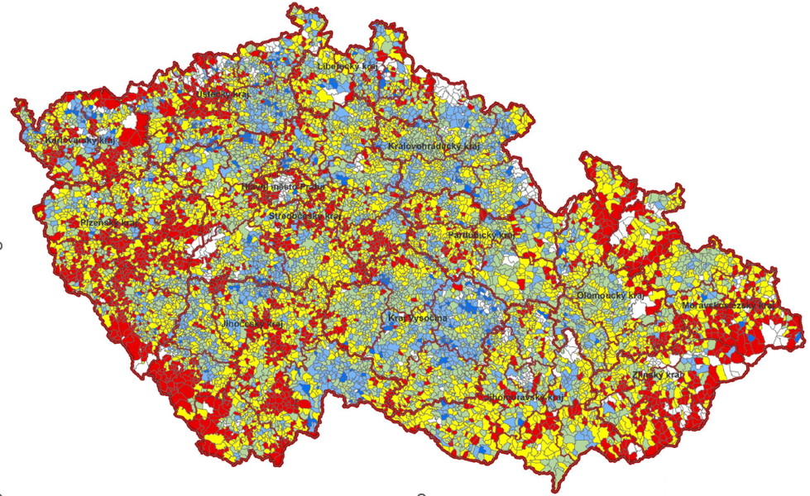
1999 - 2004
2017 - 2022
Source: CISTA

Slide 14
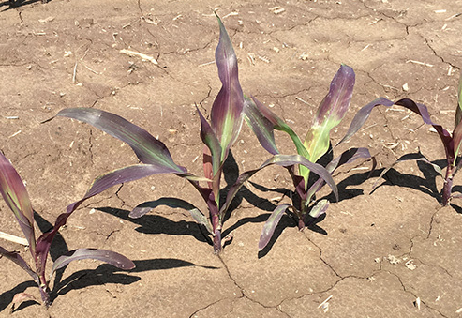
P deficiency

Slide 15
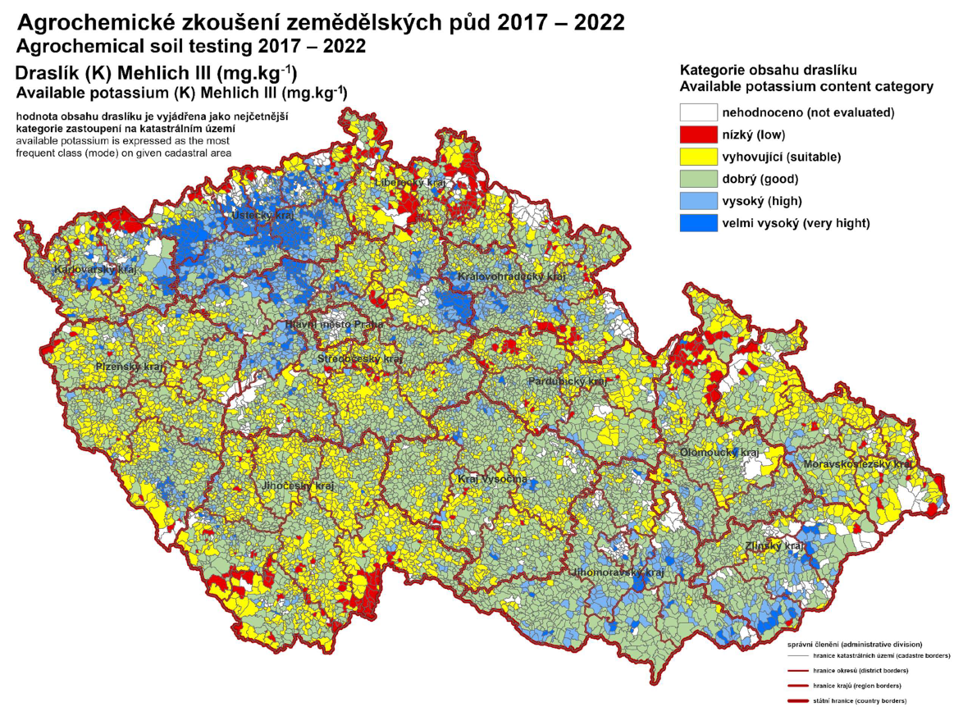
K
Source: CISTA

Slide 16
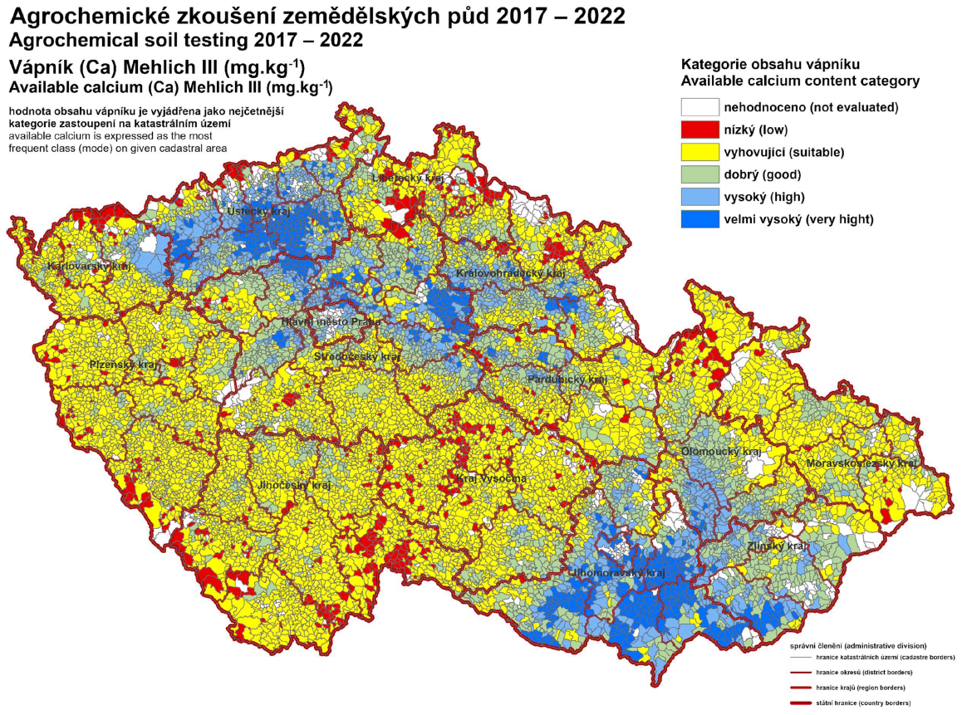
Ca
Source: CISTA

Slide 17
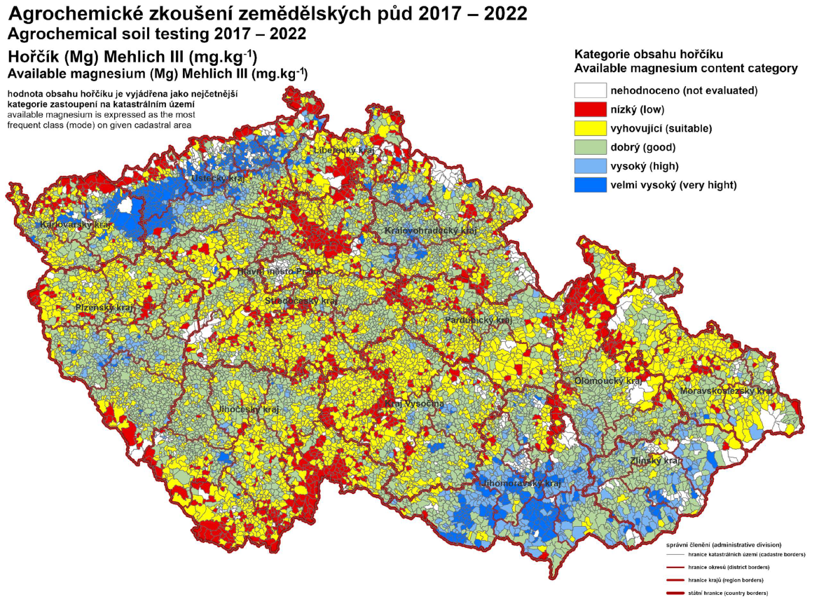
Mg
Source: CISTA

Slide 18
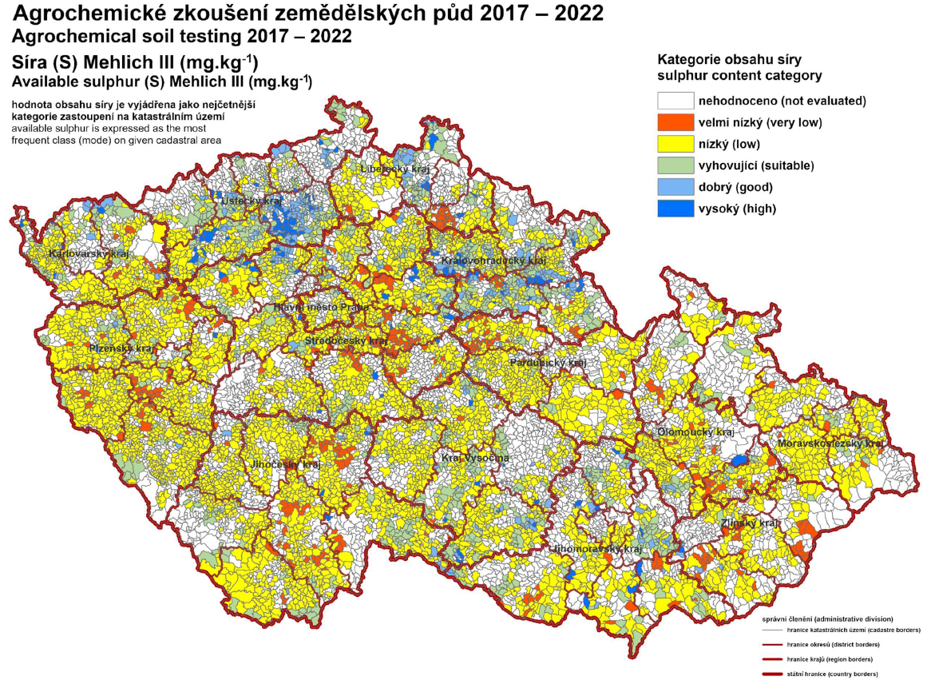
S
Source: CISTA

Slide 19
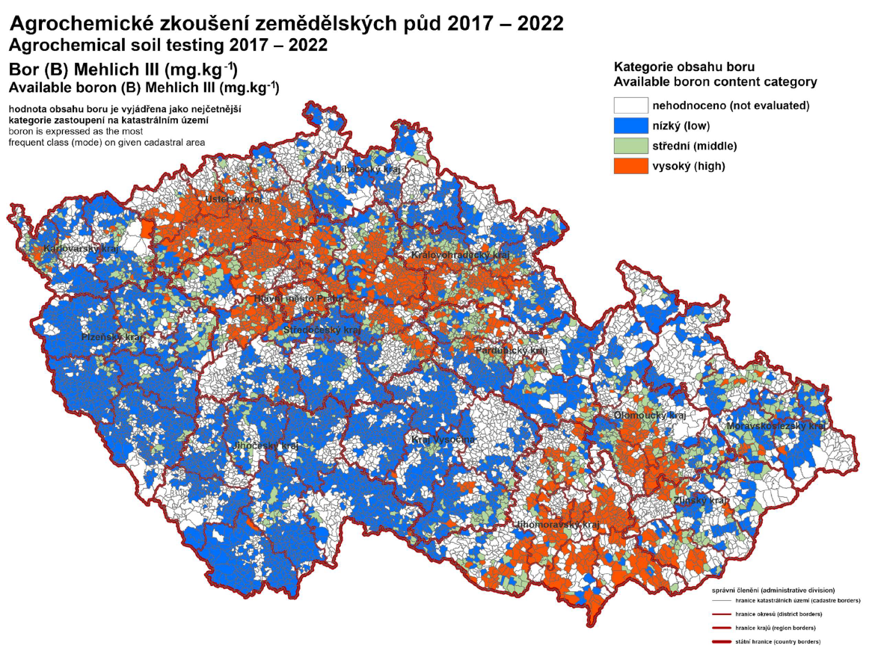
B
Source: CISTA

Slide 20
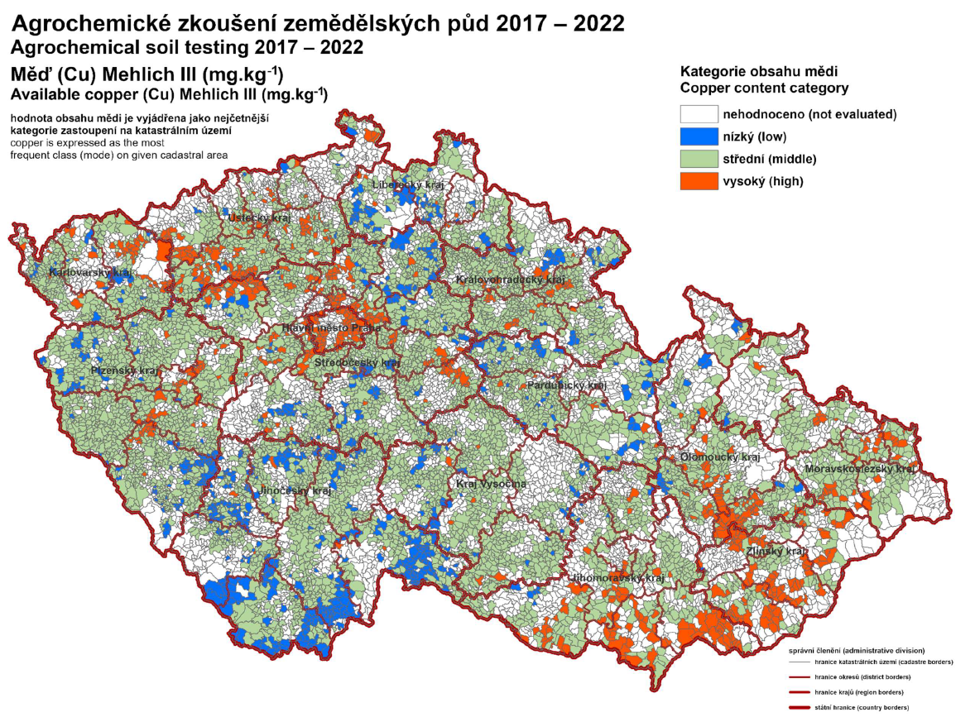
Cu
Source: CISTA

Slide 21
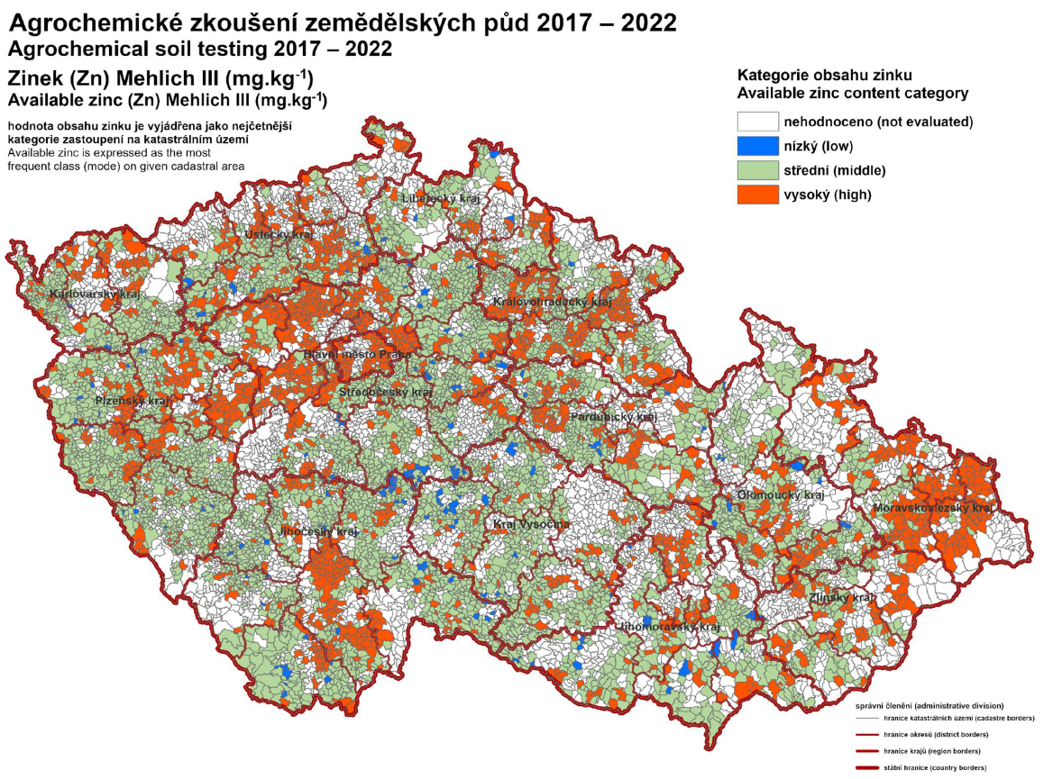
Zn
Source: CISTA

Slide 22
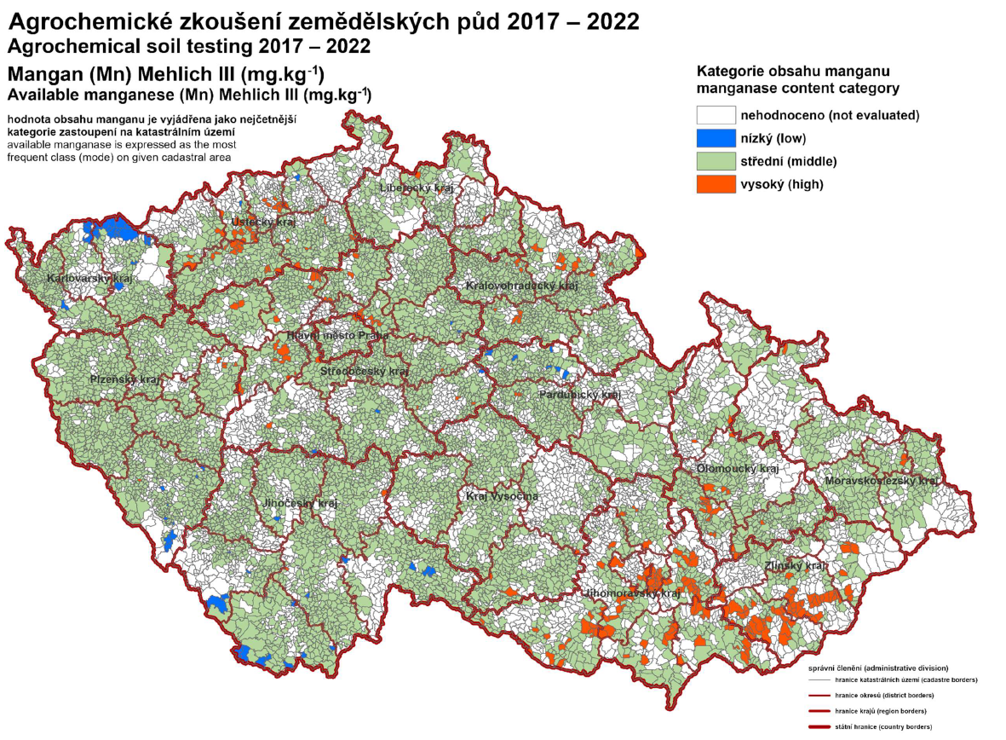
Mn
Source: CISTA

Slide 23
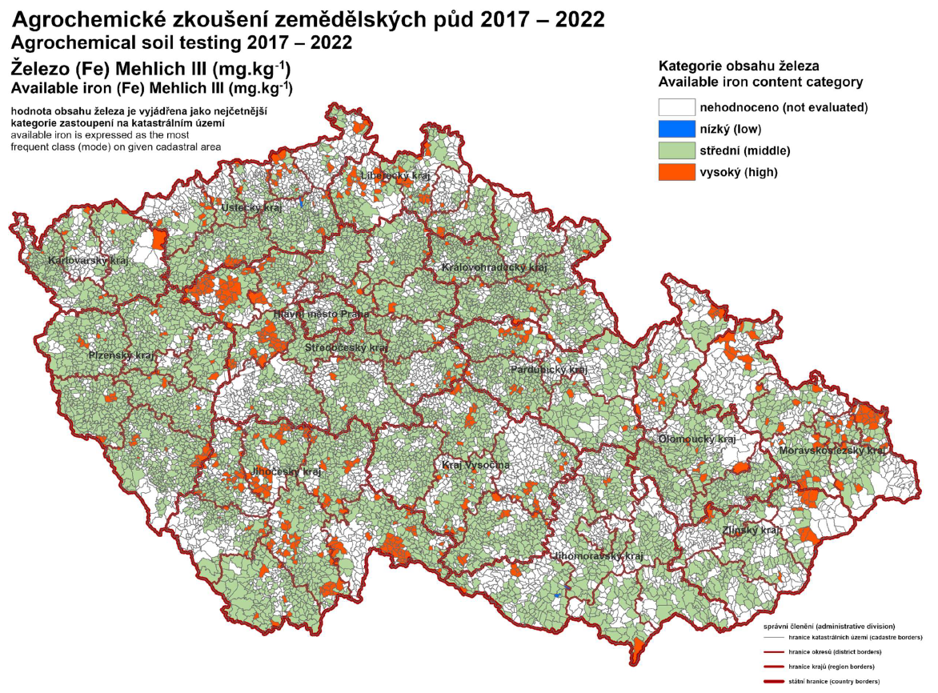
Fe
Source: CISTA

Slide 24
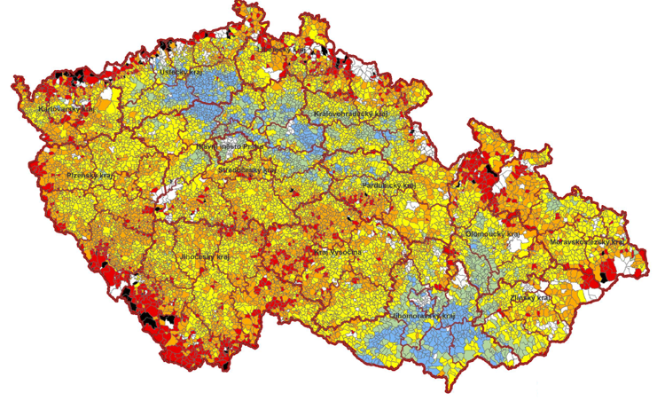
Requests for liming

Slide 25
Requests for liming

