Slide 1
Innovation and innovation economics

Slide 2
Subject content
Innovation and innovation economics
Knowledge economy and innovation economics.
Current economic megatrends and phenomenas of current economics.
Definition of innovation and classification.
Microeconomic effects of innovation.
Intellectual property rights.
Innovative Firms - models of innovation process, drivers and barriers to successful innovation process.
Measurement of innovation.
Innovation and competitiveness.
Innovation and economic growth.
Innovation and labour market.
Diffusion of innovation.
Innovation system.
Innovation policy.

Slide 3
Literature
Innovation and innovation economics
Compulsory literature:
Greenhalgh, Ch., Rogers, M. (2010): Innovation, Intellectual Property, and Economic Growth. 384 s. New Jersey: Princeton University Press. ISBN: 978-0-691-13798-8.
Hall, B.H., Rosenberg, N. (2010): Handbook of the Economics of Innovation. Amsterdam: North Holland. 804 s. ISBN: 978-04-445-1995-5.
Recommended literature:
Fagerberg, J., Mowery, D.C., Nelson, R.R. (2006): The Oxford Handbook of Innovation. Oxford: Oxford University Press. 680 s. ISBN: 978-0-19-926455-1.
Feldman, P.M., Link, A.N., Siegel, D. (2012): The Economics of Science and Technology. An Overview of Initiatives to Foster Innovation, Entrepreneurship, and Economic Growth. New York: Springer-Verlang New York Inc. 135 s. ISBN: 978-14-613-5335-5.
Griliches, Z. (2007): R&D and Productivity: The Econometric Evidence. Chicago: University of Chicago Press. 400 s. ISBN 0-226-30886-3.
Korres, G.M. (2008): Technical Change and Economic Growth: Inside the Knowledge Based Economy. Fernham: Ashgate Publishing Limited. 372 s. ISBN 978-1-84014-992-0.
OECD/Eurostat (2018): Oslo Manual 2018: Guidelines for Collecting, Reporting and Using Data on Innovation. Paris: OECD Publishing. 254 s. ISBN 978-92-64-30455-0.
Academic Journals:
Economics of Innovation and New Technology
Innovations – Journal Of Innovation Economics & Management (I-JIEM)

Slide 4
Exam and Credit
Innovation and innovation economics
Credit:
awarded at the end of the semester under following conditions:
participation on seminars (one absence);
obtaining at least 60 points:
semester project (100 points: 50% presentation).
Exam:
a combination of:
written – 30 minutes, to pass: 60% of the total number of points;
oral.

Slide 5
Introduction
Innovation and innovation economics
“The function of entrepreneurs is to reform or revolutionize the pattern of production by exploiting an invention or, more generally, an untried technological possibility for producing a new commodity or producing an old one in a new way, by opening up a new source of supply of materials or a new outlet for products, by reorganizing an industry and so on.”
J. A. Schumpeter

Slide 6
Innovation Economics
Innovation and innovation economics
Innovation Economics (IE) is a relatively new branch of economics that focuses on innovation, alongside the study of technology, knowledge, and entrepreneurship.
Innovation economics is an economic theory that emphasizes entrepreneurship and innovation.
Introduced by Joseph Schumpeter (1940s).
Growing position of IE in economic theory is results from the movement away from an industrial model of production and towards a knowledge-based economy.
Difference between IE and neoclassical economics (NE): drivers of economic growth (capital accumulation in NE, innovative capacity spurred by appropriable knowledge and technological externalities in IE).
Leading theorists of innovation economics: Paul Romer, Elhanan Helpman, Bronwyn Hall, W. Brian Arthur, Robert Axtell, Richard R. Nelson, Richard Lipsey, Michael Porter, Keun Lee and Christopher Freeman.
Notes:
A causal reading of recent economic history suggest two important trends in world economy: 1. technological change and innovation are becoming important contributors to economic growth and to well-being; 2. nations in the world economy are becoming increasingly open and interdependent. These two trends are related. Rapid communication and close contacts among innovations in different countries facilitate the process of invention and the spread of new ideas.

Slide 7
Technology, Innovation, Knowledge
Innovation and innovation economics
Economic view:
Innovation is the successful application of new ideas.
Knowledge is the whole body of scientific evidence and human expertise that is, or could be, useful in the production and supply of commodities and in the invention and design of new products and processes.
Types o knowledge:
Codified – e.g. a chemical formula or computing algorithm;
Tacit = when a person knows how to do something that is not written down (e.g. mixing a perfect cocktail).
When knowledge is embodied in individuals, it is referred to as human capital.
Technology encompasses the current set of production techniques used to design, make, package, and deliver goods and services in the economy.
Technology is the application of selected parts of knowledge stock to production activity.
Notes:
A distinction is normally made between invention and innovation.
Invention is the first occurrence of an idea for a new product or process, while innovation is the first attempt to carry it out into practice. In many cases, there is a considerable time lag between these two. While inventions may be carried out anywhere, for example in universities, innovation occur mostly in firms. To be able to turn an invention into an innovation, a firm normally needs to combine several different types of knowledge, capabilities, skills, and resources.
In principle, according to Schumpeter‘s theory, we may consider that innovation can result from technology transfer or the development of new business concepts.
Technology transfer is the process by which existing knowledge and capabilities developed with public R&D funding are used to fulfil public and private needs. It is the share of knowledge and facilities among public institutions and private organizations to increase productivity generate new industry, improve living standards and public services. Technology transfer from public research institutions can occur either through mechanisms-such as scientific publications, training students, and continuing education of engineers already working in industry-or through specific measures taken.
'Tacitness', which "refers to those elements of knowledge, insight and so on that individuals have which are ill-defined, uncodified and unpublished, which they themselves cannot fully express and which differ from person to person, but which may to some significant degree be shared by collaborators and colleagues who have a common experience".
Physical capital = machinery or buildings. For an individual, the acquisition of new skill and knowledge through education and training increases his/her human capital.
Technology refers to a collection of techniques or ways of specifying how much of various output can be produced when given quantities of various inputs are used. Technology has two aspects, called embodies or disembodies. The former is identified with hardware and consists of tools, machinery, equipment and vehicles, which together make up the category of capital goods. The other is identified with software and encompasses the knowledge and skills required for the use, maintenance, repairs, production, adaptation and innovation of capital goods. These are often called the know-how.
Technology is the application of selected parts of knowledge stock to production activity. Within the firm, the technology used determines its productive capability when combined with other inputs. Inventions and discoveries add to the stock of knowledge that can be applied to production. Some types of innovations, termed process innovations, add to available stock of technology for production, while product innovations add to the choice of product facing final customers.

Slide 8
Knowledge
Innovation and innovation economics
Types o knowledge (OECD, 1996):
know-what - refers to knowledge about “facts”. This knowledge is close to what is normally called information);
know-why - refers to scientific knowledge of the principles and laws of nature;
know-how - refers to skills or the capability to do something. Know-how is typically a kind of knowledge developed and kept within the border of an individual firm;
know-who involves information about who knows what and who knows how to do what. It involves the formation of special social relationships which make it possible to get access to experts and use their knowledge efficiently.
Sources:
know-what and know-why: reading books, attending lectures and accessing databases;
know-how: in practical experience, e.g. in situations where an apprentice follows a master;
know-who: in social practice and sometimes in specialized educational environments.
Notes:
In order to facilitate economic analysis, distinctions can be made between different kinds of knowledge which are important in the knowledge-based economy: know-what, know-why, know-how and know-who. Knowledge is a much broader concept than information, which is generally the “know-what” and “know-why” components of knowledge. These are also the types of knowledge which come closest to being market commodities or economic resources to be fitted into economic production functions. Other types of knowledge – particularly know-how and know-who – are more “tacit knowledge” and are more difficult to codify and measure. Know-what refers to knowledge about “facts”. How many people live in New York? What are the ingredients in pancakes? And when was the battle of Waterloo? are examples of this kind of knowledge. Here, knowledge is close to what is normally called information – it can be broken down into bits. In some complex areas, experts must have a lot of this kind of knowledge in order to fulfil their jobs. Practitioners of law and medicine belong to this category. − Know-why refers to scientific knowledge of the principles and laws of nature. This kind of knowledge underlies technological development and product and process advances in most industries. The production and reproduction of know-why is often organised in specialised organisations, such as research laboratories and universities. To get access to this kind of knowledge, firms have to interact with these organisations either through recruiting scientifically-trained labour or directly through contacts and joint activities. − Know-how refers to skills or the capability to do something. Businessmen judging market prospects for a new product or a personnel manager selecting and training staff have to use their know-how. The same is true for the skilled worker operating complicated machine tools. Know-how is typically a kind of knowledge developed and kept within the border of an individual firm. One of the most important reasons for the formation of industrial networks is the need for firms to be able to share and combine elements of know-how. − This is why know-who becomes increasingly important. Know-who involves information about who knows what and who knows how to do what. It involves the formation of special social relationships which make it possible to get access to experts and use their knowledge efficiently. It is significant in economies where skills are widely dispersed because of a highly developed division of labour among organisations and experts. For the modern manager and organisation, it is important to use this kind of knowledge in response to the acceleration in the rate of change. The know-who kind of knowledge is internal to the organisation to a higher degree than any other kind of knowledge.
Learning to master the four kinds of knowledge takes place through different channels. While know-what and know-why can be obtained through reading books, attending lectures and accessing databases, the other two kinds of knowledge are rooted primarily in practical experience. Know-how will typically be learned in situations where an apprentice follows a master and relies upon him as the authority. Know-who is learned in social practice and sometimes in specialised educational environments. It also develops in day-to-day dealings with customers, sub-contractors and independent institutes. One reason why firms engage in basic research is to acquire access to networks of academic experts crucial for their innovative capability. Know-who is socially embedded knowledge which cannot easily be transferred through formal channels of information.
The digital revolution has intensified the move towards knowledge codification and altered the share of codified vs. tacit knowledge in the knowledge stock of the economy. Due to codification, knowledge is acquiring more of the properties of a commodity. Market transactions are facilitated by codification, and diffusion of knowledge is accelerated. In addition, codification is reducing the importance of additional investments to acquire further knowledge. It is creating bridges between fields and areas of competence and reducing the “dispersion” of knowledge. These developments promise an acceleration of the rate of growth of stocks of accessible knowledge, with positive implications for economic growth. They also imply increased change in the knowledge stock due to higher rates of scrapping and obsolescence, which will put greater burdens on the economy's adjustment abilities. While information technologies are speeding up the codification of knowledge and stimulating growth in the knowledge-based economy, they have implications for the labour force.

Slide 9
Human capital
Innovation and innovation economics
Definition:
all of the acquired and usefull abilities of all the inhabitants of a country (Schultz, 1961).
the knowledge, skills, competences and other attributes embodied in individuals that re relevant to economic aktivity (OECD, 1998).
the knowledge, skills, copetencies and attributes embodied in individuals that facilitate the creation of personal, social and economic well-being (OECD, 2001).
Measurement:
Educational spending;
Living, health care and educational expenses;
Adult literacy rates, school enrollment rates, dropout rates, repetition rate, average years of schooling;
Labour market statistics - average salery, average salery of unqualified workers, etc.
Notes:
New theories on economic growth treat human capital as an important determinant of economic development.

Slide 10
Knowledge Economy
Innovation and innovation economics
Definition:
The knowledge economy is a concept of economic development, in which innovation and access to information drive productivity growth (EBRD, 2019).
The knowledge economy is simply an economy in which knowledge assets are deliberately accorded more importance than capital and labour assets, and where the quantity and sophistication of the knowledge pervading economic and societal activities reach very high levels (World Bank, 2007).
The knowledge economy is defined as production and services based on knowledge-intensive activities that contribute to an accelerated pace of technical and scientific advance, as well as rapid obsolescence (Powell and Snellman, 2004).
The knowledge economy as a type of economy in which there is a strategic combination of highly specialized knowledge and skills at different stages of the value chain in the context of maintaining a competitive advantage (Lüthi et al., 2011).
The knowledge economy is the accumulation of capital, technology, technology-relevant capabilities, and science in the conduct of the productive activity. In the knowledge economy, a significant component of value may thus consist of intangible assets such as the value of its workers' knowledge or intellectual property (Unger, 2019).
Notes:
Knowledge, as embodied in human beings (as “human capital”) and in technology, has always been central to economic development. But only over the last few years has its relative importance been recognized, just as that importance is growing.
The knowledge economy can be defined, in one respect, as a way of creating a product based on activities dependent on knowledge and expertise that contribute to the creation of scientific and technological progress. The fundamental determinants of the knowledge economy include a more significant ratio for the dependence of the economy on intellectual abilities than on physical inputs or natural resources in the context of the integration of new knowledge at each level of the production process.
The knowledge economy is developing on the basis of two driving forces. The first is the increasing knowledge level of economic operations and the second is the globalization of economic events. The prerequisites for the emergence of knowledge economies include the long-term tendency of a gradual increase in the weight of intangible capital on production factors and the emergence and growth of the diffusion of information and communication technologies. Achievement of a knowledge-based economy requires a transition from a material perception of the economy to one that exploits innovation potential, human capital, knowledge, and new technologies. The intellectual potential, supported by the constant development of people and the appropriate skills of the workforce, as well as the growing competition in the field of innovation, significantly influences the sustainable development of today’s economies.
The knowledge economy is an economy that invests more in quality information than capital inputs, which is an important determinant for economic development and increased competitiveness. The speed of dissemination of new and current knowledge is an important factor in economic development. This is also confirmed by the fact that the most dynamic and competitive countries in the world have economies that make large investments in information factors.
The knowledge economy participates in the creation of new resources and artificial intelligence and their implementation in all sectors of the national economy in order to substitute natural resources and human intellect. The creation of such a knowledge environment is caused by the introduction of new technologies in an effort to save resources but also by the development of extensive knowledge of new technologies and skills.

Slide 11
Knowledge Economy vs. Industrial Economy
Innovation and innovation economics
Industrial Economy | Knowledge Economy
Traditional production function focus on labour, capital, materials and energy; knowledge and technology are external influences on production. | Knowledge included directly in production function. Investments in knowledge can increase the productive capacity of the other factors of production.
Decreasing returns | Increasing returns
Economy of scarcity | Economy of abundance
Insularity and localization | Globalisation
Notes:
According to the neo-classical production function, returns diminish as more capital is added to the economy, an effect which may be offset, however, by the flow of new technology. Although technological progress is considered an engine of growth, there is no definition or explanation of technological processes. In new growth theory, knowledge can raise the returns on investment, which can in turn contribute to the accumulation of knowledge. It does this by stimulating more efficient methods of production organisation as well as new and improved products and services. There is thus the possibility of sustained increases in investment which can lead to continuous rises in a country's growth rate. Knowledge can also spill over from one firm or industry to another, with new ideas used repeatedly at little extra cost. Such spillovers can ease the constraints placed on growth by scarcity of capital.
Incorporating knowledge into standard economic production functions is not an easy task, as this factor defies some fundamental economic principles, such as that of scarcity. Knowledge and information tend to be abundant; what is scarce is the capacity to use them in meaningful ways. Nor is knowledge easily transformed into the object of standard economic transactions. To buy knowledge and information is difficult because by definition information about the characteristics of what is sold is asymmetrically distributed between the seller and the buyer. Some kinds of knowledge can be easily reproduced and distributed at low cost to a broad set of users, which tends to undermine private ownership. Other kinds of knowledge cannot be transferred from one organisation to another or between individuals without establishing intricate linkages in terms of network and apprenticeship relationships or investing substantial resources in the codification and transformation into information.
The continuous character of innovation lead to increasing rather than diminishing marginal returns under the knowledge economy. At a minimum, the constraint of diminishing marginal returns may be relaxed. To relax or to supersede the constraint of diminishing returns would be to bring about a fundamental change in the character of production (Unger, 2019).
'intangible assets' means assets that do not have a physical or financial embodiment such as patents, licences, know-how or other intellectual property
'tangible assets' means assets consisting of land, buildings and plants, machinery and equipment;

Slide 12
Knowledge Economy
Innovation and innovation economics
Characteristics:
combination of production at large scale with "destandardization" or customization;
maintenance of coherence and momentum in the plan of production with decentralization of initiative;
relaxing or even reversing the constraint of diminishing marginal returns;
permanent innovation in procedures and methods as well as in products and technologies.

Slide 13
Drivers of Knowledge Economy
Innovation and innovation economics
Global development -globalization opens up new and bigger markets;
Innovation – shorter life cycle of commodities and services, diversified market, more personalized demand and supply;
Technological revolutions - continuous change: new occupations, company management systems, education technologies, new methods of housekeeping and leisure pursuits.

Slide 14
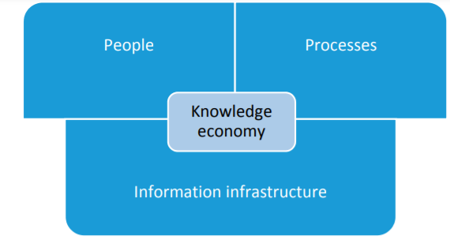
Pillars of Knowledge Economy
Innovation and innovation economics
Notes:
Collison and Parcel (2005) showed the three pillars of the knowledge economy (Figure 1). The first pillar contains people who are willing to learn and share knowledge. The second pillar is the information infrastructure that enables the exchange of knowledge. The third pillar contains processes that facilitate sharing, codification, and knowledge discovery.
Education. Recent studies of international differences in output per worker and economic growth rates have focused on the role of human capital in economic development. Indeed, most empirical, cross-country studies of long-term growth now include some measure of human capital. Barro (1991), using data for 98 countries for 1960–85 and school enrollment rates at the primary and secondary levels in 1960 as proxies for initial human capital, found that enrollment rates had statistically significant positive effects on growth of per capita real GDP. Similarly, Cohen and Soto (2001), using cross-country time-series data on educational attainment (or average years of school completed), found that education had statistically signifi cant positive effects on economic growth. Hanushek and Kimko (2000) focused on the effects of educational quality on economic growth. Using international test scores as a proxy for the quality of educational systems, they found that educational quality had a positive effect on economic growth. Information and communications technologies. A growing body of evidence shows that ICTs contribute to a country’s overall economic growth—and not just growth in its ICT sector. A recent study by the London Business School found that, in a typical developing country, an increase of 10 mobile phones per 100 people boosts GDP growth by 0.6 percentage points (cited in “Calling Across the Divide,” The Economist, March 10, 2005). Other literature suggests that ICT contributes to labor productivity through increases in the level of ICT investment and growth in the sectors that produce ICTs (Zhen-Wei Qiang, Pitt, and Ayers 2004). While individual firms or sectors of the economy are not automatically made more productive and competitive by ICTs, the potential advantages are numerous. A recent report on ICTs and economic growth in transition economies indicates strongly that ICTs are a major contributor to productivity, profitability, and growth at the level of the firm (InfoDev 2006). Innovation. Various studies have shown that innovation and the generation of technical knowledge have substantial positive effects on economic growth and growth in productivity. For example, Lederman and Maloney (2003), using regressions on data panels of five-year averages between 1975 and 2000 for 53 countries, found that a 1 percentage point increase in the ratio of total R&D expenditure to GDP increased the growth rate of GDP by 0.78 percentage points. Cincera and van Pottelsberghe (2001) investigated the long-term effects of various types of R&D on multifactor productivity growth, using OECD panel data for the period 1980–98.a They found that business, public, and foreign R&D all had statistically significant positive effects on productivity growth. Adams (1990), using numbers of academic scientific papers in various scientific fields as a proxy for the stock of knowledge, found that technical knowledge contributed significantly to the growth in total factor productivity of U.S. manufacturing industries for the period 1953–80.
The knowledge-based economy is also a combination of four interconnected items, namely the acquisition of knowledge through scientific research, its subsequent transfer in the process of education, its dissemination through information and communication technologies, and its use in technological innovations. the World Bank also has defined the dimensions of the knowledge economy: economic incentives and the institutional system, educated and skilled human resources, an effective business innovation system, and a modern and appropriate information and communication structure.

Slide 15
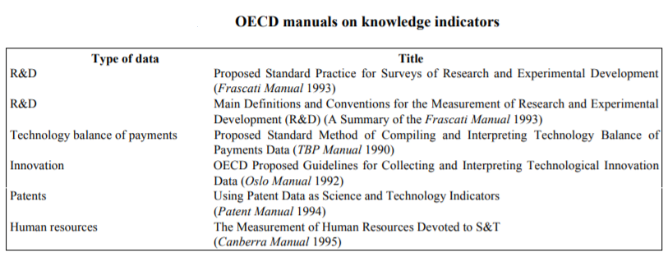
Indicators for Knowledge Economy
Innovation and innovation economics
The principal knowledge indicators (collected and standardised by the OECD):
i) expenditures on research and development (R&D);
ii) employment of engineers and technical personnel;
iii) patents;
iv) international balances of payments for technology.
Notes:
Many indicators have been gradually developed to capture the level of actual development in the knowledge economy and to take measures to support and grow accordingly. Economic indicators are measures that summarise at a glance how an economic system is performing.
Major emphasis has been placed on the input measures of R&D expenditures and human resources. Basic research plays an important role in the KBE. It generates new knowledge and understanding that provide the foundation for applied research and development. Because basic research provides reliable information about areas of future application, more intense knowledge generation through basic research could be seen as a way to enhance innovation activities.
Indicators of R&D expenditures show direct efforts to enlarge the knowledge base and inputs into the search for knowledge. Indicators relating to research personnel approximate the amount of problem solving involved in knowledge production. But only a small fraction of all inputs into knowledge creation are attributable to formal R&D expenditures and official research personnel. Successful R&D draws on ideas from many different sources, including informal professional exchanges, users' experiences and suggestions from the shop floor. In addition, current indicators count formal R&D conducted by the public sector, academia and large manufacturing firms, and tend to understate research expenditures by small firms and service-sector enterprises. As data collection improves, the importance of the services sector to R&D and innovation is only now being fully recognised. Patents, since they represent ideas themselves, are the closest to direct indicators of knowledge formation; of all the traditional knowledge indicators, patents most directly measure knowledge outputs (rather than inputs). Patent data have certain advantages in that most countries have national patent systems organised on centralised databases, the data cover almost all technological fields, and patent documents contain a large amount of information concerning the invention, technology, inventor, etc. There are several ways to analyse patent data, including categorising patents by geographic area and industrial product group. However, differences in national patenting systems introduce bias which make comparisons difficult. In general, not all new applications of knowledge are patented and not all patents are equally significant. Patents also represent practical applications of specific ideas rather than more general concepts or advances in knowledge. The technology balance of payments measures international movements of technical knowledge through payments of licensing fees and other direct “purchases” of knowledge, and thus is more appropriately a flow measure than an input measure. But there is no claim that the technology balance of payments measures the full flow of technical knowledge between any two countries. International transfers of knowledge through employment of foreign personnel, consulting services, foreign direct investment or intra-firm transfers are important avenues of diffusion that are not factored into these indicators. International joint ventures and co-operative research agreements are also instrumental in the global diffusion of knowledge.

Slide 16
Indicators for Knowledge Economy
Innovation and innovation economics
Categories:
the basic characteristics of the knowledge economy, e.g., the proportion of people working in high-tech industries, or the proportion of people with higher education.
performance or output indicators, e.g. the production of high-tech industries, high-tech exports, GDP growth, and labor productivity growth.
indicators based on R&D;
indicators based on human capital;
indicators based on information and communication technologies;
indicators based on economic and social impacts.
Notes:
We can divide the indicators of the knowledge economy into two categories. The first category focuses on the basic characteristics of the knowledge economy, and this group of indicators describes the share of the knowledge economy in the whole economy of the country, e.g., the proportion of people working in high-tech industries, or the proportion of people with higher education. In the context of information economy, universities become powerful centers that both consolidate strong intellectual capital and generate new knowledge and technological innovation in their research activities. The second large group consists of the so-called performance or output indicators. These include, among others, the production of high-tech industries, high-tech exports, GDP growth, and labor productivity growth.
Roberts (2001) divided the knowledge economy indicators into four groups:
• indicators based on innovation and entrepreneurship total R&D expenditure by industry, enterprise R&D expenditure by size of enterprise, and the number of scientific and technical publications per capita;
• indicators based on human capital;
• indicators based on information and communication technologies; and
• indicators based on economic and social impacts.
'knowledge transfer' means any process which has the aim of acquiring, collecting and sharing explicit and tacit knowledge, including skills and competence in both economic and non-economic activities such as research collaborations, consultancy, licensing, spin-off creation, publication and mobility of researchers and other personnel involved in those activities. B

Slide 17
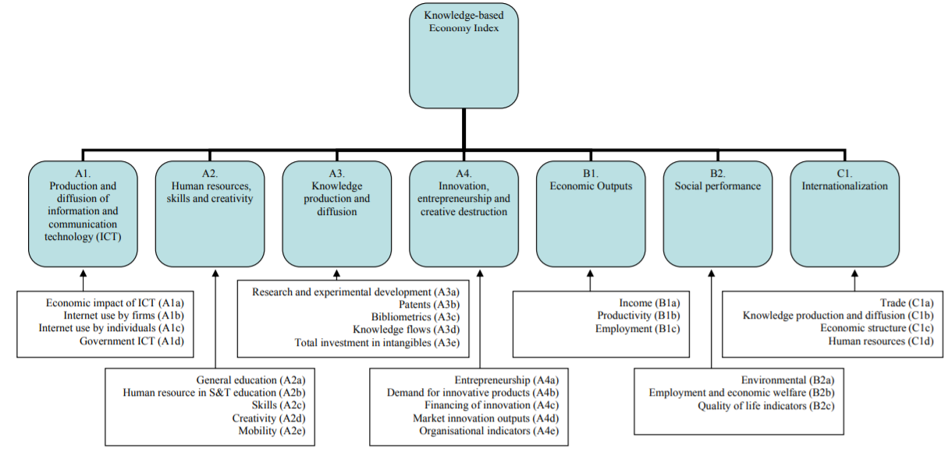
Indicators for Knowledge Economy
Innovation and innovation economics
Knowledge-based Economy Index (European Commision)
Notes:
These indicators attempt to capture the complex, multidimensional nature of the knowledge-based economy by aggregating a number of key variables, and expressing the result in the form of an overall index.
The figure shows the sub-indicators of the composite indicator.
Education, especially at universities, is seen as a crucial factor in transition to a knowledge-based economy. The effort and performance of the supply side of human resources in S&T are reflected in the number of new university graduated and PhDs. Scientific publications are used as a measure of scientific performance. Patents allow inventors to protect and exploit their inventions over a given time period, and provide a valuable measure of the inventiveness of countries, regions, and enterprises.
Exports of high-tech products reflect a country`s ability to commercialise the results of R&D and technological innovation in international markets.
The increased importance of knowledge means that the net stock of intangible capital (for instance, education, R&D) has grown faster than tangible capital (for instance, buildings, transportation, roads, and machinery). In KBE, intangible capital has become at least as important as tangible capital, and a greater share of the value of tangible capital is based on intangible inputs.

Slide 18
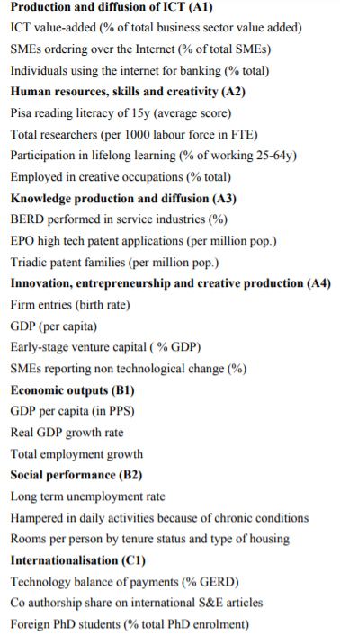
Indicators for Knowledge Economy
Innovation and innovation economics
Knowledge-based Economy Index
(European Commision)
Notes:
Individual indicators have been selected to measure the sub-dimensions of the KBE.

Slide 19
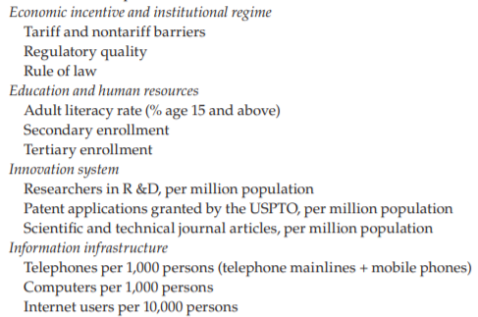
Indicators for Knowledge Economy
Innovation and innovation economics
World Bank Knowledge Economy Index- variables:
EBRD Knowledge Economy Index
Notes:
The Knowledge Economy Index (KEI), developed by the World Bank Institute for its Knowledge Assessment Methodology, is an aggregate index that represents the overall development of a country or region in KE terms, summarizing performance over the four KE pillars. It is constructed as the simple average of the normalized values, from 0 (weakest) to 10 (strongest), of the 12 knowledge indicators discussed above with reference to the basic scorecard. A KEI score close to 10 indicates good development of the four KE pillars compared with other countries; lower scores indicate poorer development. The KEI is a relative measure. A comparison will help to understand what is being measured.

Slide 20
Indicators for Knowledge Economy
Innovation and innovation economics
EBRD Knowledge Economy Index: 38 indicators divided into four pillars:
(1) institutions for innovation,
(2) skills for innovation,
(3) the innovation system,
(4) the ICT infrastructure.
Notes:
Institutions for innovation: Economies with good formal and informal institutions are more likely to specialise in innovation-intensive industries. Strong property rights, a judiciary system that ensures the rule of law and proper public governance are key elements on which the private sector relies to develop higher valueadded activities.5 There are three dimensions to this pillar of the KE Index: (i) economic openness (economies open to trade6, labour mobility7 and investment8 are better able to capture new ideas and technologies), (ii) business environment (for example, rule of law9 and lack of corruption) and (iii) governance (such as political stability10 and the effectiveness of policymaking). 2. Skills for innovation: An adequately trained workforce that chimes with private-sector needs is important for knowledge transfers, innovation and technological upgrade.11 The two dimensions of this pillar are (i) general skills (such as school enrolment12 and secondary education13), which are prerequisites to any economic activity, and (ii) specialised skills (such as number of technicians), which are key to more value-added activities.14 3. Innovation system: The knowledge economy depends heavily on major innovation players, their resources and interactions. The three dimensions of this pillar are (i) inputs into the innovation system (for example, research and development (R&D) spending),15 (ii) innovationsystem outputs (such as patents)16 and (iii) linkages within the innovation system17 (such as scientific collaboration,18 venture capital19 and value chains).20 4. ICT infrastructure: A key pillar of any knowledge economy is information and communications technology (ICT) infrastructure and its use, as this underpins effective knowledge exchange.21 Broadband speed and penetration have a positive impact on growth in the form of productivity gains22 as innovative firms increasingly require faster and more sophisticated ICT infrastructure. There are two dimensions to this pillar: (i) ICT availability and (ii) ICT sophistication. To compute the KE Index, we first aggregate the 38 indicators into 10 dimensions, then aggregate those 10 dimensions into four pillars. For each indicator and year, we compute the distance to frontier (DTF), with values on a 1 (theoretical minimum/worst) to 10 (theoretical maximum/best) scale. The index is the arithmetic mean of the four pillars.

Slide 21
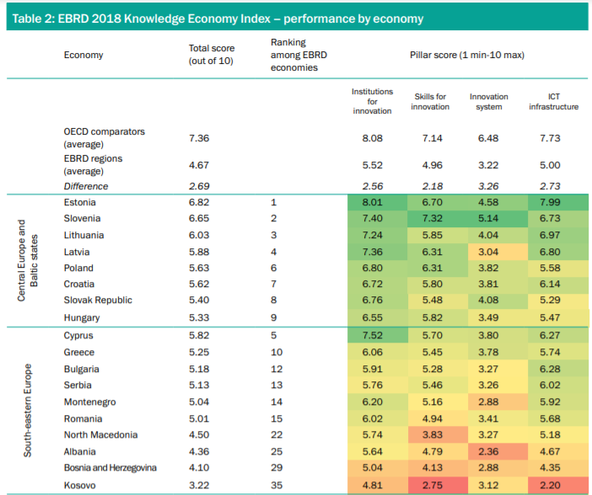
Indicators for Knowledge Economy
Innovation and innovation economics

Slide 22
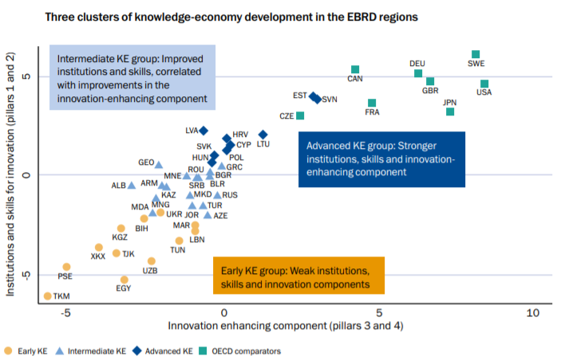
Indicators for Knowledge Economy
Innovation and innovation economics

Slide 23
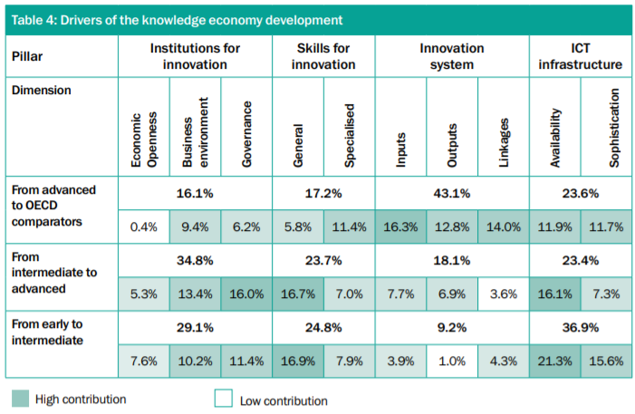
Indicators for Knowledge Economy
Innovation and innovation economics
Notes:
In the early KE group, institutions, skills and ICT infrastructure are not developed. Weak institutions for innovation, such poor business environments (weak rule of law, high levels of corruption) and governance (low regulation or limited government effectiveness) constrain investment, productivity and innovation. Moreover, relatively low economic openness (including high tariffs) acts as a barrier to the flow of ideas and leads to limited access to foreign technologies. Table 4 shows that improvements in institutions for innovation account for 29 per cent of the difference of the KE Index between the early and intermediate KE stages. Skills for innovation are also limited in the early KE group. While on some skills indicators (such as the perceived quality of the education system) economies in the early KE group score on a par with those in the intermediate group, there is a big difference in enrolment rates, especially in tertiary education. Improvements in skills for innovation account for almost 25 per cent of the difference in the KE Index between the early and intermediate KE stages. As the pressure on firms to innovate is relatively low at this stage, the inefficient innovation system pillar does not appear to be a binding factor for KE development. The early and intermediate KE groups provide similarly low inputs into the innovation system, while the share of firms that innovate and spend on R&D is also low in both pillars. The low level of innovation of the private sector thus creates only limited demand for a strong innovation system. Only 9 per cent of the change between the early and intermediate KE stages can be attributed to improvements in the innovation system. For early KE economies, the key constraint to KE development appears to be weak ICT infrastructure. Both ICT availability and sophistication are very low, which restricts innovation and reduces productivity gains and knowledge spill-over effects. Almost 37 per cent of the index difference between the early and intermediate KE stages can be put down to ICT infrastructure. As the early KE group generally does not meet the conditions for frontier innovation and knowledge creation, innovation policies in those economies should probably focus on better capturing knowledge from abroad (knowledge adoption, technology transfer). This would suggest policy interventions that lead to greater economic openness, easier trade across borders, and the rule of law. These interventions should be accompanied by significant improvements in skills for innovation and ICT infrastructure.
Economies in the intermediate KE stage demonstrate better institutions for innovation than those in the early KE group. Their more effective governance (for example, quality of regulation) and better business environment foster more investment and innovation. Intermediate KE economies also tend to be more open, with lower tariffs. Still, they need to do more to catch up with advanced KE economies. Table 4 shows that institutions for innovation account for almost 35 per cent of the KE Index difference between the intermediate and advanced KE stages. While the intermediate KE group is almost on a par with the advanced KE group on some dimensions of skills for innovation (such as enrolment in tertiary education), they significantly lag on others (for example, average years of schooling). Skill mismatches are a more pressing problem as firms demand a more sophisticated labour force. The skills deficit is demonstrated by the higher proportion of firms providing training to their employees. Perceived protection of intellectual property rights (IPR) is also low. As firms conduct more sophisticated activities, they appear to become more constrained by weak IPR systems. Enhancing general skills would appear to be the main way of reducing the skills gap between the intermediate and advanced KE groups (improvements in skills account for almost 24 per cent of the KE Index gap between the intermediate and advanced KE stages).
Intermediate KE economies typically “buy” innovation rather than “make” it.32 A large proportion of firms use foreign licensed technology or import foreign machinery and these countries pay large sums of money for intellectual property. Firms in intermediate KE economies spend slightly more on R&D and are more likely to introduce new products or services than firms in early KE economies. However, R&D activities remain mostly driven by the public sector. Patent applications (0.042 per 1,000 inhabitants) are higher than in early KE economies (0.013), but strikingly far behind the OECD comparators (0.54). To move up to the advanced KE stage, the intermediate KE group needs to further improve its institutions for innovation (in particular, governance and the business environment), focus on improving general skills and making ICT more available. Intermediate KE economies have a significantly better ICT infrastructure than those in the early KE group. In some intermediate KE economies, ICT sophistication is almost on a par with that of advanced KE economies. However, broadband availability remains limited (driven by low access in remote areas). More than 23 per cent of the KE Index difference between intermediate and advanced economies can be attributed to ICT infrastructure, in large part driven by intermediate KE economies’ lower ICT availability. The innovation policies of intermediate KE economies should focus on catching up with those of the more advanced KE group. This would mean addressing the remaining institutional gaps (business environment and economic openness) and promoting general skills and ICT availability.
The advanced KE group has developed more favourable institutional frameworks and better ICT infrastructure, providing greater incentives for innovation. Their knowledge economies are stimulated by higher economic openness, which is similar to that of the OECD comparators (low tariffs and easier trade across borders). Some measures of governance have also reached frontier levels (for example, political stability), though significant gaps remain, particularly in relation to the rule of law and government effectiveness. Good ICT infrastructure enables more effective flows of knowledge and information. The internet is more widely available, although there is still a gap to the OECD comparators in terms of ICT sophistication. While the advanced KE economies possess similar general skills to their OECD comparators, they lag when it comes to specialised skills. Their secondaryeducation enrolment rates are similar to those of the OECD comparators, for example, but their tertiary enrolment rates remain low. Weak linkages within the innovation system are responsible for the largest gap between the advanced KE group and the OECD comparators. While the advanced KE economies’ R&D spending is relatively high (at around 1 per cent of GDP annually), it remains significantly short of the 2.4 per cent of GDP spent by the OECD comparators. The proportion of R&D carried out by the private sector (around 38 per cent of the total) in the advanced KE group also lags that of the OECD comparators (at around 55 per cent). In addition, there is insufficient collaboration between the private sector and universities, venture capital is often not available and value chains remain limited (on a scale of 1 to 7, from worst to best, advanced KE economies score 3.8 compared with the OECD comparators’ 5.3.
Advanced KE economies tend to “make” their own technology, innovation that is “new to the world” is rare. Firms in advanced KE economies rely less on imports of foreign know-how (net IP receipts are lower than in intermediate KE economies) and they allocate more resources to R&D, which translates into more patents and a higher rate of new product introduction. Still, the advanced KE group clearly lags the group of OECD comparators on number of patent applications and magnitude of R&D spending. The EBRD KE Index suggests that to close the gap to the OECD comparators, the advanced KE group needs to significantly improve the efficiency of its innovation system. Innovation policies should focus on knowledge creation, as well as stimulating privatesector innovation and R&D. Specific focus should be on strengthening links within the innovation system. Interactions between academia and the private sector, the availability of early-stage financing and participation in global value chains are likely to raise the productivity of the resources devoted to innovative activities.
In the early KE stage, the emphasis should be on building the basic requirements for KE development, in particular, building better institutions for innovation (improving economic openness, governance and the business environment), general skills for innovation and ICT infrastructure. In the intermediate KE stage, economies should make efforts to catch up with those countries at the technological frontier. This includes improvements in innovation-specific factors, such as the protection of intellectual property rights. Lastly, economies in the advanced KE group should focus on building capabilities for frontier innovation globally. This involves enhancing firms’ ability to commercialise new products (for example, through accelerators), better channelling of funds to innovative firms (through venture-capital programmes, for instance) and stronger academiabusiness ties (for example, innovation vouchers). In general, advanced KE economies have room to implement more sophisticated innovation-policy instruments, such as incentives for private-sector R&D and smart specialisation.

Slide 24
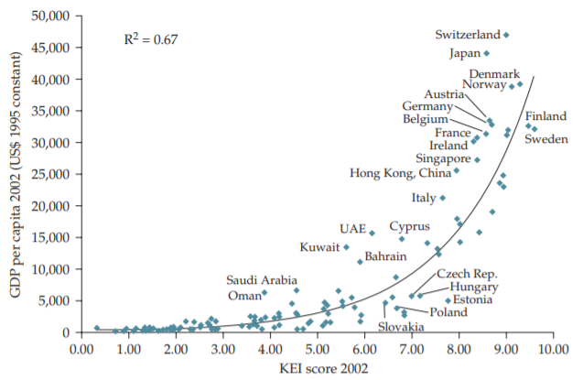
Knowledge Economy and Economic Growth
Innovation and innovation economics
Notes:
However, the positive correlation between the results of the KEI and the level of economic development does not establish a causal relationship—a high KEI will not necessarily produce a high level of economic development. On the other hand, it is plausible that high-income countries, because they are more affluent, are able to afford greater investments in knowledge and thus score higher on the KEI. In fact, econometric tests reveal a statistically significant causal relationship running from the level of knowledge accumulation as measured by the KEI to future economic growth. It is clear, therefore, that higher KEI values are associated with higher rates of future economic growth, if other factors are held constant.

Slide 25
Knowledge Economy
Innovation and innovation economics
Explanation of knowledge economy: by Roberto Mangabeira Unger, a philosopher and a social and legal theorist, is the former Minister of Strategic Affairs of Brazil and the present Roscoe Pound Professor of Law at Harvard University.

Slide 26
Mega-trends
Innovation and innovation economics
Megatrends are long-term driving forces that are observable now and will most likely have significant influence on the future.
Shift in global economic power;
Demographic shift;
Accelerating urbanization and migrating global population;
Accelerating technological change and convergence;
Climate change, resource scarcity and global competition for resources.
Notes:
Megatrends are macroeconomic and geostrategic forces that are shaping the world. Global megatrends are global, long‑term trends that are slow to form but have a major impact once in place. They are the great forces that are likely to affect the future in all areas throughout the world over the next 10 to 15 years. Furthermore, they are often strongly interconnected.
From an historical perspective, since the onset of the Industrial Revolution in Europe in the second half of the 18th century, megatrends like technological development and increased access to natural resources, economic growth, improvement standards of living and consequent population growth, have mutually reinforced each other, contributing to growing demand for resources and environmental pollution. This pattern has been further strengthened since then and it has expanded to the global scale, leading to unprecedented growth in population, economy, demand for resources and environmental pollution. For example, the world population had increased dramatically from the year 1800 when 1 billion people were registered, reaching 7.7 billion in mid‑2019 (UN DESA, 2019). Global energy consumption has grown 25 times from 1800 to the present day and has been largely based on non‑renewable fossil fuels (85 % to 90 %). Similarly, the global use of materials (i.e. metals, fossil fuels, minerals and biomass) increased tenfold between 1900 and 2009 (Krausmann et al., 2009). From 1950 onward, the pace of growth in population, economic activity and resource consumption increased further. For example, the global economic output increased about 12‑fold between 1950 and 2016 (Bolt et al., 2018), leading to enormous improvements in living standards and well‑being for hundreds of millions of people, especially in Europe and other highly industrialised world regions. As a result, from the 1950s to the present day the world population experienced a fourfold increase, thanks to a combination of factors that led to a significant reduction in mortality rates. Consequently, the sheer size of global population growth and the intensity of human activities has caused tremendous pressures on the Earth's life support systems through climate change, biodiversity loss, and changes in the chemical composition of the atmosphere, oceans and soil among others. The period after the 1950s marked a unique period in human history with unprecedented and accelerating human‑induced global change. This has become known as 'the Great Acceleration. Change is occurring on such a scale that human activities have now significantly altered the Earth's system from the stable Holocene to a new human‑dominated epoch referred to as the Anthropocene (Waters et al., 2016). Human activities are estimated to have caused approximately 1.0 °C of global warming above pre‑industrial levels, and global warming is likely to reach 1.5 °C between 2030 and 2050 if current rates continue in the future (IPCC, 2018). As a consequence of the pressures exerted on ecosystems, the Earth is experiencing an exceptionally rapid loss of biodiversity, and more species are threatened with extinction now than at any other point in human history (IPBES, 2019). Anthropogenic activities have unleashed a mass extinction event, the sixth in roughly 540 million years, wherein many current life forms could be annihilated or at least condemned to extinction by the end of this century (Ripple et al., 2017). In the last 50 years growing global material demand has led to nearly 90 % of biodiversity loss and water stress and approximately half of climate change pressures (IRP, 2019). Climate change, loss of natural capital and biodiversity, and pollution are highly interconnected and mutually reinforcing. For example, climate change and growing pollution are likely to further increase the loss of natural capital and biodiversity by impacting natural and productive terrestrial and marine systems globally, in turn, the loss of natural capital and related carbon stocks increases Greenhouse gas emissions (GHG), leading to climate change. While tipping points are fundamentally uncertain, exceeding them might lead to catastrophic consequences for the functioning of the planet's ecological system, including the human species (e.g. a loss of pollinators).

Slide 27
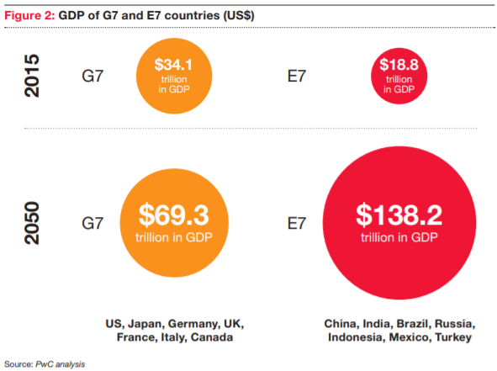
Mega-trends
Innovation and innovation economics
Shift in global economic power:
Since the 1990s, much of global economic growth has been driven by emerging economies, such as Brazil, China and India.
For example, China's economy grew on average 9.5 % annually between 1990 and 2017, compared with 1.7 % in the euro area.
China and many other developing countries are benefiting from a competitive advantage in labour‑intensive manufacturing as a result of a cheaper workforce. They are also massively investing in research and development.
China emerged as a global technological power and overcome the EU concerning research and development investment rates. While R&D investments in China and other non‑OECD countries are expanding, Europe is experiencing a stagnation in R&D intensity.
Western economic dominance is a waning.
The focus of global growth has shifted to the East and
to the South.
As economic power shifts, emerging countries and
regions may also seek to increasingly translate their
economic gains into global influence.
Notes:
Since the 1990s, much of global economic growth has been driven by emerging economies, such as Brazil, China and India, and translated in growing affluence in these regions. For example, China's economy grew on average 9.5 % annually between 1990 and 2017, compared with 1.7 % in the euro area (World Bank, 2020a). Moreover, measured in purchasing power parity (PPP), China's gross domestic product (GDP) surpassed the United States' GDP in 2013 (OECD, 2018b)

Slide 28
Mega-trends
Innovation and innovation economics
Shift in global economic power - implications:
The rapidly changing landscape of global economic power has led to increasing geopolitical uncertainties and tensions in the global multilateral system.
The rapid economic growth in developing regions has lifted millions of people out of poverty in recent decades, and allowed a number of countries to reach middle‑income status.
A realignment of global economic and business activity is transitioning BRIC (Brazil, Russia, India, and China) and other growth countries from centers of labor and production to consumption-oriented economies.
The increasingly multi-polar world may reshape the competitive environment for companies.
Mature markets may lose influence and capital and become less attractive for talent and business. Governments increasingly may compete using tax and regulation as well as investment support.
Competition generated from new geographies and sources may create different competitor profiles than those historically faced.
Notes:
Overall, the rapidly changing landscape of global economic power has led to increasing geopolitical uncertainties and tensions in the global multilateral system (ESPAS, 2015). This is seen in a waning of the consensus on the benefits of globalisation and trade liberalisation, resulting in countries turning away from multilateral agreements and increasing protectionist measures (EPSC, 2018b). Therefore, the future of international trade has become more uncertain in recent years, as a result of political elections in Western countries and China's reorientation towards its internal market. Access to strategic resources (e.g. energy carriers and materials) is fundamental to sustaining competitive economies; given the uneven distribution of resources across the globe, much of the future geopolitical challenges will revolve around trade agreements and access to raw materials and international markets.
Economic development has increased revenues for households and allowed governments to invest in social infrastructure and services (e.g. education, health and social security), contributing positively to increased life expectancy. Nevertheless, extreme poverty still exists; for example in 2018, 6.2 million children died before reaching the age of 14 years, which is equivalent to more than the population of Denmark (World Bank, 2019b). From the perspective of consumption levels, Western societies are still better off than emerging economies. For example, when looking at GDP per capita, it is expected that China will remain just below 50 % of the EU value until 2035, suggesting that if the speed of structural convergence between economies is high, the gap itself will remain substantial for a long time.
The improvement of living conditions for a significant part of the world, alongside with maintained consumerism in Western societies, have occurred at a significant cost to the environment. While international trade, facilitated by liberalisation (e.g. limited tariffs) and digitalisation, has been one key factor behind the rebalancing of global economic output, its rapid expansion is associated with growing environmental pressures and resource consumption. Industrialising countries, a rising global middle‑class and international trade, are largely at the core of this mechanism.

Slide 29
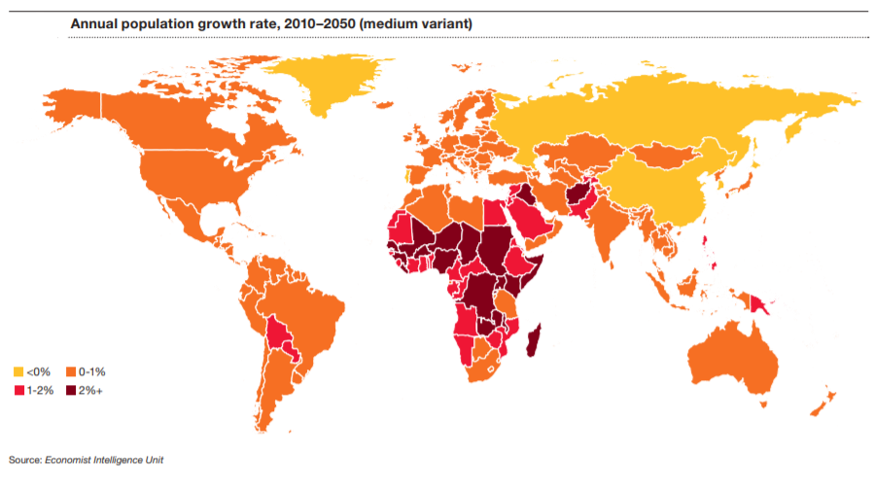
Mega-trends
Innovation and innovation economics
Demographic shift:
The global population is expected to increase from its current figure of 7.8 billion to reach 8.5 billion in 2030, 9.7 billion in 2050 and 10.9 billion in 2100, with most of the projected growth expected in urban areas of developing countries (According to the United Nations Department of Economic and Social Affairs scenarios).
A large share of population increase is associated to socio‑economic development (e.g. health care, wealth and education) which led to decreasing mortality rates and consequent rise in global life expectancy.
Fertility has been declining globally, a trend that in combination increased life expectancy, has led to an overall ageing of the global population.
The largest share of projected population growth is expected to occur mainly in sub‑Saharan Africa, Northern Africa, Central and South‑East Asia (with India becoming the most populous country in the world), although with important regional differences. Instead, East Asia and Europe are expected to observe stabilisation and subsequent decrease.
Countries have very different
demographic trajectories: rapid aging (West),
even shrinking societies vs. young and
growing societies.

Slide 30
Mega-trends
Innovation and innovation economics
Demographic shift - implications:
Explosive population growth in some areas vs. declines in others -> shifts in economic power, resource scarcity, changes in societal norms.
Shifts in longevity affect business models, pension costs, and talent goals/ambitions.
National demographics set national priorities for government spending:
As populations age, the demand for social services and healthcare put pressure on budget priorities that could compete with or even crowd out defense and security expenditures or governments may come under pressure to raise taxes to maintain social programs.
On the contrary, the growth in the youth populations in LDCs could create increased radicalization and civil unrest.
Notes:
Explosive population growth in some areas against declines in others contributes to everything from shifts in economic power to resource scarcity to the changes in societal norms. Countries have very different demographic trajectories. Some societies‘ populations are aging rapidly, even shrinking, and their workforces will be constrained as a share of the total population. Other societies are young and growing, which will create ever larger labor forces and consumer markets. Youthful, growing populations must be fed, housed, educated, and employed for productive potential to be realized.
As populations age in the West, government budget priorities are shifting to entitlements such as healthcare and other social costs associated with a retired population. Entitlement spending as a share of the budget and of overall GDP is competing with and crowding out priorities for defense and security spending. The aging population is also limiting the number of military aged citizens eligible and interested in military service.
The rapidly growing demographic group of young men in developing nations with limited economic opportunities, access to education, and safety is creating significant security challenges as these conditions breed social discontent, crime, violence, and susceptibility to radical ideologies and movements. The greatest growth of this demographic segment is in those nations least prepared to deal with the challenges from a governance and/or defense and security perspective, specifically the North African Tier, Sub-Saharan Africa, Southwest Asia, and Latin America.
Demographic aspects have also implications on international migration. In fact, some areas of the world, particularly where fertility rates are still high, are likely to experience youth bulges in the short term, which result in high shares of children and young adults, bringing both opportunities for economic growth (e.g. 'demographic dividend') and challenges for social cohesion if jobs are lacking. This trend, alongside with continued global inequality between regions, and geopolitical tensions, is contributing to the increase of international migrants. While at the global scale it concerns only 3 % of the population and it has mainly an intra‑continental character, world regions have witnessed very different patterns, with high‑income countries absorbing the majority of the net increase in the last few decades. While Europe is a key destination for refugees, especially because of geographical reasons and proximity of recent conflicts, Asia is becoming increasingly attractive as a destination for migrants, as a result of increased economic development. Irregular migration is unfortunately associated with high public's concern, contributing to xenophobia, populism and right‑wing movements gaining ground across Europe

Slide 31
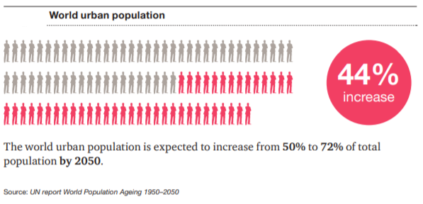
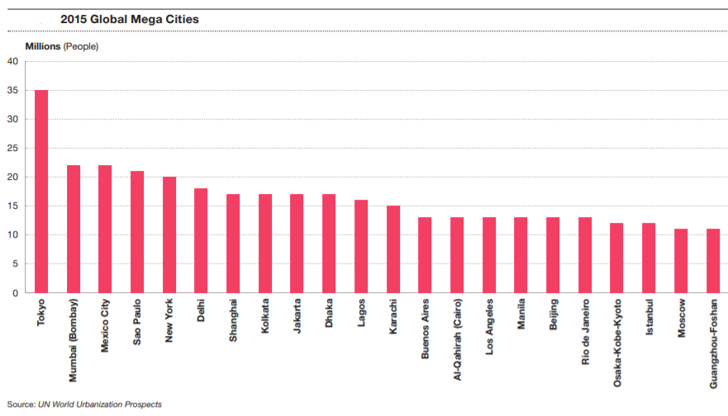
Mega-trends
Innovation and innovation economics
Accelerating urbanization and migrating global population:
1950s: less than 30% of the world’s population lived in cities.
Currently: 50% of the world’s population lived in cities.
Challenges of the explosion in urbanization:
law enforcement, security and defense;
city infrastructure, support new trade flows (airports, sea ports), address education, health, security, employment demands, etc.
Larger concentrations of people in smaller geographic areas present greater opportunities for terrorists and other non-state actors to inflict asymmetric disruption and destruction.
Mass migration to cities leads to overcrowding and poverty and overwhelms a government’s ability to provide basic services. Additionally, mass migration of foreigners without assimilation may create similar dysfunctions and allow for the proliferation of organized crime and alternate forms of governance and coercion.
Notes:
. In the 1950s, less than 30% of the world’s population lived in cities. Currently, that proportion has risen to 50% and, by 2030, the UN projects that some 4.9 billion people will be urban dwellers. Much of the growth in urban population will likely take place in Asia and Africa. Large scale migrations from rural areas will power much of this growth. In developed economies and older cities in the developing world, infrastructure will be strained to the utmost— and beyond—as populations expand. Meanwhile, in emerging economies, new cities will rise rapidly and require massive investments in smart infrastructure to accommodate explosive growth.
The explosion in urbanization will present tremendous challenges for law enforcement, intelligence and internal security agencies, as well as traditional defense organizations. The sheer growth of urban populations may outpace governments ability to provide basic services that could, in turn, breed the growth of radicalization and alternative governance structures dominated by organized crime, and non-state terrorist entities, which will unlawfully force/subjugate the urban dwelling populations. Providing adequate police and security for these areas will be costly and will require a higher level of interagency information-sharing and collaboration. Defense organizations will also be challenged to respond to internal unrest and to monitor foreign influences that seek to destabilize these populations for political ends. The mega-cities that emerge and grow out of this trend will also provide a more fertile ground for non-state actors such as terrorists and revolutionaries, who simultaneously seek to “hide in plain sight” and inflict the highest level of disruption and destruction on a concentrated population. The higher concentration of people in these cities will increase the impact of natural and man-made disasters, and it will require a massive whole of government approach to address the humanitarian, defense and security challenges that accompany them.

Slide 32
Mega-trends
Innovation and innovation economics
Migrating global population:
global inequality between regions and geopolitical tensions contribute to the increase of international migrants;
in the coming decades, environmental degradation and climate change are expected to become increasingly important drivers of migration globally.

Slide 33
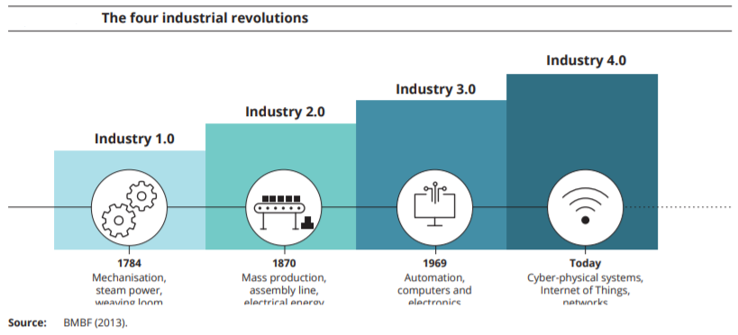
Mega-trends
Innovation and innovation economics
Accelerating technological change and convergence:
Technological innovation is currently accelerating, mainly fuelled by the widespread digitalisation of economies and societies worldwide.
Widespread digitalisation is the key enabler of the 'Fourth Industrial Revolution', which fuses digital technologies with the physical and biological worlds — a trend referred to as „technology convergence“.
Hyperconnectivity, the Internet of Things (IoT), augmented reality and collective intelligence systems, combined with falling costs of implementation of new technologies are transforming entire systems of production, management, and governance. This is expected to provide opportunities for more integrated and efficient industrial processes, personalised production, new jobs and economic growth. However, digitalisation is currently changing the nature of jobs, creating new opportunities and risks, and requiring the development of new skills.
Notes:
Breakthroughs in such disciplines as artificial intelligence, nanotechnology, and other frontiers of research and development are increasing productive potential and opening up new investment opportunities. Entire new industries are being created, which could have a significant impact on the size and shape of the world’s manufacturing and high-tech sectors and the companies that operate within them. The combination of the internet, network capable mobile devices, data analytics, cloud computing, and machine and deep learning capabilities will continue to transform our world. Many companies across all sectors are grappling with how these developments will affect consumer expectations, the way they interact with their customers, and the underlying business models that support this.
However, digitalisation is currently changing the nature of jobs, creating new opportunities and risks, and requiring the development of new skills. There is a real risk that, because of further automation, more jobs will be lost than created, and that job losses and creations will affect occupations, sectors and countries unequally. Alongside with automation, it might contribute to weakening the welfare system. The development of digital platforms, alongside with the diffusion of smart devices and the emergence of the 'on‑demand' economy, has enabled the diffusion of business models whose success is largely dependent on their ability to escape fiscal or social regulations (e.g. taxation and social contribution), leading to precarious forms of work, low wages and job insecurity, besides opportunities for economic development and creation of new jobs.

Slide 34
Mega-trends
Innovation and innovation economics
Accelerating technological change and convergence:
Shift from physical business and operating models to virtual ones.
Assets (and liabilities) are increasingly accessed on flexible terms: shift from own assets to rent one.
Automatization - changing the nature of jobs and requiring the development of new skills.
New competitors emerge as technology and innovation create new competitive advantages and increase productivity across sectors and geographies.
The ability to gather and analyze data in real time become a requirement for doing business, rather than a competitive advantage.
Smart infrastructure is more vulnerable to massive cyberattacks.
Notes:
Technology will enable virtual versus physical business and operating models. • Assets (and liabilities) will be increasingly accessed on flexible terms: where previously assets were primarily available to own, adaptable businesses now provide them for rent in innovative ways. • Access to systems and information should enable management models to flatten organizational structures. • New competitors will emerge as technology and innovation create new competitive advantages and increase productivity across sectors and geographies. • The ability to gather and analyze data in real time may become a requirement for doing business, rather than a competitive advantage.
In recent years there has been a dramatic increase in unlawful cyber security breaches and infiltrations. Some of these have been orchestrated by independent criminal actors, but others are far more sophisticated and coordinated, formally and informally, by government agencies seeking to disrupt or create competitive advantages. Network vulnerabilities to such attacks creates national security vulnerabilities that extend beyond financial crime to the crippling of key infrastructure and access to classified information that could compromise critical national infrastructure in addition to ongoing military and police operations. Undetected cyber penetration of critical commercial networks can allow adversaries to gather information regarding defense supply chains that could enable major disruptions during a time of crisis.
Emerging digital technologies, such as big data analytics, artificial intelligence and blockchain, offer tremendous opportunities in each aspect of everyday life, however implications from an ethical, privacy and security perspective are significant and are causing increasing concerns within society. Today, data ownership is concentrated, with international bandwidth use shifting towards giant content providers such as Amazon, Google, Facebook and Microsoft.
Technological developments such as digitalisation, hyperconnectivity and the ever‑increasing penetration of social media in all aspects of life, information have also contributed to new socio‑political phenomena regarding access to information, the diffusion of 'fake news' and the polarisation of public opinion. Hence they play a fundamental role in matters of security and democracy, raising serious ethical concerns and creating also new challenges for the governance of sustainability transitions.

Slide 35
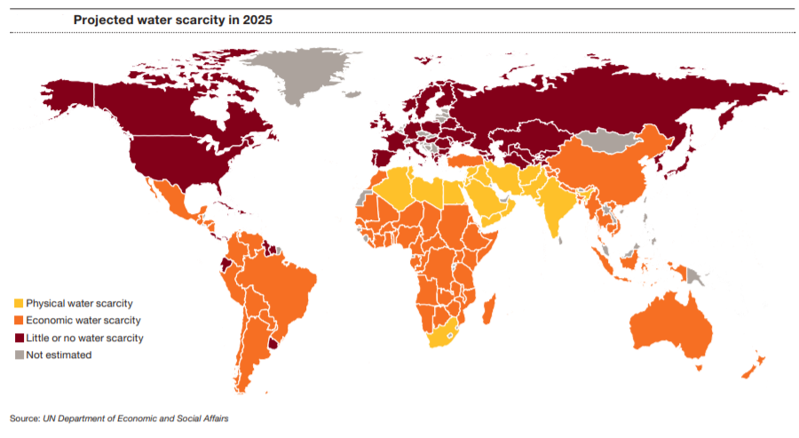
Mega-trends
Innovation and innovation economics
Climate change and resource scarcity:
Global demand for materials has increased ten-fold during the 20th century and is set to double again by 2030, compared to 2010.
Demand for water, food, energy, land and minerals will continue to rise substantially, given the increasing purchasing power of a growing population.
The global demand for land is projected to grow, particularly as 25 % to 100 % more food may be required globally by 2050, depending on socio‑economic and technical assumptions.
The global demand for water is projected to rise by 55 % by 2050, assuming a continuation of current policies and socio‑economic trends.
Nowadays, 1.9 billion people live in severely water‑scarce regions, and this number could increase to 5.7 billion by 2050.
The geography of environmental pollution is changing as a result of global shifts in economic power.
Notes:
newly industrialising countries build new infrastructure for accommodating a growing urban population and increase their manufacturing capacity, while high‑income countries outsource the more material‑ and energy‑intensive stages of production and subsequently import intermediate and final products. As a consequence of that, emerging economies have been responsible for most of the direct increase in global consumption of metals and two thirds of the increase in energy consumption over the past 20 years, with China on its own accounting for 83 % of the global increase in metal consumption and 48 % of the increase in energy consumption (World Bank, 2018). Developed countries exert significant share of their environmental pressures and impacts abroad, through trade. For example, in 2011 nearly one third of Europe's energy footprint and nearly two‑thirds of its land use footprint were occurring in other parts of the world. Similarly, recent estimates indicate that the EU carbon footprint is 27 % higher than GHG emissions associated with production in the EU (Wood et al., 2019). The externalisation of a share of environmental pressures to the other parts of the world may hinder the achievement of the Sustainable Development Goals, as this often occurs in countries where environmental regulation and governance is less effective than in the EU.
The geography of environmental pollution is changing as a result of global shifts in economic power. For example, air pollution, the main environmental contributor to the global burden of disease contributing to 6 to 7 million premature deaths annually, has improved in developed economies, albeit at different paces, while emissions have been on the rise in developing countries and emerging economies in the last decade. The highest death toll is in East Asia and South Asia, as cities in these regions have a very large population and high levels of pollution.

Slide 36
Mega-trends
Innovation and innovation economics
Climate change and resource scarcity - implications:
Environmental degradation worldwide creates social and economic impacts and contributes to increasing inequalities as well as regional and international migration.
Securing resources domestically and internationally becomes critical for governments and businesses.
Increased conflict and political tension, especially over resources, may occur as food, energy, and water patterns change.
Increased levels of regulation, both directly relating to environmental changes and indirectly through taxation and similar types of incentives/disincentives.
New industries created, or existing ones revolutionized, in response to energy scarcity, climate change and lack of resources; the pace of these changes will be accelerated by new technologies.
Notes:
Tensions between nations over access to natural resources is nothing new. As the global population continues to grow these disputes will become more acute, and more critical to national survival particularly when it comes to very basic resources such as food, water, and energy sources. This will undoubtedly lead to regional and potentially global confrontations over water, oil, wind, fishing, hunting, and other mineral rights.

Slide 37
References
Innovation and innovation economics
EBRD (2019): Introducing the EBRD Knowledge Economy Index. London: European Bank for Reconstruction and Development.
OECD (1996): The Knowledge-Based Economy. Paris: OECD.
Powell, W.W., Snellman, K. (2004): The Knowledge Economy. Annu. Rev. Sociol, 30: 199–220.
Weresa, M.A. (2014). Innovation, Human Capital and Trade Competitiveness. How Are They Connected and Why Do They Matter? Cham: Springer International Publishing. 486 p. ISBN 978-3-319-02071-6.
World Bank (2007): Building Knowledge Economies Advanced Strategies for Development. Washington DC: World Bank. 163 p. ISBN 978-0-8213-6957-9.

