Slide 1
Sustainable Growth and Economic Policy 2023-2024 =Seminar=
Pavel Kotyza, Tomáš Maier
E357
kotyza@pef.czu.cz (MON 12:30 – 13:30)
maiert@pef.czu.cz (THR 12:00 – 13:00)
Sergei Pismennyi
E263
pismennyi@pef.czu.cz (TUE 12:15 – 14:00 )
All PRAGUE timing

Slide 2
MOODLE – PASS ….
Passwords
MO 0845 | SGEP24MO0845
MO 1030 | SGEP24MO1030
MO 1400 | SGEP24MO1400
WE 1400 | SGEP24WE1400
TH 0845 | SGEP24TH0845
TH 1030 | SGEP24TH1030

Slide 3
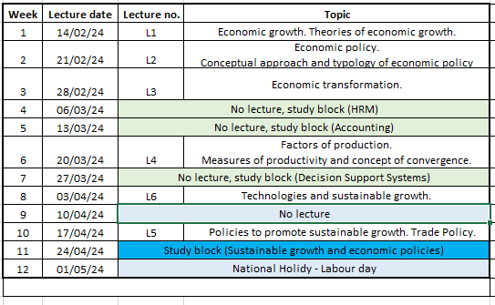
LECTURE PLAN
The lecture will be on Wednesday from 7.00 - 10.00 in TI class.

Slide 4
Structure of seminar
Some introductory notes
Teachers of the Course
Program of the course
Structure of seminar
Demands and rules
Little theory

Slide 5
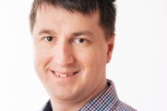
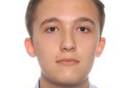
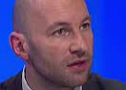
Teachers
Lectures:
doc. Ing.Irena Benešová, Ph.D (Lectures)
Seminar:
Ing.Pavel Kotyza, Ph.D.
PhDr. Ing. Tomáš Maier, Ph.D.
Ing. Sergei Pismennyi
External:
O'Brien William (Worcester State University)

Slide 6
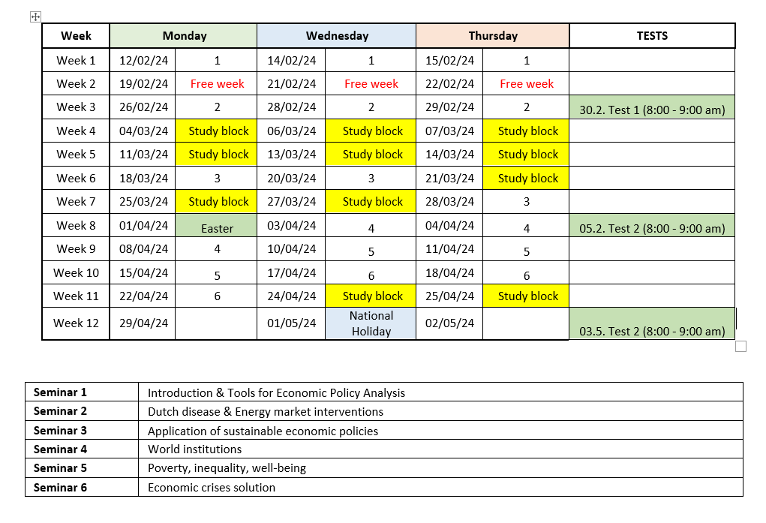
Preliminary seminar program

Slide 7
Structure of seminar
Discussion on up-to-date topics
Little theory
2 x presentations, different groups, each for 20 minutes in PPT
Questions & Answers & Comments, Discussion, additional work
DETAILED INFORMATION IS AVAILABLE ON MOODLE IN THE FOLLOWING FILE:
Seminar requirements 2023 – 2024 (see Moodle)

Slide 8
Demands and rules of the course
Attendance. One (1) absence is allowed.
Group presentation of the case study (in groups)
Everyone takes part in the presentation preparation,
Everyone contributes to the PRESENTATION
Those, who will be indicated by other group members as reluctant to participate or contribute, will not be evaluated for presentation
3 Tests
Mid-term essay
Study block attendance (obligatory) with block homework done
A student needs to receive at least 22 POINTS from seminars and Moodle activities to be allowed to sit for the EXAM = 55%

Slide 9
Attendance
This means 1 absence.
In case of longer illness or any other problems, please keep in mind that you have to prove it (e.g. by a medical certificate), this will be solved by management of the faculty.
Foreign police / Embassy visit are no excuses.

Slide 10
Final evaluation
Seminars
Presentation (20p)
Mid-term essay (10p)
3x Moodle tests. Each point from the test will be multiplied by 0.25, i.e. from 40q you can get 10p that will be counted)
Study block
Required tasks + attendance (25p)
Examination
Multiple-choice (10) and open-ended questions (5) (40p, min. 24p to pass the exam)
BONUS POINTS = MAX 5 (from lectures and seminars based on your other activity, TBD)

Slide 11
Evaluation
Final mark will be based on the sum of all reached points.
90p – 100p or more … Excellent (1)
76p – 89p … Very good (2)
60p – 75p … Good (3)

Slide 12
TESTS
You can expect 3 tests during the semester
Tests are related to lectures and seminars
Tests are open for all students simultaneously for 1 hour on Moodle
Multiple choice questions
13 (?) + 13 (?) + 14 (?) = 40 questions
Tests are organised on MOODLE
Section “Uploads & Quizzes & Exams”
TEST 1: 1.3.2024, 8:00 – 9:00 a.m. on MOODLE (L1-2, S1-2)
TEST 2: 05.4.2023, 8:00 – 9:00 a.m. on MOODLE (L2-3, S2-3)
TEST 3: 3.5.2023, 8:00 – 9:00 a.m. on MOODLE (L5-6, S5)

Slide 13
MID-TERM ESSAY
18. March 2024 in TI (ROOM) at 7:00
Case-study based essay.
Using own logics, no study materials allowed.
10 points is the maximum.
More information to be provided later.

Slide 14
PRESENTATION
TEAM WORK – 2 – 3 MEMBERS mixed international teams are preferred
The presentation should take max 20 minutes, longer performance will be stopped
Needs to fulfil all standard formal requirements (i.e. use of proper English symbols, resources, currencies, decimal points, etc.)
All presentations are to be available on the Moodle in advance to all participants. Therefore, file must be uploaded to Moodle a day prior to the presentation. It must be uploaded by 5.00 p.m.
ALL TEAM MEMBERS TAKES PART IN THE PRESENTATION.
NO READ!!!
If problems appear and presentations being STOPPED, repeat = 50% points

Slide 15
Project PRESENTATION
Groups need to submit seminar presentation that would deal with their seminar topic. Projects shall be analytical, i.e. groups should not only prepare literature overview, but shall propose, based on literature and data analyses, significant and objective conclusions.
Introduction
Aims (incl. research questions)
Methodology (clearly define applied methods, data sources, time range, etc.)
Topic overview.
Own analyses and discussion/comparison. Your analyses should be prepared and presented in the given sequence:
1) Own analyses of available data and preparing your own conclusions (answer to research question)
2) Comparison / Discussion of your own conclusions with available literature (different authors, different result, reasons of differences, at leasts comparing your results with 3 similar studies).
OWN conclusions.
If not mentioned before, state news or up-to-date issues.
References.

Slide 16
Project PRESENTATION
Evaluation
Your performance will be evaluated from the following viewpoints:
Timing of presentation (1p) – 20 min
Style of presentation (2p) – how you perform in front of the screen
Presentation uploaded to Moodle on time (1p)
Format and formal requirements (2p)
Logical structure (1p)
Defined aims and research questions (1p)
Methodology quality (4p)
Own results (4p)
Discussion (2p)
Ability to answer asked questions (2p)
TOTAL = 20 points

Slide 17
PRESENTATION
Presentation needs to fulfil following requirements:
Everything shall be properly quoted (resources below each table, graph, diagram, etc.)
Topic shall be presented in a neutral way (no subjective point of view is expected) – e.g. shall present both positive and negative aspects.
Present up-to-date ideas on the issue (mainly from the research articles) and find weaknesses of the presented ideas
Use books, academic articles, official publications and databases as a main source of information. Do not use sources as Wikipedia, Investopedia, etc.
Use mostly data from trustworthy agencies (UN, OECD, IMF, World Bank, EU, etc…)

Slide 18
Sources of Information and DATA
http://infozdroje.czu.cz/menu
Scopus, ScienceDirect, Ebsco (scientific papers, books)
OECD data and publications for free
Passport (market research data)
Scholar.Google.com, books.google.com
Scopus and Web of Science is obligatory
OECD
EUROSTAT / FAOSTAT
Data from UN Agencies
WORLDBANK, IMF
Comtrade national Statistical offices
UN COMTRADE (trade data)
SCI-HUB (https://sci-hub.st/) – opens paid research

Slide 19
Presentation TOPICS
2nd seminar (Week 3) – DUTCH DISEASE & ENERGY MARKET INTERVENTIONS
Role of natural resources in national economy – case study of selected country
Energy market interventions – case study of selected country.
3rd seminar (Week 6) – APPLICATION OF SUSTAINABLE POLICIES
Economic effects of economic policies supporting country sustainability (Country A)
US Inflation Reduction Act and its impact on green transformation of the US
Anyone has state exam this May/June?

Slide 20
Presentation TOPICS
4th seminar (Week 7) – WORLD INSTITUTIONS
Impact of International Monetary Fund’s assistance to selected country.
Impact of World Bank Group (specifically IDA) assistance to selected country.
5th seminar (Week 11) – POVERTY, INEQUALITY, WELL-BEING
Comparison of income inequality in developing and developed countries (countries to be selected and compared).
National redistribution policy to eliminate poverty and/or inequality (case study of a selected country).
6th seminar (Week 12) – ECONOMIC POLICY FOR CRISES SOLUTION
Policies (Policy tools) implemented in COUNTRY to tackle economic crises and policy outcomes (country to be selected by group and agreed by teacher).
Policies (Policy tools) implemented in COUNTRY to tackle economic crises and policy outcomes (country to be selected by group and agreed by teacher).

Slide 21
Project selection
You will have chance to sign for the group project topic on Moodle Friday, 16 Feb, at 8 a.m. Prague time
After registration to the topic I need to receive EMAIL with group members.
otherwise, group selection not accepted.
Registration is opened up to Sun, Feb 18, 23:59
But first you need to be registered for the right seminar, use the correct password

Slide 22
ANY QUESTIONS?

Slide 23
ECONOMIC POLICIES

Slide 24
Economic Policies
Could be understood as:
Approach of the state toward its own economy, it is always intentional and real activity…
Theoretical discipline that analyse ongoing phenomenon and propose specific measures using given instruments.
There does not exists single truth. Used measures result from theoretical background of governments.
Who is responsible for economic policies used?

Slide 25
Economic Policies
… could be understood as government seeking for conscious and qualified social consensus within economy of given country..
We search for answers:
WHO are they? … actors of economic policies
What instruments? …
Why? … targets, aims of the policy
What are (expected) outcomes?

Slide 26
Actors of economic policies
Private Persons
Government
Investors
Consumers
NGOs
WHAT ARE THEIR INTERESTS?

Slide 27
Relationship between aims and tools
Rule of system conformity
Using tolls that are in harmony with system of the country (e.g. in open market economy shall not be used price setting instruments)
Stability of policies (W. Eucken)
Not necessary 100% unchangeability, but rather its future predictability and transparency => confidence
Principe of responsibility (J. E. Meade)
One macroeconomic goal should be controlled by single institution that is also for the goal responsible (e.g. National Banks)

Slide 28
What does policymakers do:
Set and enforce the rules of economic game
Tax and spend
Issue and manage the currency
Produce goods and services
Fix problems or pretend to
Negotiate with other countries
Etc.
Benassy A. (2010) Economic Policy: Theory and Practice.

Slide 29
Tools
Positive (supporting)
Negative (prohibiting)
Market (indirect)
Exposure level = Micro and macro level
Action = Fiscal, monetary etc.
Influence = Direct and indirect
The way how they interact = Selective and general
… And of course combinations

Slide 30
After a while you will be divided into small groups Listen carefully for your task. 10 min

Slide 31
Duration of policies
Short-term
Medium-term
Long-term
Permanent policies
What is their time horizon?
Define for each time horizon and provide several real and specific examples …

Slide 32
Scope
Local
Regional
National
Supranational
Global
Which are mostly employed?
Define for each kind several examples …
Who is in charge ….

Slide 33
ANY QUESTIONS?

